Slide 1
FINANCE LEARNING FORUM on
BUDGET MANAGEMENT
25-November-2025

Slide 2
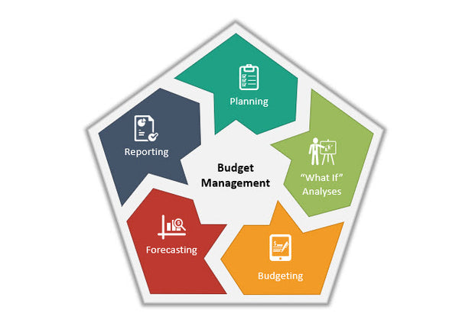
BUDGET MANAGEMENT

Slide 3

BUDGET MANAGEMENT
GROUP DISCUSSION
a. 3 Groups – 15 Mins
b. Present 5 Min/Group

Slide 4
BUDGET MANAGEMENT
Identify Meaning, Benefit / Useful
Budget
Projection
Reforecasting
Burning Rate
Linear Rate
Monitoring
Controlling

Slide 5
BUDGET MANAGEMENT
Feature | Reforecast | Projection
Purpose | Update the official budget | Predict future spending
Formality | Formal, structured, often donor-required | Internal or informal analysis
Basis | Actuals + revised assumptions + workplan changes | Trends + planned activities + estimates
Output | Revised budget | Forecast numbers
Timing | Quarterly or when major changes occur | Monthly or ongoing
Used for | Donor reporting, realignment, approvals | Monitoring, cashflow, decision-making
Changes the approved budget? | Yes (with donor approval) | No

Slide 6
BUDGET MANAGEMENT
Concept | Linear Rate | Burn Rate
Meaning | Planned spending path | Actual spending path
Data Source | Budget | Expenditure reports
Purpose | Benchmark for monitoring | Measure real performance
When used | Budget planning & monitoring | BVA review, reporting
Indicates | What should happen | What is happening

Slide 7
BUDGET MANAGEMENT
Aspect | Monitoring | Control
Purpose | Observe & track | Correct & manage
Focus | What is happening? | What should we do about it?
Frequency | Regular, continuous | As needed (when issues arise)
Tools | BVA, progress reports, dashboards | Budget realignment, approval limits, corrective actions
Responsibility | Program & finance teams | Managers & decision-makers
Output | Variance information | Actions and adjustments

Slide 8
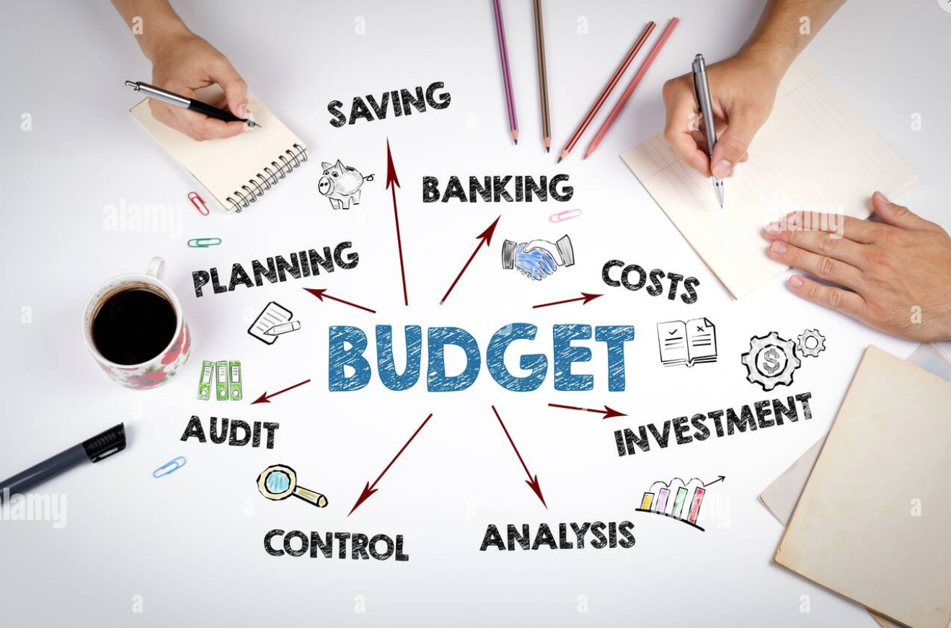
BUDGET MANAGEMENT

Slide 9
BUDGET MANAGEMENT
Depends on donor:
Indirect Costs / Overheads
NICRA (for USG-funded projects)
Organizational overhead percentage
Administration costs

Slide 10

BUDGET MANAGEMENT

Slide 11
BUDGET DEVELOPMENT
Before starting the numbers, clarify:
Project duration
Objectives and activities
Donor rules (allowable costs, indirect rates, procurement rules)
Required budget format (line-item, activity-based, or both)

Slide 12
BUDGET DEVELOPMENT
Detailed Budget
Include columns for:
Description
Unit
Unit cost
Quantity
Frequency (per month/year)
Total cost
Funding source

Slide 13
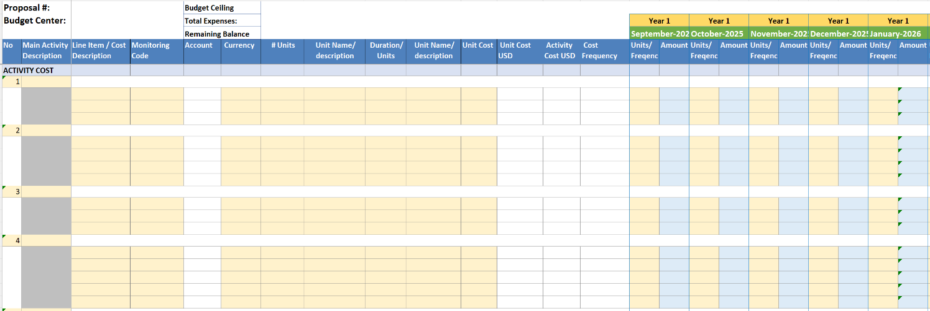
BUDGET MANAGEMENT

Slide 14
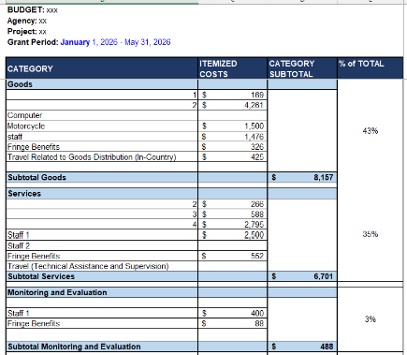
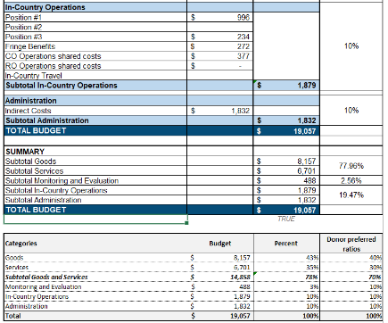
BUDGET MANAGEMENT

Slide 15
BUDGET DEVELOPMENT
Budget Summary
Detailed Budget
Budget Notes / Justification
Validate Against Donor Requirements
Final Checks

Slide 16
Key Components of Budget Management
A. Budget Planning
B. Budget Implementation
C. Budget Monitoring & Control
D. Budget Adjustment
E. Budget Reporting

Slide 17
C. Budget Monitoring & Control
1. Regular Budget vs. Actual (BVA) Review
2. Variance Analysis
3. Reforecasting
4. Documentation and Compliance

Slide 18
Tools & Documents for Effective Budget Management
1. Budget vs Actual (BVA) Template
Shows real-time spending and remaining balance.
2. Cash Flow Forecast
Predicts future cash needs to avoid shortages.
3. Procurement Plan
Links purchases with timelines and cost estimates.
4. Activity Workplan
Aligns deliverables and spending.
5. Financial Policies
Procurement rules, per diem policies, approval thresholds.
Notes:
Tools & Documents for Effective Budget Management
1. Budget vs Actual (BVA) Template
Shows real-time spending and remaining balance.
2. Cash Flow Forecast
Predicts future cash needs to avoid shortages.
3. Procurement Plan
Links purchases with timelines and cost estimates.
4. Activity Workplan
Aligns deliverables and spending.
5. Financial Policies
Procurement rules, per diem policies, approval thresholds.

Slide 19

BUDGET MANAGEMENT

Slide 20
What Is Budget Monitoring?
Spends according to plan
Avoids overspending or underspending
Uses funds efficiently and effectively
Meets donor financial requirements
Supports timely decision-making

Slide 21
Key Objectives of Budget Monitoring
Compare Budget vs Actual (BVA)
Identify variances (differences)
Provide explanations for variances
Recommend corrective actions
Update financial forecasts
Support decision-making for program and finance teams

Slide 22
Core Components of Budget Monitoring
A. Budget vs Actual (BVA) Analysis
B. Variance Analysis
C. Activity-Based Monitoring
D. Expenditure Documentation Review
E. Financial Forecasting (Reforecasting)
F. Internal Compliance Checks

Slide 23

BUDGET MANAGEMENT

Slide 24
Objectives of Budget Control
Prevent overspending and under-spending
Ensure funds are used appropriately and efficiently
Make sure spending follows the workplan
Maintain donor and audit compliance
Support informed decision-making
Maintain financial predictability through forecasting

Slide 25
Key Components of Project Budget Control
A. Internal Controls
B. Expenditure Control
C. Budget vs Actual (BVA) Control
D. Forecasting (Reforecasting)
E. Financial Compliance Control
F. Corrective Actions
Notes:
1. Budget Check Before Spending
Every purchase or activity should be checked against:
Available budget in that category
Donor allowable cost rules
Project timeline

Slide 26
A. Internal Controls
1. Authorization and Approval
2. Segregation of Duties
3. Procurement Controls
Notes:
1. Authorization and Approval
Clear approval levels for expenditure
Documented sign-off for purchases, travel, and contracts
2. Segregation of Duties
Different people handle:
Requesting
Approving
Processing
Recording
This reduces risk of fraud and errors.
3. Procurement Controls
Competitive bidding
Approved vendor lists
Clear documentation
Following donor procurement rules

Slide 27
Role in Budget Development
Role | Major Responsibilities
Project Manager | Lead budgeting, approve variances, align with workplan
Finance Officer | Ensure accuracy, compliance, prepare BVA
Technical Leads | Estimate activity costs
Procurement Team | Provide unit costs and procurement plan
HR | Confirm salaries and staffing structure
M&E | Cost monitoring & evaluation activities
Senior Management | Final approval, risk oversight
Donor | Approve budget and modifications
Internal Audit | Ensure compliance and documentation
Partners/Community | Provide local cost inputs

Slide 28
Key Components of a Budget Projection
1. Actual Spending to Date
2. Remaining Budget
3. Updated Assumptions
4. Planned Future Activities
5. Projected Monthly or Quarterly Costs
6. Forecasted End-of-Project Spending

Slide 29
How to Use Burn Rate in Project Management
1. Monitoring
2. Decision-making
3. Reporting
4. Risk management
Notes:
How to Use Burn Rate in Project Management
1. Monitoring
Compare actual burn vs. expected burn
Identify variances
2. Decision-making
Speed up or slow down activities
Adjust procurement schedule
Reforecast the budget
3. Reporting
Donors often request burn rate in financial reports
Used to justify budget realignment
4. Risk management
Under-burn = risk of returning funds
Over-burn = risk of budget shortfall

Slide 30
How Budget Projection Helps Project Team
1. Program team
2. Finance team
3. Management
4. Donor
Notes:
How Budget Projection Helps Project Teams
1. Program team
Understand upcoming resource needs
Schedule activities realistically
Adjust implementation pace
2. Finance team
Plan cashflow
Ensure compliance
Prevent financial surprises
3. Management
Decide on budget realignment
Prepare for donor reporting
Assess project performance
4. Donor
See expected end-of-project financial position
Approve reallocation requests early

Slide 31
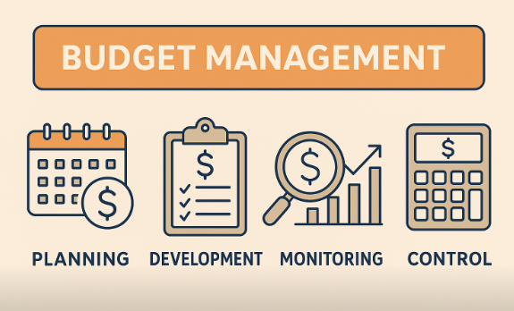
BUDGET MANAGEMENT

Slide 32
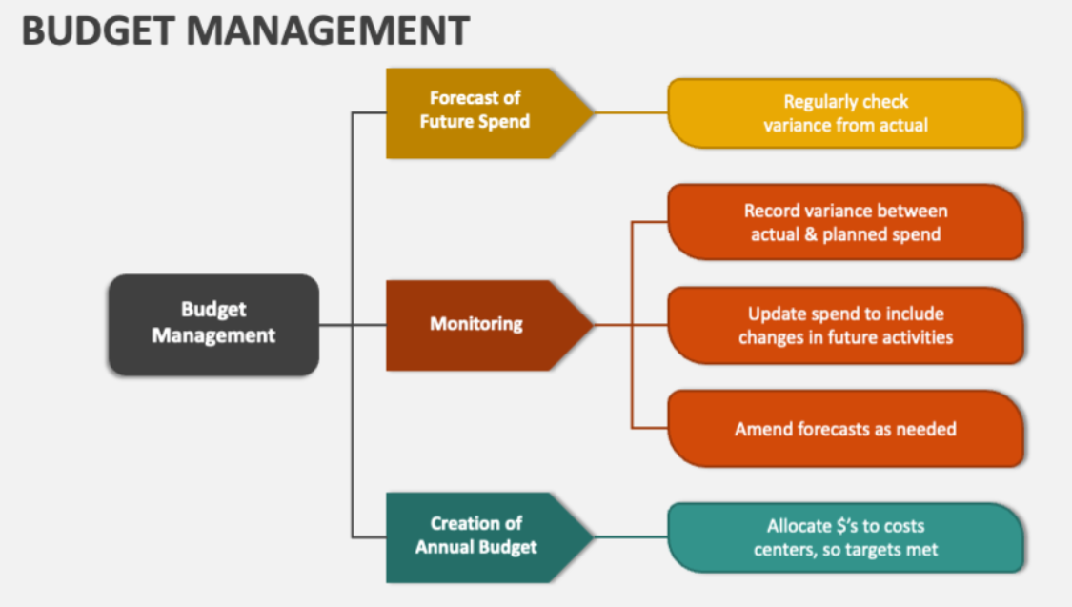
BUDGET MANAGEMENT

Slide 33

អរគុណ ! Thanks!

Slide 34
BUDGET MANAGEMENT

