Slide 1
ដំណើរការទិន្នន័យ ការសម្អាត និងវិភាគទិន្នន័យ
Data Processing, Cleaning, and Analysis
ថ្ងៃទី ២១ កុម្ភៈ ឆ្នាំ២០២៥
February 21, 2025

Slide 2
មាតិកា Content
ដំណើរការទិន្នន័យ data processing
ការសម្អាតទិន្នន័យ Data cleaning
ការវិភាគទិន្នន័យ Data analysis
ការបកស្រាយទិន្នន័យ Data interpretation

Slide 3

ដំណើរការទិន្នន័យ

Slide 4
ដំណើរការទិន្នន័យ Data Processing
បើតាមបទពិសោធន៍របស់អ្នក តើអ្នកដំណើរការទិន្នន័យយ៉ាងដូចម្ដេចខ្លះ?

Slide 5

What Data Processing?
Plenary Discussion

Slide 6
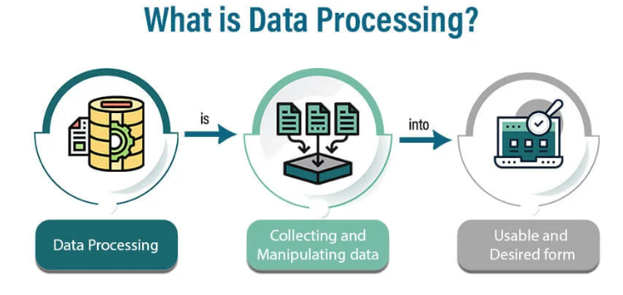

Slide 7
Why Do We Need to Process the Data?
Plenary Discussion

Slide 8

Efficiency & Speed – Digital data is easier to store, search, retrieve, and analyze compared to paper-based records.
Accuracy & Reduced Errors – Digital systems help minimize human errors in data entry and calculations.
Storage & Space Saving – Digital files require far less physical space than paper archives, reducing storage costs.
Security & Backup – Digital data can be encrypted, access-controlled, and backed up to prevent loss or unauthorized access.
Easy Sharing & Collaboration – Digital documents can be shared instantly across locations, improving teamwork and workflow.

Slide 9
How Did You Make the Data Processing?
Plenary Discussion

Slide 10
Manual entry (Excel, Google Sheets, Epi-Data, SPSS,…..)
Automated tools (KoboToolbox, Google Forms, scanning apps)

Slide 11
Best Practices or Tips for Data Entry
Plenary Discussion

Slide 12
Ensuring consistency in data format (dates, numbers, text)
Using data validation techniques to reduce errors
Creating a simple digital survey form

Slide 13

ការសម្អាតទិន្នន័យ

Slide 14
ការសម្អាតទិន្នន័យ Data Cleaning
បើតាមបទពិសោធន៍របស់អ្នក តើអ្នកសម្អាតទិន្នន័យយ៉ាងដូចម្ដេចខ្លះ?

Slide 15
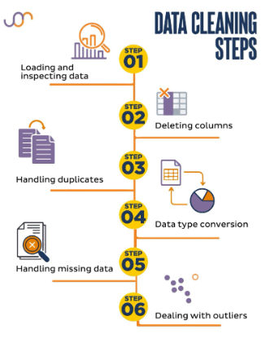
ការសម្អាតទិន្នន័យ Data Cleaning
Loading and inspecting data: ទាញឯកសារចេញពី Digital data collection platform និងពិនិត្យមើល ស្វែងយល់ពីសំណួរដែលយើងចង់សិក្សាពីវានិងត្រូវវិភាគវា ថាតើមានបាត់ទិន្នន័យ (Missing), ជាន់គ្នា (Duplicates)​ដែរឬទេ។
Deleting columns: ពិនិត្យមើលថាតើមាន columns ណាគ្មានព័ត៌មានដែរទេ ឬ មិនចាំបាច់ប្រើក្នុងការវិភាគ រួចលុបវាចោល។
Handling duplicates: បើមានព័ត៌មានណា ឬ អ្នកឆ្លើយតបណាដូចគ្នា អាចលុបមួយចោល។
Data type conversation: នេះយើងត្រូវស្វែងយល់ពីប្រភេទទិន្នន័យដូចបាននិយាយនៅជំហានទី១ ព័ត៌មានខ្លះជាលេខ ជាថ្ងៃខែឆ្នាំ ឬបញ្ចូលខុស តែពេលដែលទាញចេញ (download) មកវាប្រែជាអក្សរ (String) ដែលអាចឲ្យអ្នកវិភាគទិន្នន័យជួបការលំបាក ឬការកំណត់ទម្រង់ថ្ងៃខែឆ្នាំមិនស៊ីគ្នា។ ព័តមានខ្លះមិនស៊ីគ្នាពិសេស សំណួរដែលមានរំលង ឬផ្សេងៗ។ ដូចនេះត្រូវធ្វើវាឲ្យត្រឹមត្រូវវិញ។
Handling missing data: dataset ខ្លះមិនមានព័ត៌មានទាល់តែសោះនៅលើ row ខ្លះ យើងអាចលុប row នោះចោល។
Dealing with outliers: ទិន្នន័យខ្លះរបស់អ្នកឆ្លើយតបពីរបីនាក់វាខុសដាច់ស្រឡះពីទិន្នន័យរបស់អ្នកឆ្លើយតបផ្សេងទៀត។ ឧទាហរណ៍ព័ត៌មានទាក់ទងនឹងអាយុ ប្រាក់ចំណូល ឬចំនួនផ្សេងៗ។ ករណីនេះយើងអាចលុបវាចោល ឬកែតម្រូវបើអាចមានព័ត៌មានច្បាស់លាស់។

Slide 16
ការសម្អាតទិន្នន័យ Data Cleaning
សម្មតិកម្ម
ផ្អែកទៅលើទិន្នន័យដែលបានចែកជូន ទិន្នន័យនេះត្រូវបានប្រមូលពីប្រជាជននៅខេត្តចំនួនបី នៅក្នុងអំឡុងខែធ្នូ ឆ្នាំ២០២១ និង ខែមករា ឆ្នាំ២០២២។ នៅក្នុងទិន្នន័យនេះមានទិន្នន័យមិនប្រក្រតីមួយចំនួនដូចជា៖
ថ្ងៃខែឆ្នាំ ដែលបានសម្ភាស
ថ្ងៃខែឆ្នាំកំណើតរបស់កុមារ
ឃុំ
ភូមិ
សំណួរ ៤៤ ៤៥​ និង៤៦
សំណួរផ្សេងៗទៀតដែលមានចម្លើយ 99 (ផ្សេងៗ)
សំណួរពិភាក្សា និងអនុវត្ត
សូមលោក លោកស្រី អ្នកនាងកញ្ញារកមើលបញ្ហានោះ ហើយគួរដោះស្រាយយ៉ាងដូចម្ដេច?

Slide 17

ការវិភាគទិន្នន័យ Data Analysis

Slide 18
ការវិភាគទិន្នន័យ Data Analysis
តើអ្វីជាការវិភាគទិន្នន័យ? What is data analysis?

Slide 19
ការវិភាគទិន្នន័យ Data Analysis
It can help
It is the process of
Identifying what is working well
Examining data
Data Analysis
Identifying what is working not well
Filtering data
Adapting​ data
can use the basic information before the project starts or make the changes/adjustments needed in the next timeline/phase to achieve project objective/outcomes and goals/impacts.
Modeling data

Slide 20
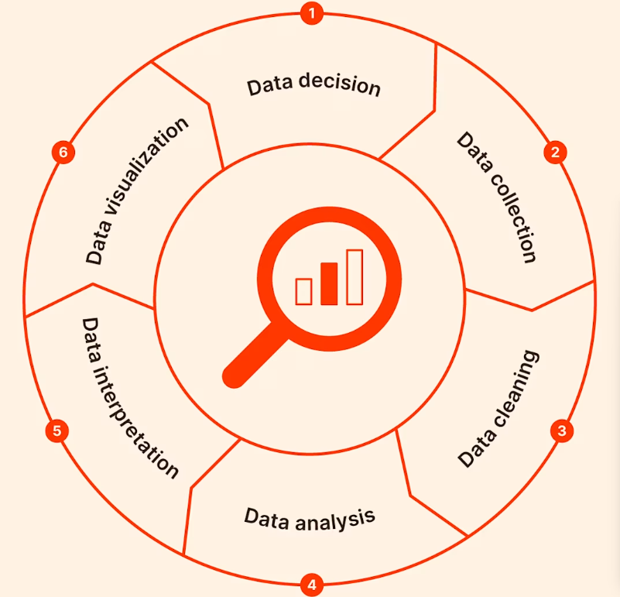
ការវិភាគទិន្នន័យ Data Analysis
ដំណើរការនៃការវិភាគទិន្នន័យ Data Analysis Process

Slide 21
ការវិភាគទិន្នន័យ Data Analysis
បើតាមបទពិសោធន៍របស់អ្នក តើអ្នកធ្វើយ៉ាងដូចម្ដេចខ្លះដើម្បីវិភាគទិន្នន័យបានត្រឹមត្រូវ លឿន និងច្បាស់លាល់?

Slide 22
ការវិភាគទិន្នន័យ Data Analysis
Tips for the data analysis
យល់ពីនិយមន័យនៃសូចនាករនិយមួយៗឲ្យបានច្បាស់
ដឹងពីការព័ត៌មានដែលត្រូវញែក (Disaggregation): ញែកតាមភេទ ក្រុមអាយុ កម្រិតអប់រំ ភូមិសាស្ត្រ ។ល។
ត្រូវមានផែនការវិភាគទិន្នន័យឲ្យបានច្បាស់*
ដឹងពីប្រភពព័ត៌មាន ថាត្រូវប្រមូលទិន្នន័យពីណាមក
ស្វែងយល់ពីកម្រងសំណួរឲ្យបានច្បាស់ ថាតើឧបករណ៍ណា ត្រូវនឹងសូចនាករអ្វីខ្លះ
ដឹងពីសំណួរដែលពាក់ព័ន្ធត្រូវវិភាគដើម្បីឆ្លើយតបនឹងសូចនាករដែលត្រូវវិភាគ

Slide 23
ការវិភាគទិន្នន័យ Data Analysis​
សំណួរបំផុសគំនិត Brainstorming
តើបងប្អូនណាខ្លះធ្លាប់វិភាគទិន្នន័យ?
តើបងប្អូនណាខ្លះធ្លាប់រៀបចំផែនការវិភាគទិន្នន័យ?
តើផែនការវិភាគទិន្នន័យនោះមានព័ត៌មានសំខាន់ៗអ្វីខ្លះ ដែលគួរត្រូវបានរំលេចក្នុងទម្រង់ផែនការវិភាគទិន្នន័យ?

Slide 24
ការវិភាគទិន្នន័យ Data Analysis​
Components of Datana Analysis Plan Template
លទ្ធផលគម្រោង Project results
សូចនាករ Indicator
និយមន័យនៃសូចនាករ និងភាពជាក់លាក់ Definition and specification
ឧបករណ៍ប្រមូលព័ត៌មាន Data collection tools
សំណួរពាក់ព័ន្ធ ដែលត្រូវយកមកវិភាគសម្រាប់សូចនាករនិមួយៗ Related Questions From The Tool
ព័ត៌មានដែលតម្រូវឲ្យបំបែក (Disaggregation)
កម្មវិធីដែលត្រូវប្រើដើម្បីវិភាគទិន្នន័យ Proposed Program for Data Analysis

Slide 25
ការវិភាគទិន្នន័យ Data Analysis​
Sample of Datana Analysis Plan Template

Slide 26
ការវិភាគទិន្នន័យ Data Analysis​
ការបង្ហាញពីការវិភាគទិន្នន័យជាក់ស្ដែង Demonstration of data analysis
Univariate Analysis
Province
Q44
Q45
Q46
OCI1: Percentage of pregnant women received ANC 4 times and plus
Bivariate Analysis
Indicator – ANC4+ by geographic, education level, and ethnicity

Slide 27
ការវិភាគទិន្នន័យ Data Analysis​
ការអនុវត្តជាក់ស្ដែងរបស់អ្នកចូលរួម Participants’ practices
Univariate Analysis
Child gender
Child age group
Education level
Ethnicity
OCI2: Percentage of low birth weight child <2.5kg
OCI5: % of female caregivers reported that their male partners join them to monitor child growth or to access public health service for acute malnutrition
Bivariate Analysis
OCI2 by geographic, gender, education, and ethnicity
OCI5: by geographic, education, and ethnicity

Slide 28

Interpreting the Data
ការបកស្រាយទិន្នន័យ

Slide 29
What Is Data Interpretation?
Plenary Discussion

Slide 30
Interpreting the Data
The process of using diverse analytical methods to review data and arrive at relevant conclusions.
To categorize, manipulate, and summarize the information in order to response to research’s objectives, questions, or hypothesize.

Slide 31
Tips for Data Interpretation
Plenary Discussion

Slide 32
Tips for Data Interpretation
1. Clean and Validate Your Data –Verify that the data is correct and free from errors, inconsistencies, or missing information. Reliable data is crucial for accurate interpretation.

Slide 33
Tips for Data Interpretation
2. Comprehend the Context – Before analyzing data, make sure you fully understand the objectives, research questions, and hypothesizes.

Slide 34
Research Objectives
Describe what we expect to achieve by conducting a research.
Ex. To describe what factors farmers, take into account in making such decisions as whether to adopt a new technology or what crops to grow.
Research Question
is a specific inquiry which the research seeks to provide a response to.
BUT
Tips for Data Interpretation
It is not a single question in your questionnaire.
Ex. What does our target group mainly do for their living?
Research Hypothesis
is a statement that introduces a research question and proposes an expected result.
Mostly it is
developed based on previous knowledge or literature review.
2. Comprehend the Context – Before analyzing data, make sure you fully understand the objectives, research questions, and hypothesizes.
Ex. Based on ….. Many people in the target communities rely on tree logging for living.
Ex. …… study informed that majority of people (60%) in Mondokiri collecting NTFP for their living.

Slide 35
Tips for Data Interpretation
3. Use Visualizations – Graphs, charts, and tables can help clarify complex data and highlight key trends, making it easier to communicate your findings.

Slide 36
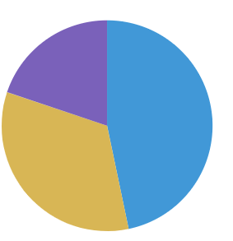
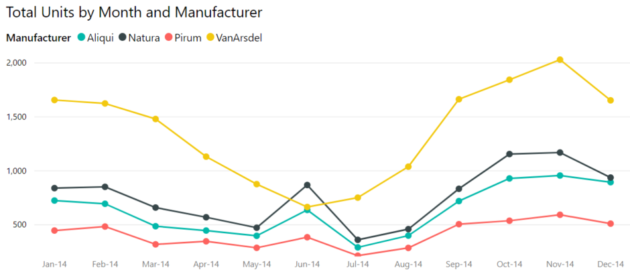
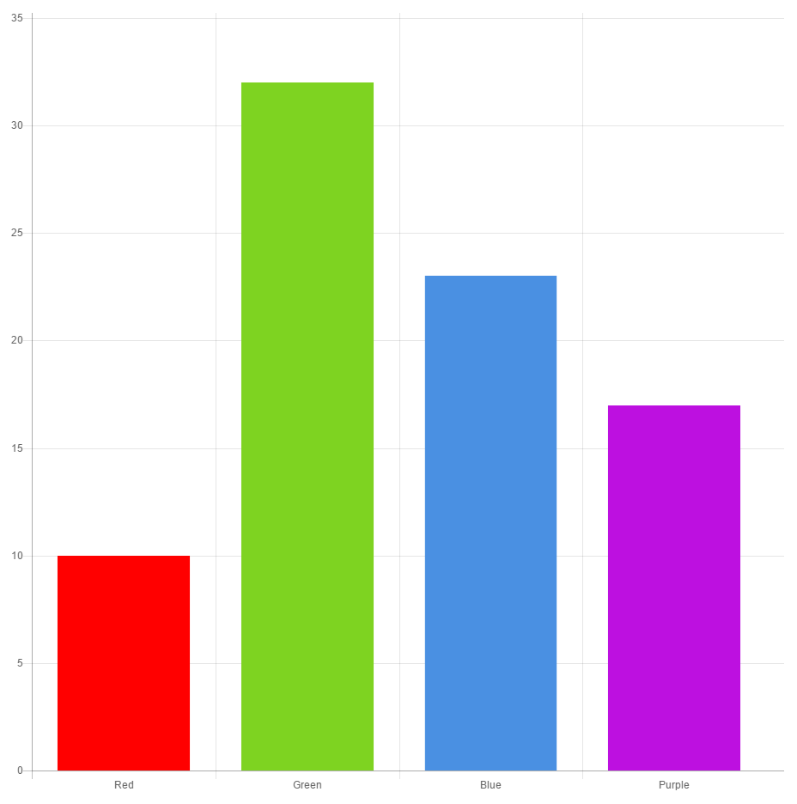
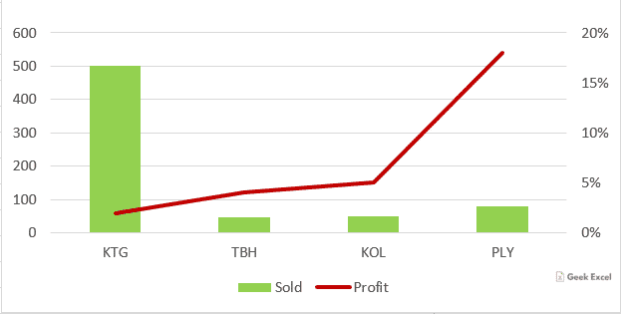
Popular Charts
Tips for Data Interpretation
3. Use Visualizations – Graphs, charts, and tables can help clarify complex data and highlight key trends, making it easier to communicate your findings.

Slide 37
Tips for Data Interpretation
5. Spot Patterns and Trends – Look for patterns, trends, or correlations within the data. This can help identify relationships between variables and forecast future developments.

Slide 38
Tips for Data Interpretation
6. Start with Visual: Explain in your own words what the graph(s), table(s), or diagram(s) is showing

Slide 39
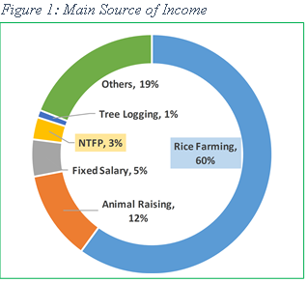
Figure 1: Primary Sources of Income for People in Mondulkiri Province in 2024
Tips for Data Interpretation
6. Start with Visual: Explain in your own words what the graph(s), table(s), or diagram(s) is showing
Ex. Figure 1 illustrates the various sources of income that residents of Mondulkiri province depend on for their livelihood in 2024.

Slide 40
Tips for Data Interpretation
7. Highlight Key Variables – Focus on the most relevant data points or metrics that align with your objectives. Avoid becoming overwhelmed by all the data—concentrate on the essentials.

Slide 41
Figure 1: Primary Sources of Income for People in Mondulkiri Province in 2024
Tips for Data Interpretation
7. Highlight Key Variables – Focus on the most relevant data points or metrics that align with your objectives. Avoid becoming overwhelmed by all the data—concentrate on the essentials.
Ex. Overall, rice farming is the primary source of income for people in the target communities.

Slide 42
Tips for Data Interpretation
8. Features in Detail: Provide details and some discussions.

Slide 43
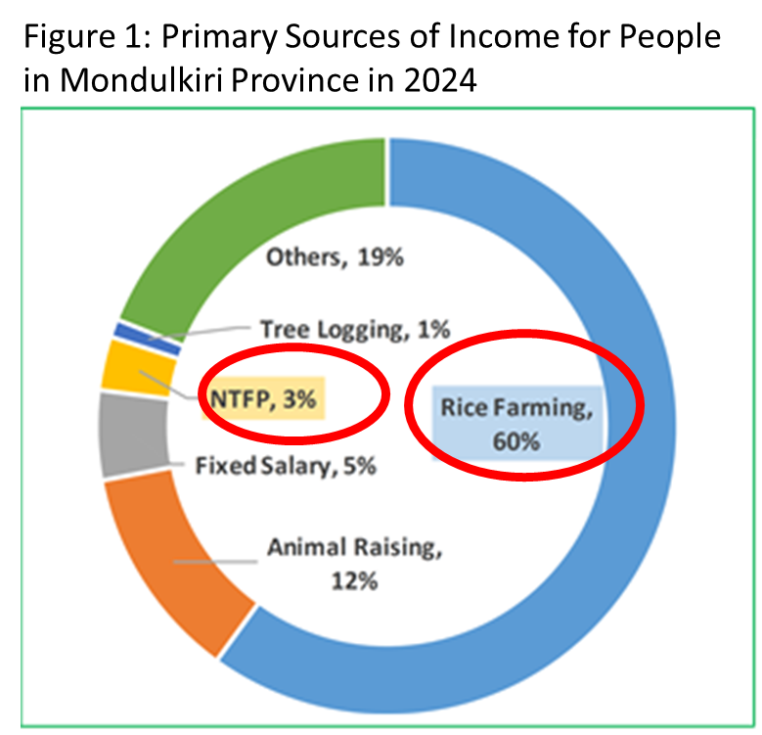
60% of respondents reported that rice farming was their primary source of income. This finding stands in stark contrast to the ABC study conducted in 2022, which indicated that the majority of people in the target areas relied on collecting non-timber forest products (NTFP) and logging for their livelihoods, with 60% and 30% of people respectively engaged in these activities. In comparison, this current study found only 1% and 3% of respondents depending on NTFP collection and logging. This significant shift suggests that there has been a transition in the livelihoods of people in the target areas, with a growing reliance on agriculture, particularly rice farming, as a primary income source. This trend reflects positively on the impact of conservation efforts in the province, indicating a move towards more sustainable practices and a reduction in dependence on natural resource extraction.
Tips for Data Interpretation
8. Features in Detail: Provide details and some discussions.

Slide 44
Figure 1 illustrates the various sources of income that residents of Mondulkiri province depend on for their livelihood in 2024. In general, rice farming stands out as the main income source for people in the target communities, with 60% of respondents identifying it as their primary livelihood. This finding sharply contrasts with the ABC study from 2022, which found that most people in the target areas relied on collecting non-timber forest products (NTFP) and logging, with 60% and 30% of people involved in these activities, respectively.
Data Interpretation
In comparison, this study revealed that only 1% and 3% of respondents are now dependent on NTFP collection and logging. This notable shift suggests that there has been a significant change in the livelihoods of people in the target areas, with agriculture—especially rice farming—becoming the predominant source of income. This change is a positive indicator of the success of conservation efforts in the province, signaling a move towards more sustainable livelihoods and reduced reliance on the extraction of natural resources.

Slide 45


Practice Interpreting Data
Data Interpretation
Divided into 8 Groups
Divided into 2 Groups

Slide 46

Presenting Key Findings
Data Interpretation
Divided into 8 Groups
Divided into 2 Groups

Slide 47
សូមអរគុណ

