Slide 1


In reference to presentation and
Updated Result of INGO Survey
Bi-Monthly Member Meeting
MoU Registration or Renewal
2022
Vision: Sustainable and Democratic Development for Cambodia

Slide 2
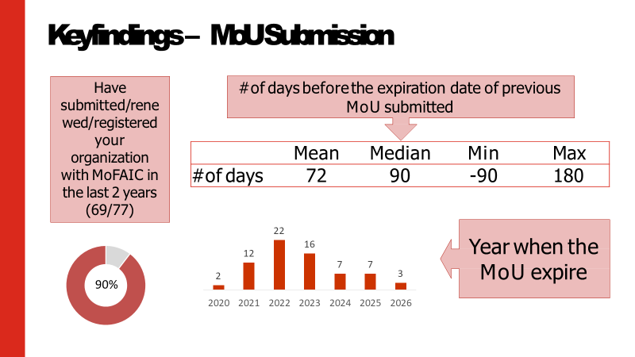
About the survey
Online Survey from 22 May- 13 June 2023 23 Aug-04 Sep 2023 Using Kobo Toolbox, 43 NGO + 42 NGOs

Slide 3
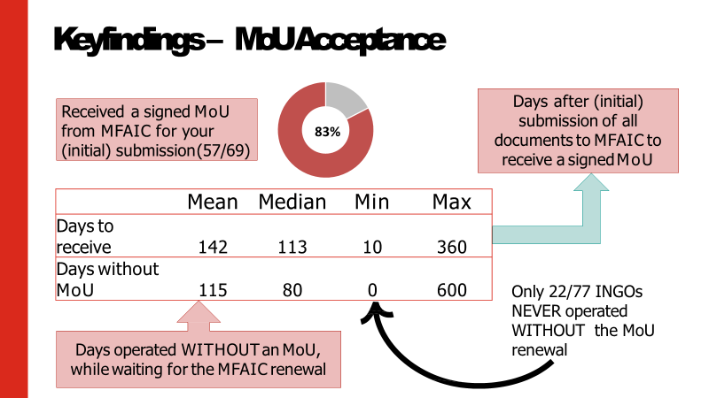
About the survey

Slide 4
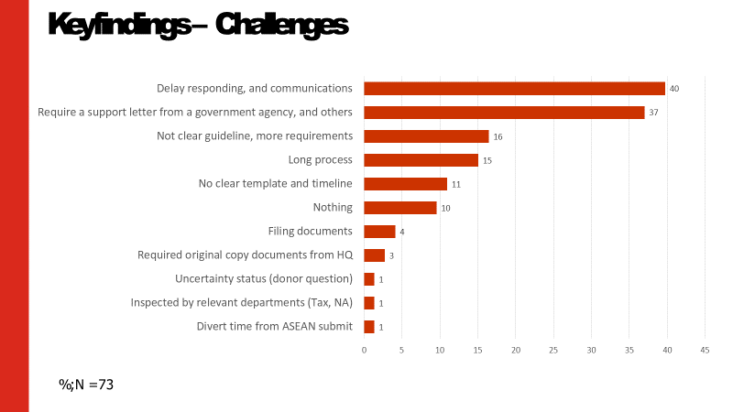
About the survey

Slide 5
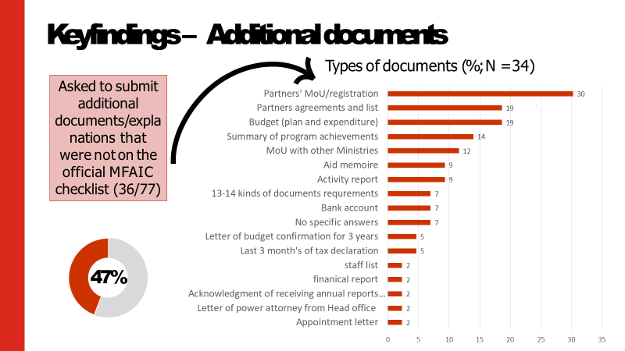
About the survey

Slide 6
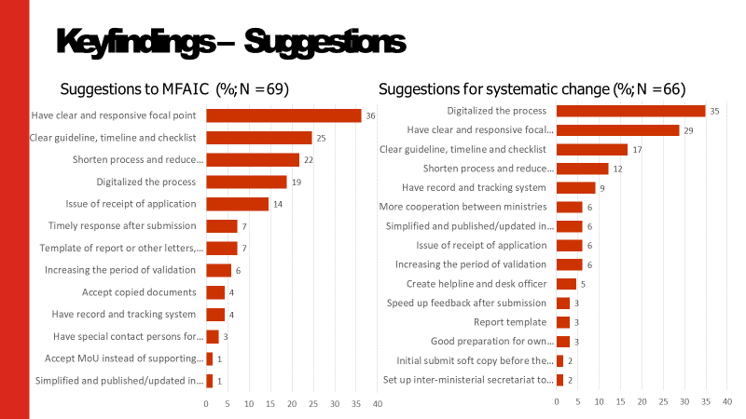
About the survey

Slide 7
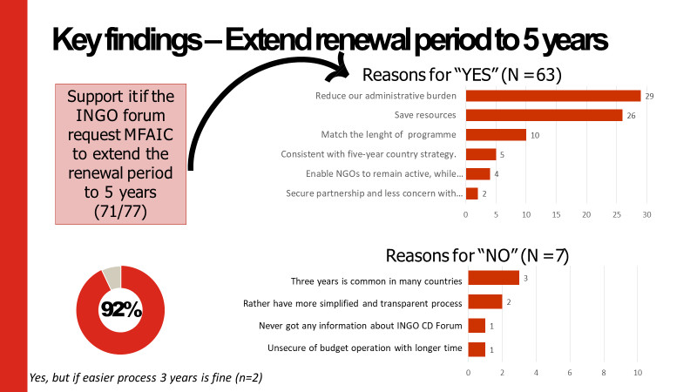
About the survey

Slide 8
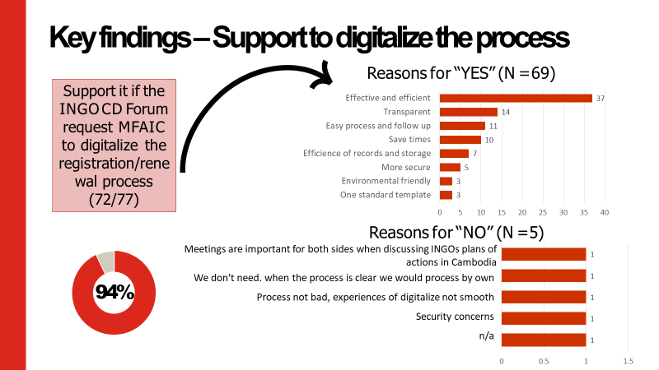
About the survey

Slide 9
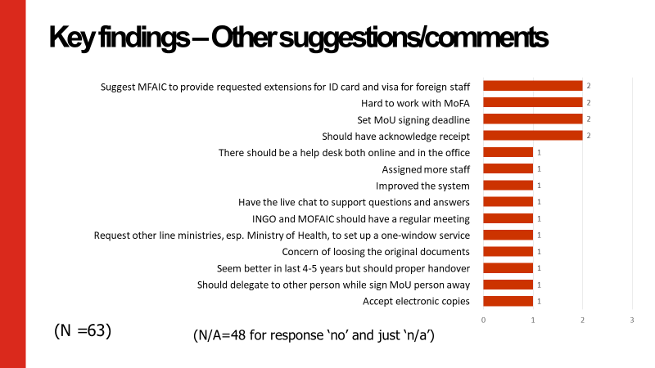
About the survey

Slide 10

http://www.ccc-cambodia.org www.facebook.com/CCCsince1990
www.youtube.com/CCCambodia
THANK YOU!

