Slide 1
Online CCC Members Meeting
How to Maintain Civic Space and Promote Enabling Environment for CSOs
Presented by Theary Luy, HoP

Slide 2
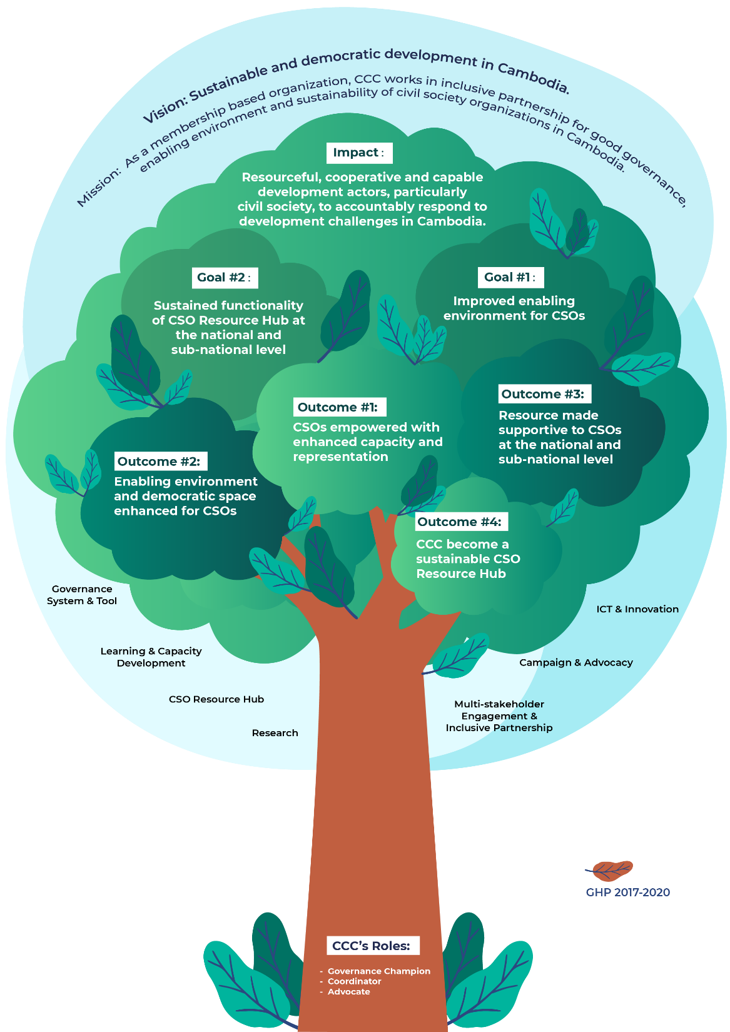
CCC
GHP
Tree

Slide 3
Strategic Elements of the GHP 2021-2023
Vision
Sustainable and democratic development in Cambodia.
Mission
As a membership based organization, CCC works in inclusive partnership for good governance, enabling environment and sustainability of civil society organizations in Cambodia.
Impact
Resourceful, cooperative and capable development actors, particularly civil society, to accountably respond to development challenges in Cambodia.
Values
Integrity,
Quality,
Inclusiveness.
Responsiveness,
Cooperation,

Slide 4
Overall Program Objectives/Goals
1. Improved enabling environment for CSOs
2. Sustained functionality of CSO Resource Hub at the national and sub-national level
Program Goals

Slide 5
Civic Space and Enabling Environment

Slide 6
Law and Policy Related
LANGO Submitted 14 articles proposed amendment with MoI
Auditing and Accounting Laws Leadership Meeting between CSOs & AAR
Draft Cyber Law and National Internet Gateway
Mid-Term Review of NSDP; and collective response & evaluation on the government commitment to NSDP
Leadership Changes and Impact of Covid-19 on Taxation Compliance

Slide 7
Partnership Engagement
Sub-national level Re-new 15 MoU Provincial NGO networks (3 re-arrangement)
National level NEP, CPDD, Chab Dai, HACC, NGOForum, YRDP, CHRAC, and so on (CCC & NGOForum-MoU 2021-2023)
Gov’t: Partnership Forum (Postponed), National Accounting Council (NAC), CSDGs (Relevant Ministries), MoH, NSSF (Pension), ISAF, General Tax Department (GDT)
DPs: UNDP, Australia Embassy, EU, Japan Embassy(Advocate for space and partnership with Gov’t during COVID)

Slide 8
Regional Advocacy
CIVICUS
IFP: International Forum of National NGO Platforms
OECD Watch: The Organization for Economic Co-operation and Development
ADN: Asia Democracy Network
ADA: Asia Development Alliance
Forus
Global Reference Standard
AGNA
UN Volunteers
ISAF: Implementation Social Accountability Framework, NCDD

Slide 9
Member Services

Slide 10
Member Services
Bi-monthly meeting
Annual General Assembly
Learning Forums (HRM, FM, M&E and ICT)
CSOs consultative workshop (Civic space and enabling environment, legal compliance and policy advocacy)
Other capacity development trainings (DNH, governance, resource mobilization and local fundraising, etc.

Slide 11
Member Services
Governance System and Tools | New GPP modality has been implemented 3 awards of new GPP system and standards: Good Governance, Dynamic Program, Good Resource Management GPP community of Practice
Learning and Capacity Development | 4 Learning Forum Platforms (FM, HRM, M&E, and ICT) Holistic Institutional Development (HID) training Do No Harm and Conflict Sensitivity training
CSO Resource Hub | Three important resource pillars, Financial resources, Technical and human resources, Information resources
Research | 6 research studies related to CSOs: Impact of Covid-19 on CSOs work, Member satisfaction survey, Civic Space in Cambodia, NSDP-MTR, Enabling environment for CSOs

Slide 12
Member Services
Multi-stakeholder Engagement and Inclusive Partnership | CSO technical working group CSO consultative workshop and meeting Existing mechanism: Technical Working Group (TWGs), DCPS, ISAF, CSR, CSO-GDT mixed WG, SDGs Youth Ambassador, Government-CSO partnership dialogues CCC AGM, and BMM
Campaign and Advocacy | Legal compliance (LANGO, Taxation, AAL, Labor, NSSF, Covid-19, A2I, …) Facebook Live and Campaign based on SDGs framework
ICT and Innovation | CSO database, research database Video documentation Online advocacy ICT trainings (virtual meeting platform)

Slide 13



THANK YOU!
http://www.ccc-cambodia.org www.facebook.com/CCCsince1990
www.youtube.com/CCCambodia
^{Vision:} Sustainable and Democratic Development for Cambodia

