Slide 1

Cambodian Financial Reporting Standard for Not-for-Profit Entities
Boundlessly Excellent.

Slide 2
Contents
1. About PCG & Partners
Cambodian Financial Reporting Standard for Not-for-Profit Entities
© 2019 PCG & Partners Co., Ltd
This presentation has been prepared for general guidance on matters of interest only and does not constitute professional advice. You should not act upon the information contained in this publication without obtaining specific professional advice. No representation or warranty (express or implied) is given as to the accuracy or completeness of the information contained in this presentation, and, to the extent permitted by law, PCG & Partners Co,. Ltd, its members, employees and agents do not accept or assume any liability, responsibility or duty of care for any consequences of you or anyone else acting, or refraining to act, in reliance on the information contained in this publication or for any decision based on it.
2. CFRS for NFPEs

Slide 3






Our team is the member of these professional bodies:
Founded in 2011 by six Cambodian Professional
90
6
prestigious Professional Institutions
Management & staff
This logos are the trademarks or registered trademark of their respective holders and should be treated as such.

Slide 4


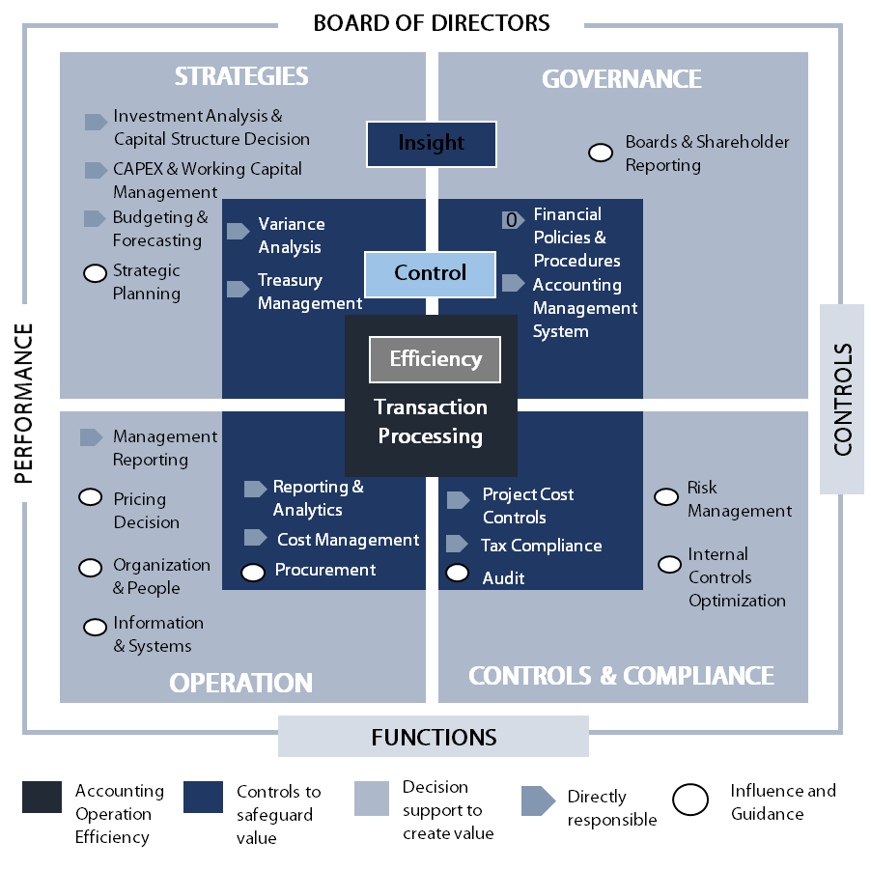
Our service is built around this roles and responsibilities of finance function:
Main Services

Slide 5
វិសាលភាព
  ច្បាប់ស្តីពី គណនេយ្យ និងសាវនកម្ម
  នស/រកម/០៤១៦/០០៦
មាត្រា៣៖
ច្បាប់នេះមានរិសាលភាពអនុវត្តចំពោះស្ថាប័ន​សាធារណ: សហគ្រាសអង្គភាពមិនស្វែងរកប្រាក់ចំណេញ គណនេយ្យករ និងសវនករ ។
Law on Accounting & Auditing
គោលបំណង៖ គ្រប់គ្រងវិស័យគណនេយ្យនិងសវនកម្មប្រកបដោយប្រសិទ្ធិភាព តម្លាភាព គណនេយ្យភាព និងភាពអាចជឿទុកចិត្តបាន។

Slide 6
ស្តង់ដាគណនេយ្យ
  ច្បាប់ស្តីពី គណនេយ្យ និងសាវនកម្ម
  នស/រកម/០៤១៦/០០៦
មាត្រា១១៖
ស្តង់ដាគណនេយ្យ ត្រូវសម្រេចដាក់ឲ្យអនុវត្តដោយ ប្រកាសរបស់រដ្ឋមន្ត្រីក្រសួងសេដ្ឋកិច្ច និងហិរញ្ញវត្ថុ តាមសំណើររបស់ ក.ជ.គ ។
Law on Accounting & Auditing
គោលបំណង៖ គ្រប់គ្រងវិស័យគណនេយ្យនិងសវនកម្មប្រកបដោយប្រសិទ្ធិភាព តម្លាភាព គណនេយ្យភាព និងភាពអាចជឿទុកចិត្តបាន។

Slide 7
Cambodian Financial Reporting Standard for Not-Profit-Profit Entities
ស្តង់ដារបាយការណ៍ហិរញ្ញវត្ថុកម្ពុជាសម្រាប់អង្គភាពមិនស្វែងរកប្រាក់ចំណេញ
៣៣៥​ សហវ ​ ប្រក
សេចក្តីជូនដំណឹងលេខ ៣៣៥​ សហវ ​ ប្រក
២៧ មិនា​ ឆ្នាំ២០១៨

Slide 8
ស្តង់ដារបាយការណ៍ហិរញ្ញវត្ថុកម្ពុជាសម្រាប់អង្គភាពមិនស្វែងរកប្រាក់ចំណេញ
សេចក្តីជូនដំណឹងលេខ ៣៣៥​ សហវ ​ ប្រក
២៧ មិនា​ ឆ្នាំ២០១៨
Boundlessly Excellent.
Cambodian Financial Reporting Standard for Not-for-Profit Entities

Slide 9

Objective
To facilitate Not-for-Profit Entities in preparing financial report which shall comply with CFRS.
To improve the quality and consistency of information disclosed in financial report
Cambodian Financial Reporting Standard for NFPEs
I. What is Cambodian Financial Reporting Standard for NFPEs (CFRS for NFPEs)?
Scope
Apply to NFPEs which are under Cambodian Laws
Standard
NFPEs shall prepare a Financial Report in accordance with requirement set out in Appendix A and the transitional provisions in Appendix B of CFRS for NFPS
This standard applies cash-basic accounting
This Standard is accompany with an explanatory guide containing a template and guidance notes that illustrate the requirements of this Standard
Effective date: 01 January, 2018

Slide 10
A7. The required components of the Financial Report are:
  Entity Information explaining what the entity is and why it exists)
  Statement of Receipts and Payments showing cash received and paid by the entity over the year so the net cash surplus or deficit can be calculated for that financial year
  Note to Financial report explaining amounts shown in the Statement of Receipts and Payments as well as relevant events affecting the financial year
Cambodian Financial Reporting Standard for NFPEs
Section 2: Objective of Reporting and Overview of Reporting Requirement

Slide 11
A26. Format of Statement of Receipts and Payments
Statement of Receipts and Payments
Operating receipts (by category) xx
Less operating payments (by category) xx
Operating surplus or (deficit) xx
Add capital receipts payments (by category) xx
Less capital payments (by category) xx
Increase or (decrease) in cash xx
Difference on currency translation xx/(xx)
Plus bank accounts and cash at the beginning of the financial year xx
Total bank accounts and cash at the end of the financial year xx
Represented by:
Bank account (s) xx
Term deposit (s) xx
Cash on hand (includes petty cash) xx
Total bank accounts and cash at the end of the financial year xx
Cambodian Financial Reporting Standard for NFPEs
Section 4: Statement of Receipts and Payments

Slide 12

Cambodian Financial Reporting Standard for NFPEs
Required Information:
  A35. Receipts shall be aggregated and presented separately in categories as follow:
Section 4: Statement of Receipts and Payments
Operating receipts | Capital receipts
(a).Donations, fundraising and other similar receipts | (e). Receipts from the sale of resources
(b).Fees, subscriptions and other receipts from members | (f). Receipts from borrowings
(c). Receipts from providing goods or services
(d). Interest, dividends and other investment income receipts

Slide 13
Cambodian Financial Reporting Standard for NFPEs
A41. Optional Information: To enhance the user's understanding of the entity's financial performance, additional categories are listed below:
Operating receipts:
      Donations from the public
      Fundraising receipts
      Grants not directly related to service delivery
      Fees and subscriptions from members
      Donations or offerings from members;
      Receipts from grants or contracts for service with national or sub-national administration
      Receipts from grants or contracts for service with non-governmental agencies
      Receipts from sales to the public
      Receipts from sales to members
      Receipts from commercial activities
      Lease or rental receipts
      Interest and dividend income receipts; and
      Other operating receipts.
Section 4: Statement of Receipts and Payments

Slide 14

Cambodian Financial Reporting Standard for NFPEs
Required Information
  A48. In order to make info understandable to users, payments shall be presented in categories as following:
Section 4: Statement of Receipts and Payments
Operating payments | Capital payments
(a). Payments related to public fundraising | (e). Purchase of resources
(b). Volunteer and employee related payments | (f). Repayment of borrowings
(c). Payments related to providing goods or services
(d). Grants and donations paid

Slide 15
Cambodian Financial Reporting Standard for NFPEs
A54. Optional Information: To enhance users' understanding of the entity's financial performance. Additional categories are listed below:
  Operating payments:
      Administration and overhead payments;
      Lease and rental payments;
      Affiliation fees;
      Interest payments; and
      Program/Project by activities.
      Other operating payments.
Section 4: Statement of Receipts and Payments

Slide 16

Cambodian Financial Reporting Standard for NFPEs
Bank Accounts and Cash:
A57. Bank accounts and cash comprises:
      petty cash, cash on hand at reporting date,
      cheque accounts,
      deposits held at call with banks and other financial institutions,
      bank overdrafts,
      term deposits and
      restricted cash.
Required Information:
  A58. Bank accounts and cash shall be recorded at the amount actually held.
    However, bank account balances shall be adjusted to reflect amounts deposited but not yet shown on the bank statement, or cheques that have been issued but not yet presented to the bank.
Section 4: Statement of Receipts and Payments

Slide 17

Cambodian Financial Reporting Standard for NFPEs
Grant with Conditions
A grant of R 6,000,000 was made by the local council to a food bank (the reporting entity). R2,000,000 was a contribution towards the purchase of a refrigerator for the storage of perishable items, and R4,000,000 for buying food for distribution The agreement requires the grant to be spent as specified or be returned to the local council. At the end of the year the refrigerator had been purchased but only half the food.
Section 6: Illustrative Examples
Treatment : The reporting entity records:
In the statement of receipts and payments the entire amount of the grant when received (as an operating receipt: donations, fund raising and other similar receipts).

Slide 18
Cambodian Financial Reporting Standard for NFPEs
In the statement of receipts and payments, the R2,000,000 that has been spent on the refrigerator (as a capital payment); and the R2,000,000 spent on the food (as an operating payment: payments related to providing goods or services).
In the schedule of resources in the note to financial report, the refrigerator and its purchase value (cost).
In the schedule of other information in the note to financial report, the following: the total amount of the grant, the fact that a condition of the grant is that it only be used to purchase a refrigerator and buy food for distribution, and the fact that R2,000,000 of the grant has not yet been spent on food for distribution at year end.
Section 6: Illustrative Examples
Optional Information: The entity may wish to include information about the grant provider in any list of grant providers and their contributions included in the notes to the financial report.

Slide 19
Cambodian Financial Reporting Standard for NFPEs
Section 6: Illustrative Examples
Optional Information: The entity may wish to include information about the grant provider in any list of grant providers and their contributions included in the notes to the financial report.

Slide 20
Cambodian Financial Reporting Standard for NFPEs
2. Loan Forgiveness
A government agency lends an entity R40,000,000 to enable the entity to buy a van.
Treatment: The loan is recorded in the statement of receipts and payments as a capital receipt on receipt of the funds. Future repayments are recorded in the statement of receipts and payments as a capital payment as they are made, and the amount owing at each reporting date is recorded in the note to financial report.
Section 6: Illustrative Examples
b. After a change in policy, the government agency decides not to require repayment of the loan. There are no conditions attached to this decision.
Treatment: The entity removes the loan from the schedule of commitments in the note to financial report
Optional Information: The entity may wish to record in the notes to the financial report the reason it no longer has the loan recorded in its schedule of commitments

Slide 21
Cambodian Financial Reporting Standard for NFPEs
3. Volunteer Services
The reporting entity is a charity shop run by volunteers.
Treatment: The entity information section reports that the entity is reliant on time of volunteers, and the donation of goods for sale, for the operation of the charity shop (see paragraph A23(0).
Optional Information: In its note to financial report (Note 9.2) the entity may provide a quantification of the contributions from volunteers in terms of numbers of volunteers, number of volunteer hours or full-time staff equivalents involved in running the shop.
Section 6: Illustrative Examples

Slide 22
Cambodian Financial Reporting Standard for NFPEs
3. Bequests
A client (who is not a related party) of a registered charity advises that she has named the charity as the beneficiary of R40,000,000 in her will, and that the money is to be used for a specified purpose.
Treatment: There is no recording of the bequest when the will is made, or upon the death of the benefactor. The cash receipt is recorded in the statement of receipts and payments as an operating receipt when the cash from the bequest is received. The conditions attached to the bequest are reported in the note to financial report (once the bequest is received).
Optional Information: In the periods between when the charity is named in the will and the bequest is received, the charity may wish to record in the additional notes to the financial report the fact that they have been named as a beneficiary
Section 6: Illustrative Examples

Slide 23
Cambodian Financial Reporting Standard for NFPEs
5. Receipts for a future activity
An entity has received ticket monies for a ball it is going to hold in the next financial year as a fundraiser.
Treatment: Ticket monies received are recorded as an operating receipt in the statement of receipts and payments. The entity also reports in the note to financial report that it has committed to holding a ball as a fundraising activity and that it has received R4,000,000 of ticket monies in advance; and these have been recorded as an operating receipt and are held in the entity's bank account.
Section 6: Illustrative Examples

Slide 24
Cambodian Financial Reporting Standard for NFPEs
6. Related Parties
  Scenario I:
  The reporting entity has total operating payments of
  R 20,000,000 these payments are all made to the spouse of the chairman for office administration duties of the entity, the payments are made on normal terms and conditions.
Scenario 2
The reporting entity has total operating payments of R20,000,000; a few of these payments (R200,000) are made to the spouse of the chairman for relieving the office administrator, the payments are made at the same hourly rate as the office administrator receives.
Treatment: In both of the scenarios above the spouse of the chairman is a related party of the entity (see paragraph A69(a)).
Section 6: Illustrative Examples

Slide 25
Cambodian Financial Reporting Standard for NFPEs
Treatment: In both of the scenarios above the spouse of the chairman is a related party of the entity (see paragraph A69(a)).
In scenario I the transactions with the related party whilst on normal terms and conditions are significant to the entity (see paragraph A72(a)) and therefore the entity reports in the notes to the financial report the information set out in paragraph A73(a)-(c).
In scenario 2 the transactions with the related party are not significant to the entity and therefore the entity is not required to report those transactions in the notes to the financial report.
Section 6: Illustrative Examples

Slide 26
សេចក្តីជូនដំណឹង
  សេចក្តីជូនដំណឹងស្តីពីការពន្យារការអនុវត្តស្តង់ដារបាយការណ៍ហិរញ្ញវត្ថុកម្ពុជាសម្រាប់អង្គភាពមិនស្វែងរកប្រាក់ចំណេញ
ពន្យារពេលការអនុវត្តស្តង់ដារហូតមានការជូនដំណឹងជាថ្មី ។
អង្គភាពដែលពុំមានស្តង់ដាប្រើប្រាស់ពីមុន អាចប្រើប្រាស់ស្តង់ដានេះបាន ។
អង្គភាពមិនស្វែងរកប្រាក់ចំណេញ ត្រូវផ្ងើរមកក្រសួង សេដ្ឋកិច្ចនិងហិរញ្ញវត្ថុ នូវរបាយការណ៍បូកសរុបសកម្ម ភាពការងារ និងរបាយការណ៍ហិរញ្ញវត្ថុប្រចាំឆ្នាំមួយច្បាប់តាមពេលកំណត់ដូចដែលមានចែងនៅក្នុងព្រះរាជ ក្រម នស/រកម/០៨១៥/០១០​​ ច្បាប់ស្តីពីសមាគម និងអង្គការមិនមែនរដ្ឋាភិបាល ។
លេខ ០៣០ ក.ជ.គ ថ្ងៃ២១ ខែមករា ឆ្នាំ២០១៩

Slide 27
សិទ្ធ ផលប្រយោជន៍ និងកតព្វកិច្ចិរបស់សមាគម ឬអង្គការមិនមែនរដ្ឋាភិបាល
ច្បាប់ស្តីពីសមាគម និងអង្គការមិនមែនរដ្ឋាភិបាល
  នស/រកម/០៨១៥/០១០
មាត្រា​ ២៥
អង្គការមិនមែនរដ្ឋាភិបាលក្នុងស្រុកត្រូវផ្ញើរទៅក្រសួងមហាផ្ទៃ និងក្រសួងសេដ្ឋកិច្ចនិងហិរញ្ញវត្ថុ នូវរបាយការណ៍បូកសរុបសកម្មភាពការងារ និងរបាយការណ៍ហិរញ្ញវត្ថុប្រចាំឆ្នាំមួយច្បាប់ និងមិនឲ្យហួសពីបំណាច់ខែកុម្ភ:នៃឆ្នាំបន្ទាប់ ។
Law on Associations and Non-governmental Organization

Slide 28
សេចក្តីព្រាង
លេខ ៣៨៣ ក.ជ.គ ថ្ងៃ២៨ ខែធ្នូ ឆ្នាំ២០១៨
Cambodian Financial Reporting Standard Accrual for Not-for Profit Entities​ (CFRSA for NFPEs)
  សេចក្តីព្រាងស្តង់ដារបាយការណ៍ហិរញ្ញវត្ថុកម្ពុជាសម្រាប់អង្គភាពមិនស្វែងរកប្រាក់ចំណេញ (កម្រិត២)

Slide 29
2. Objective of Reporting and Overview of Reporting Requirements
លេខ ៣៨៣ ក.ជ.គ ថ្ងៃ២៨ ខែធ្នូ ឆ្នាំ២០១៨
Required Components of the Performance Report
A8. An entity shall prepare a performance report every financial year with, at a minimum, the following components:
  Entity information which explains what the entity is and why it exists (section 3);
  A statement of service performance which explains what the entity was seeking to achieve (outcomes) and what it did (outputs) (section 4);
  A statement of financial performance showing what the entity has generated (revenue) and the cost of running the entity (expenses), over the year, so that users and preparers know whether the entity has made a surplus or a deficit for that financial year (section5);
  សេចក្តីព្រាងស្តង់ដារបាយការណ៍ហិរញ្ញវត្ថុកម្ពុជាសម្រាប់អង្គភាពមិនស្វែងរកប្រាក់ចំណេញ (កម្រិត២)

Slide 30
2. Objective of Reporting and Overview of Reporting Requirements
លេខ ៣៨៣ ក.ជ.គ ថ្ងៃ២៨ ខែធ្នូ ឆ្នាំ២០១៨
  A statement of financial position showing what the entity owns (assets), what the entity owes (liabilities) and the difference (accumulated funds) at the reporting date (section 6);
  A statement of cash flows showing the cash the entity received, and the cash the entity paid out during the year (section 7);
  A statement of accounting policies which explains the accounting rules used to prepare the performance report (section 8); and
  Notes to the performance report explaining some of the amounts shown in the statements in (b)–(e) above, as well as explaining relevant events affecting the financial year including commitments and contingencies (section 9).
  សេចក្តីព្រាងស្តង់ដារបាយការណ៍ហិរញ្ញវត្ថុកម្ពុជាសម្រាប់អង្គភាពមិនស្វែងរកប្រាក់ចំណេញ (កម្រិត២)

Slide 31
5. Statement of Financial Performance
លេខ ៣៨៣ ក.ជ.គ ថ្ងៃ២៨ ខែធ្នូ ឆ្នាំ២០១៨
Format of Statement of Financial Performance:
Required Information:
A46. The statement of financial performance shall be presented as follows:
    Revenue (by category) xx
    Less expenses (by category) xx
    Surplus/(Deficit) xx
A47. If the entity pays income tax, this shall be shown as a separate line item after surplus or deficit, with a further total called Surplus/(Deficit) after Tax also reported.

Slide 32
5. Statement of Financial Performance
លេខ ៣៨៣ ក.ជ.គ ថ្ងៃ២៨ ខែធ្នូ ឆ្នាំ២០១៨
Optional Information
A48. Where the making of grants and donations is a major activity of the entity, the following format may be used:
Revenue (by category) XX
Less expenses (by category) XX
Surplus/(Deficit) before grants
and donations made XX
Less grants and donations made XX
Surplus/(Deficit) XX
A49. Additional line items, headings and subtotals may be presented in the statement of financial performance when such presentation will help users to understand the entity’s financial performance.

Slide 33
5. Statement of Financial Performance
លេខ ៣៨៣ ក.ជ.គ ថ្ងៃ២៨ ខែធ្នូ ឆ្នាំ២០១៨
A54. In order to make information understandable to users, revenue shall be aggregated and separately presented in categories. As a minimum, the following aggregated categories shall be reported separately:
(a) Donations, fundraising and other similar revenue;
(b) Fees, subscriptions and other revenue from members;
(c) Revenue from providing goods or services; and
(d) Interest, dividends and other investment revenue.

Slide 34
5. Statement of Financial Performance
លេខ ៣៨៣ ក.ជ.គ ថ្ងៃ២៨ ខែធ្នូ ឆ្នាំ២០១៨
The minimum categories specified in paragraph A54 may be disaggregated, or additional categories may be presented in the statement of financial performance, when such presentation will enhance users’ understanding of the entity’s financial performance. Possible disaggregated or additional categories are listed below.
(a) Donations or koha from the public;
(b) Fundraising revenue;
(c) Grants not directly related to service delivery;
(d) Fees and subscriptions from members;
(e) Donations, koha or offerings from members;
(f) Revenue from grants or contracts for service with central or local government;
(g) Revenue from grants or contracts for service with non-governmental agencies;
(h) Revenue from sales to the public;
(i) Revenue from sales to members;
(j) Revenue from commercial activities;
(k) Lease or rental revenue;
(l) Interest or dividend revenue; and
(m) Other revenue..

Slide 35
Cambodian Financial Reporting Standard Accrual for NPEs
5. Statement of Financial Performance
Table 1: Recording of Specific Types of Revenues
Source | When to Record | Comments
Donations, fundraising and other similar revenue
Fundraising – cash | If no “use or return” condition attached (that is, no requirements to return the funds if they are not used as intended) record as revenue when cash is received. | May be received in the form of donations or from the sale of goods or services. It is rare that fundraising has a “use or return” condition attached. Funds may be raised for a specific purpose; this is not a condition but a restriction of use.

Slide 36

Cambodian Financial Reporting Standard Accrual for NPEs
5. Statement of Financial Performance
Table 1: Recording of Specific Types of Revenues (Cont)
Fundraising – other | If the entity receives an asset refer to section on “donated assets” below. If the entity receives goods or services refer to section on “donated goods or services (other than donated assets)” below. | As part of a fundraising campaign the entity may receive donations of assets (other than cash) which it may keep, or the entity may receive donated goods which it may sell to raise funds.
Donations and grants with no “use or return” condition attached | Record as revenue when cash received. | Recording as revenue shall not be deferred even if the resources are received in advance of any expense on the activity funded by the donation or grant.

Slide 37

Cambodian Financial Reporting Standard Accrual for NPEs
5. Statement of Financial Performance
Table 1: Recording of Specific Types of Revenues (Cont)
Grants for current operations with no “use or return” condition attached | Record as revenue on receipt. | A grant for current operations might be to help staff a drop-in centre for new mothers, whereas a grant for capital purposes might be to contribute to a new building.
Grants for capital purposes with no “use or return” condition attached | Record as revenue on receipt.
Grants that are service contracts which have a “use or return” condition attached | On receipt of grant record asset received (generally cash) and a liability. As the conditions are met (i.e. services provided) the liability is reduced and revenue is recorded. | The liability as at reporting date reflects the extent to which obligations under the service contract have not been satisfied.

Slide 38

Cambodian Financial Reporting Standard Accrual for NPEs
5. Statement of Financial Performance
Table 1: Recording of Specific Types of Revenues (Cont)
Grants and donations that have a “use or return” condition attached | On receipt of grant record asset received (generally cash) and a liability. As the conditions are met the liability is reduced and revenue is recorded. | The liability as at reporting date reflects the extent to which conditions have not been satisfied.

Slide 39
Cambodian Financial Reporting Standard Accrual for NPEs
5. Statement of Financial Performance
Table 1: Recording of Specific Types of Revenues (Cont)
Donated assets | Significant donated assets with useful lives of 12 months or more: Record on receipt at readily obtainable values such as rateable value or government value. Significant donated assets that are difficult to value such as intangible assets, highly specialised assets, and heritage assets: Do not record. Other donated assets: Do not record. | Significant donated assets that are recorded: Disclose in the notes to the performance report details of the assets in accordance with the disclosure requirements of this Standard in relation to the particular class of asset (see paragraphs A190–A191). Significant donated asset not recorded: Details are disclosed in the notes to the performance report (see paragraph A192).

Slide 40
Cambodian Financial Reporting Standard Accrual for NPEs
5. Statement of Financial Performance
Table 1: Recording of Specific Types of Revenues (Cont)
Donated goods or services (other than donated assets) | Do not record | Significant donated goods or services (including services in kind) are to be disclosed in the notes to the performance report (see paragraph A68).
Pledges and bequests | Record as revenue on receipt of the cash or significant asset. | Disclosure of known pledges and bequests not yet received is optional.

Slide 41

Cambodian Financial Reporting Standard Accrual for NPEs
5. Statement of Financial Performance
Table 1: Recording of Specific Types of Revenues (Cont)
Fees, subscriptions and other revenue from members
Fees and subscriptions in exchange for goods or services or to purchase goods or services at prices lower than those charged to non-members | If the goods or services are of similar value in each time period (for example, a monthly magazine or monthly access to members’ facilities): Record as revenue evenly over the period in which the items are provided to the members. If the goods or services vary in value from period to period: Record as revenue proportionally on the basis of the value of each item in relation to the total estimated value of all items covered by the subscription. | Any fees or subscriptions received in advance or the period to which they relate should be recorded as a liability.

Slide 42

Cambodian Financial Reporting Standard Accrual for NPEs
5. Statement of Financial Performance
Table 1: Recording of Specific Types of Revenues (Cont)
Other fees and subscriptions | Record as revenue when cash received. | Any fees or subscriptions received in advance of the period to which they relate should be recorded as a liability.
Donations from members with no “use or return” conditions attached | Record as revenue when cash received. | Recording as revenue shall not be deferred even if the resources are received in advance of any expense on the activity funded by the donation.
Donations from members that have “use or return” conditions attached to them. | On receipt of donation record asset received (generally cash) and a liability. As the conditions are met the liability is reduced and revenue is recorded. | The liability as at reporting date reflects the extent to which conditions have not been satisfied.

Slide 43
Cambodian Financial Reporting Standard Accrual for NPEs
5. Statement of Financial Performance
Table 1: Recording of Specific Types of Revenues (Cont)
Revenue from providing goods or services
Sale of goods | Record as revenue when the goods are sold (this is usually when the goods are received by the purchaser). | If the purchaser pays before they receive their goods, the entity records a liability. If the purchaser does not pay on receipt of the goods, the entity records a debtor.
Provision of services | Record as revenue by reference to the stage of completion of the service at reporting date, based on the actual service provided as a percentage of the total service to be provided. | The stage of completion of a service may be determined in many ways including: (a) On an event by event basis if that is the basis for charging; or (b) Services performed to date as a percentage of total services.

Slide 44

Cambodian Financial Reporting Standard Accrual for NPEs
5. Statement of Financial Performance
Table 1: Recording of Specific Types of Revenues (Cont)
Entrance fees and one-off fees | Record as revenue when the event takes place. | Any fees received for events that have not yet taken place are recorded as a liability.
Subscriptions to a series of events (including tuition fees) | Record as revenue as events occur, allocating to each event on a basis that reflects the extent to which services are performed at each event. | Any subscriptions received for events that have not yet taken place are recorded as a liability.

Slide 45
Cambodian Financial Reporting Standard Accrual for NPEs
5. Statement of Financial Performance
Table 1: Recording of Specific Types of Revenues (Cont)
Lease or rental revenue | Record as revenue on a straight-line basis over the term of the agreement, unless another systematic basis is representative of the time pattern of the user’s benefit. | If the lessee pays in advance, the entity (as lessor) records a liability being the amount of the advance payment. If the lessee pays after the leased asset is used, the entity (as lessor) records as an asset any amount owed to the entity.

Slide 46
Cambodian Financial Reporting Standard Accrual for NPEs
5. Statement of Financial Performance
Table 1: Recording of Specific Types of Revenues (Cont)
Interest, dividends and other investment revenue
Interest | Record as revenue as it is earned during the period. | If the borrower pays interest in advance, the entity records a liability being the amount of the advance payment. If the borrower pays interest in arrears (after the investment period has elapsed), the entity records as an asset, any amount owed to the entity as a receivable.
Dividends and similar revenue | Record as revenue when receivable, for example when the dividend is declared (which would usually be before it is paid). | Dividends declared after the end of the financial year of the entity are not recorded as revenue.

Slide 47
Cambodian Financial Reporting Standard Accrual for NPEs
5. Statement of Financial Performance
Table 1: Recording of Specific Types of Revenues (Cont)
Other revenue
License fees and royalties | Record as revenue as they are earned in accordance with the substance of the relevant agreement. | As a practical matter, this may be on a straight line basis over the term of the agreement.
Commission for acting on behalf of another entity as the agent of that other entity (the principal) | Record as revenue when receivable, which would usually be defined in the agency agreement. | Revenue includes only amounts received and receivable by the entity on its own account, not the amounts collected for the principal.
Gain on sale of an asset | Record as revenue when control of the asset transfers to the new owner. | The gain is the proceeds from the sale less the amount recorded as the value of the asset prior to its sale.

Slide 48
Cambodian Financial Reporting Standard Accrual for NPEs
5. Statement of Financial Performance
Grant or donation (cash or significant asset) received?
Figure 1: Decision Tree: Accounting for Revenue with and without Conditions
Yes
NO
Is there a condition attached?
Record as revenue.
Record spending of grant as an expense. May use a separate reserve within Accumulate funds to keep track of unspent balance.
Yes
Is it a “use or return” condition?
NO
Record as revenue; disclose conditions in notes to the performance report.
Yes
Record as a liability. As conditions are met record as revenue.

Slide 49
5. Statement of Financial Performance
លេខ ៣៨៣ ក.ជ.គ ថ្ងៃ២៨ ខែធ្នូ ឆ្នាំ២០១៨
A72. In order to make information understandable to users, expenses shall be aggregated and separately
presented in categories. As a minimum, the following aggregated categories shall be reported separately:
(a) Expenses related to public fundraising;
(b) Volunteer and employee related costs;
(c) Costs related to providing goods or services; and
(d) Grants and donations made.
A77. The minimum categories specified in paragraph A72 may be disaggregated, or additional categories may
be presented in the statement of financial performance, when such presentation will enhance users’
understanding of the entity’s financial performance. Possible disaggregated or additional categories are
listed below.
(a) Administration and overhead costs;
(b) Lease and rental expense;
(c) Affiliation fees;
(d) Interest expense;
(e) Bad debts;
(f) Depreciation;
(g) Impairment charges; and
(h) Other expenses

Slide 50
Cambodian Financial Reporting Standard Accrual for NPEs
5. Statement of Financial Performance
Table 2: Recording of Specific Types of Expenses
Source | When to Record | Comments
Expenses related to public fundraising
Advertising costs, printing of fundraising materials, staff training | Record the expense when the advertising service is received or the other expense is incurred. | This category would include expenses associated with seeking gifts or donations.
Amounts paid to third party fundraisers | Record the expense when it is incurred.

Slide 51

Cambodian Financial Reporting Standard Accrual for NPEs
5. Statement of Financial Performance
Table 2: Recording of Specific Types of Expenses (cont)
Volunteer and employee related costs
Wages and salaries, annual leave, performance related bonuses, and any benefits such as medical care, housing, and free or subsidised goods or services for current employees for operating activities | Record the expense as staff provide services and become entitled to wages and salaries and leave entitlements. | Amounts for leave entitlements are recorded as liabilities. Amounts deducted from staff wages and salaries and held to pay to a third party (for example, Inland Revenue, Kiwisaver) are recorded as liabilities.
Wages and salaries related to the production of inventory or other assets | Do not record as an expense – include in cost of asset.

Slide 52

Cambodian Financial Reporting Standard Accrual for NPEs
5. Statement of Financial Performance
Table 2: Recording of Specific Types of Expenses (cont)
Wages and salaries paid in advance | Record the expense when the staff provide services. | Record as an asset (prepayment) until the relevant services are provided.
Bonuses | Record the expense when the employee is notified that the bonus has been granted.
Superannuation contributions | Record the expense as staff provide services. | This category comprises the entity’s contribution to KiwiSaver or other superannuation schemes on behalf of staff. Amounts not yet paid over are recorded as liabilities.

Slide 53
Cambodian Financial Reporting Standard Accrual for NPEs
5. Statement of Financial Performance
Table 2: Recording of Specific Types of Expenses (cont)
Honoraria | Record the expense when the honoraria are paid. | The payment of honoraria is usually discretionary so there is no obligation on the entity prior to payment.
Vouchers provided to volunteers (such as petrol vouchers) | Record the expense when the voucher is purchased.
Other (including ACC levies) | Record the expense in accordance with the relevant agreement. | Often recorded as an expense evenly over the period of the agreement.

Slide 54

Cambodian Financial Reporting Standard Accrual for NPEs
5. Statement of Financial Performance
Table 2: Recording of Specific Types of Expenses (cont)
Costs related to providing goods or services
Inventory sold or distributed | Record the expense when the goods are sold or distributed. | Where donated inventory is not recorded as an asset, there is no expense to record on sale or distribution.
Inventory written down or written off | Record the expense when it is determined that the amount on the statement of financial position is greater than the value of the inventory (either as a sale or a distribution). | Inventory may lose value as: It ages (for example, fresh food); Future customers would not pay as much for the inventory; (c) Stock becomes obsolete; and (d) The inventory is less valuable to service recipients.

Slide 55

Cambodian Financial Reporting Standard Accrual for NPEs
5. Statement of Financial Performance
Table 2: Recording of Specific Types of Expenses (cont)
Administration and overhead costs | Record the expense when the cost is incurred. | Examples include premises rental, utilities (rates, power, phone), maintenance, IT costs, stationery etc.
Other costs associated with the delivery of services | Record the expense when the cost is incurred.
Grants and donations made
Grants and donations made | Record the expense when the grant or donation has been approved and the recipient advised.

Slide 56
Cambodian Financial Reporting Standard Accrual for NPEs
5. Statement of Financial Performance
Table 2: Recording of Specific Types of Expenses (cont)
Other expenses
Affiliation fees | Record the expense when the fees are due to be paid.
Interest expense | Record the expense as it is incurred during the period. | This category is the amount paid during the period which relates to borrowings. Includes any interest amount owing but not yet paid.

Slide 57
Cambodian Financial Reporting Standard Accrual for NPEs
5. Statement of Financial Performance
Table 2: Recording of Specific Types of Expenses (cont)
Impairment charges (changes in the value of assets) | Record the expense when it is apparent that an asset is recorded at an amount that is greater than its net realizable value. | The impairment expense is the amount by which the asset’s recorded amount is reduced. Impairment charges relate mostly to property, plant and equipment, inventory, and receivables (which become bad debts). See also Table 3 for further discussion on impairment.
Depreciation | Record the expense at year end based on the established depreciation rate. | See also Table 3 for further discussion on depreciation.

Slide 58
Cambodian Financial Reporting Standard Accrual for NPEs
5. Statement of Financial Performance
Table 2: Recording of Specific Types of Expenses (cont)
Tax expense | Record the expense in the financial year to which the tax payable relates. | If a tax return is filed, record the tax payable at the amount in the tax return. Otherwise, record at an estimated amount.
Loss on sale of an asset | Record the expense when control of the asset transfers to the new owner. | The loss is the amount recorded as the value of the asset prior to its sale, less the proceeds from the sale.
Other expenses | Record the expense when it is incurred. | It may be useful to consider the above principles.

Slide 59
6. Statement of Financial Position
លេខ ៣៨៣ ក.ជ.គ ថ្ងៃ២៨ ខែធ្នូ ឆ្នាំ២០១៨
Format of Statement of Financial Position
Required Information
A88. The statement of financial position shall be presented as follows:
  សេចក្តីព្រាងស្តង់ដារបាយការណ៍ហិរញ្ញវត្ថុកម្ពុជាសម្រាប់អង្គភាពមិនស្វែងរកប្រាក់ចំណេញ (កម្រិត២)
Assets (by category) | XX
Less Liabilities (by category) | XX
Assets less Liabilities | XX
Accumulated Funds (by category) | XX

Slide 60
6. Statement of Financial Position
លេខ ៣៨៣ ក.ជ.គ ថ្ងៃ២៨ ខែធ្នូ ឆ្នាំ២០១៨
Format of Statement of Financial Position
Required Information
A89. Alternatively if the entity considers it more relevant to users of the performance report, the entity may use the following format:
  សេចក្តីព្រាងស្តង់ដារបាយការណ៍ហិរញ្ញវត្ថុកម្ពុជាសម្រាប់អង្គភាពមិនស្វែងរកប្រាក់ចំណេញ (កម្រិត២)
Assets (by category) | XX
Less Liabilities (by category) | XX
Plus Accumulated Funds (by category) | XX
Total Liabilities and Accumulated Funds | XX

Slide 61
6. Statement of Financial Position
លេខ ៣៨៣ ក.ជ.គ ថ្ងៃ២៨ ខែធ្នូ ឆ្នាំ២០១៨
A92. In order to make information understandable to users, assets shall be aggregated and presented separately in categories. As a minimum, the following aggregated categories shall be reported separately and split between current and non-current (see paragraph A102):
(a) Bank accounts and cash;
(b) Debtors and prepayments;
(c) Inventory;
(d) Property, plant and equipment; and
(e) Investments

Slide 62
6. Statement of Financial Position
លេខ ៣៨៣ ក.ជ.គ ថ្ងៃ២៨ ខែធ្នូ ឆ្នាំ២០១៨
The main asset category where this is likely to be useful is property, plant, and equipment. A class of property, plant, and equipment is a grouping of assets of a similar nature or function in an entity’s operations. Possible classes of property, plant and equipment that could be reported separately (either in the statement of financial position or in the notes to the performance report) are:
(a) Land;
(b) Buildings;
(c) Motor vehicles;
(d) Furniture and fixtures;
(e) Office equipment;
(f) Computers (including software); and
(g) Machinery

Slide 63
Cambodian Financial Reporting Standard Accrual for NPEs
6. Statement of Financial Position
Accounting for Assets
A107. Assets shall be recorded on the occurrence of a recognition event and reported using the measurement basis appropriate for the asset type. Details for recording and measuring specific asset types are provided in Table 3.

Slide 64
Cambodian Financial Reporting Standard Accrual for NPEs
6. Statement of Financial Position
Table 3: Recording of Specific Types of Asset
Bank Accounts and Cash (note: bank overdrafts should be separately recorded as a liability)
When to record | When the cash is received (either in hand or in the bank account).
Measurement | At the amount held.
Debtors
When to record | When action is taken (such as goods or services sold) to give the entity the right to collect cash in the future. Compensation due from third parties (such as insurers) for assets that were impaired, lost, or given up should also be recorded as a debtor (and included as revenue in the statement of financial performance).

Slide 65
Cambodian Financial Reporting Standard Accrual for NPEs
6. Statement of Financial Position
Table 3: Recording of Specific Types of Asset
Initial measurement | At the amount owed.
When to record impairment | When it is likely that the amount owed (or some portion) will not be collected. Record the loss as a bad debt expense.
Change measurement at reporting date | Consider whether any amounts are impaired (see paragraph A108). If the entity charges interest on overdue amounts, add this to the amount of the debtor and record revenue.
When to no longer record | When amount is collected or written off.

Slide 66
Cambodian Financial Reporting Standard Accrual for NPEs
6. Statement of Financial Position
Table 3: Recording of Specific Types of Asset
Prepayments
When to record | When payment made.
Initial measurement | At the amount relating to the future goods or services to be received.
When to record impairment | If the entity is unlikely to get the service it has paid for.
Change measurement at reporting date | Re-measure at the amount relating to the future services still to be received at that date.
When to no longer record (when to expense) | Once the entity receives the benefit for which it has paid, the prepayment (or portion thereof), is transferred from prepayments and is recorded as an expense.

Slide 67
Cambodian Financial Reporting Standard Accrual for NPEs
6. Statement of Financial Position
Table 3: Recording of Specific Types of Asset
Inventories
When to record | When acquired.
Measurement | Purchased inventories: At cost.
When to record impairment | Goods for sale: Write-down to lower of cost and selling price. Goods for use or distribution: Write-down if the value to the entity decreases (for example, materials to be distributed are out of date or damaged).
Change measurement at reporting date | Only if impaired.
When to no longer record (when to expense) | When sold, distributed or written off.

Slide 68
Cambodian Financial Reporting Standard Accrual for NPEs
6. Statement of Financial Position
Table 3: Recording of Specific Types of Asset
Property, Plant and Equipment (including Heritage Assets)
When to record | When purchased or donated.
Initial measurement | Purchased: Cost (cash price equivalent). Donated: Current value (such as rateable value or government value).
When to record impairment | Asset to be sold: If the market price for an equivalent asset falls below the carrying amount of the asset. Asset to be used: If the value to the entity in using the asset falls below the carrying amount of the asset (for example, the entity no longer provides the service supported by the asset).

Slide 69
Cambodian Financial Reporting Standard Accrual for NPEs
6. Statement of Financial Position
Table 3: Recording of Specific Types of Asset
Property, Plant and Equipment (including Heritage Assets) (cont)
Change measurement at reporting date | Record depreciation – spread the cost of the asset over the expected useful life of the asset, using a structured method such as straight line or diminishing value. Note that land is not depreciated.
When to no longer record | When sold, otherwise disposed of or written off.

Slide 70
Cambodian Financial Reporting Standard Accrual for NPEs
6. Statement of Financial Position
Table 3: Recording of Specific Types of Asset
Investments
When to record | When purchased.
Initial measurement | At the amount paid.
When to record impairment | If it appears that the carrying amount of the investment will not be recovered, it shall be written down to the current market price.
Change measurement at reporting date | If the current market price falls below cost.
When to no longer record | When sold, otherwise disposed of, or written off.

Slide 71
Cambodian Financial Reporting Standard Accrual for NPEs
6. Statement of Financial Position
Table 3: Recording of Specific Types of Asset
Other Assets
When to record | When: (a) The asset is acquired; and (b) The asset has a cost or value that can be measured reliably.
Initial measurement | At the amount paid or other value that can be measured reliably.
When to record impairment | If it appears that the carrying amount of the asset will not be recovered, that is, it is more than the current market value (if it can be determined).
When to no longer record | When the asset is sold or otherwise disposed of.

Slide 72
Cambodian Financial Reporting Standard Accrual for NPEs
6. Statement of Financial Position
Bank Overdraft
When to record | When the overdraft occurs.
Measurement | At the amount of the actual overdraft (not the overdraft facility).
Creditors and Accrued Expenses
When to record | When transaction occurs that creates the payment obligation, for example on the receipt of goods or services from a supplier.
Initial measurement | At the amount owing. If the entity has not received a supplier invoice it shall record an accrual for an estimate of the amount to be paid
Change measurement at reporting date | Review in case some part has been paid or is no longer owed (for example, a supplier changes the arrangement to donations of goods therefore revenue will be recorded).
When to no longer record | When settled.

Slide 73
Cambodian Financial Reporting Standard Accrual for NPEs
6. Statement of Financial Position
Table 4: Recording of Specific Types of Liabilities (Cont)
Employee Costs Payable
When to record | When an employee has earned the entitlement or the entity has withheld amounts from wages and salaries already paid. It is uncommon for entities with paid employees to have no employee costs payable.
Initial measurement | At the amount to be paid.
Change measurement at reporting date | If employees have been granted increased wages and salaries, amounts owing may change (for example, annual leave is based on amounts to be paid when the employee is expected to take the leave).
When to no longer record | When settled.

Slide 74
Cambodian Financial Reporting Standard Accrual for NPEs
6. Statement of Financial Position
Table 4: Recording of Specific Types of Liabilities (Cont)
Unused Donations and Grants with Conditions
When to record | When the grant or donation is received.
Initial measurement | At the amount to be returned if the conditions are not fulfilled.
Change measurement at reporting date | Assess whether the conditions have been fulfilled. If not, assess the amount of the grant that relates to conditions that haven’t yet been fulfilled.
When to no longer record | When the conditions are fulfilled.

Slide 75
Cambodian Financial Reporting Standard Accrual for NPEs
6. Statement of Financial Position
Table 4: Recording of Specific Types of Liabilities (Cont)
Provisions
When to record | When an event has occurred that leads to an obligation.
Initial measurement | At the entity’s best estimate of the amount to be paid.
Change measurement at reporting date | Review the estimate of the amount of the obligation in light of conditions at reporting date.
When to no longer record | When no obligation remains.

Slide 76
Cambodian Financial Reporting Standard Accrual for NPEs
6. Statement of Financial Position
Table 4: Recording of Specific Types of Liabilities (Cont)
Loans
When to record | When the amount borrowed has been received.
Initial measurement | At the amount borrowed from the lender (usually referred to as the loan principal).
Change measurement at reporting date | Include any loan principal outstanding and any interest owing that has not yet been paid.
When to no longer record | When all principal and interest has been paid.

Slide 77
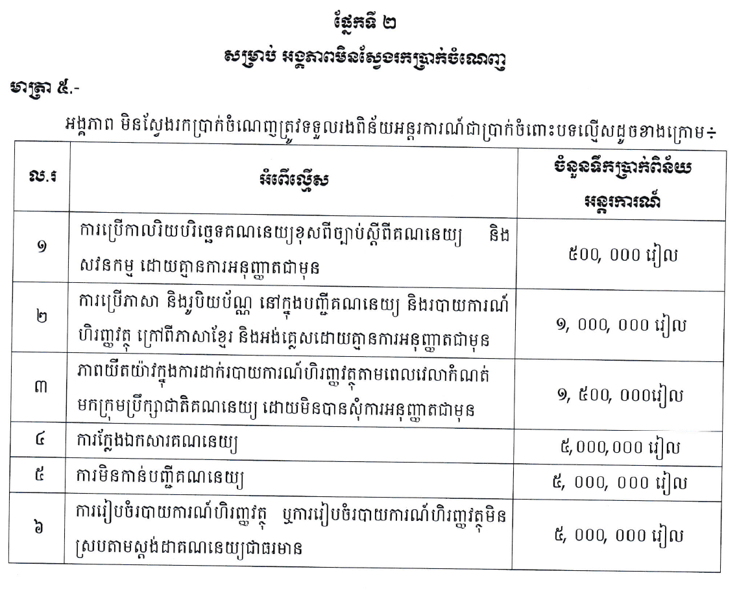
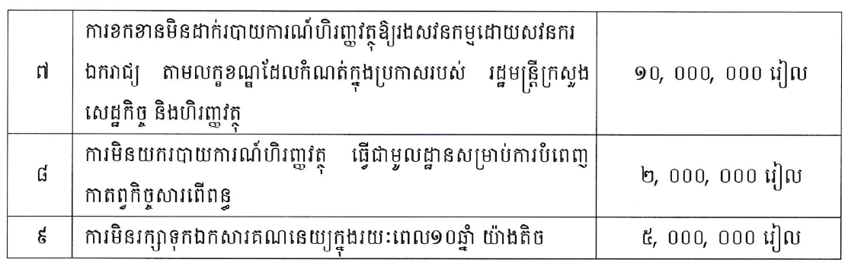
លេខ ២០៥ ក.ជ.គ ថ្ងៃ១៩ ខែមិថុនា ឆ្នាំ២០១៨
  សេចក្តីព្រាងអនុក្រឹត្យ និងសេចក្តីព្រាងប្រកាសទាក់ទងទៅនឹងគណនេយ្យ និងសវនកម្ម

