Slide 1


Global Standard For CSO Accountability

Slide 2
Presentation Outlines
Why Global Standard
Clusters, Commitments, and Key Actions
Accountability Standard Locally and Globally

Slide 3

Accountability Standard in Locally
Governance & Professional Practices Standards (GPP)
6 Heading, 25 Standards, 71 Indicators, 65 Guidelines

Slide 4


Asia Development Bank States about GPP

Slide 5

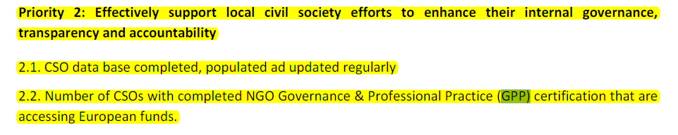
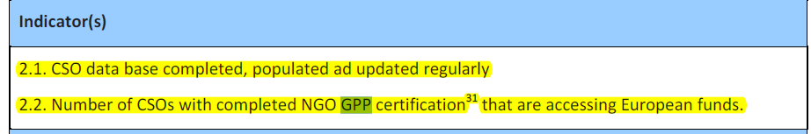
EU Road Map with GPP

Slide 6
Accountability Standard in Globally
Global Standard for CSO Accountability
Cooperation Committee for Cambodia and other managing code organization join together to develop the Global Standard

Slide 7
CHANGES IN CIVIL SOCIETY
Rapid growth in CSOs
Relevance, effectiveness and legitimacy in question
Declining public trust
Repressive laws, regulations and practices
Donor focus on innovation and impact
Proliferation of accountability

Slide 8







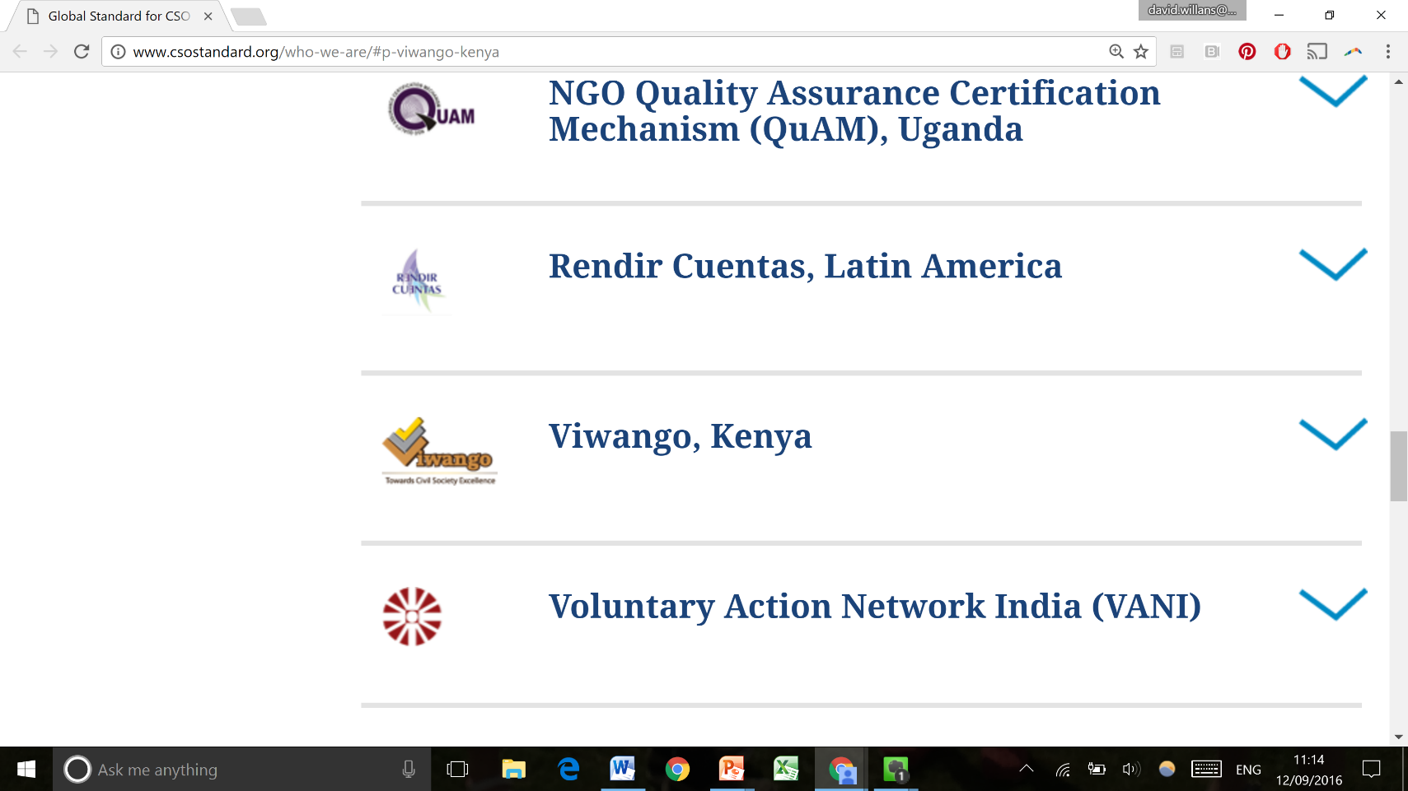




A STRONG NETWORK
Built by these nine organisations from around the world, jointly with a network of 1,500 CSOs globally

Slide 9
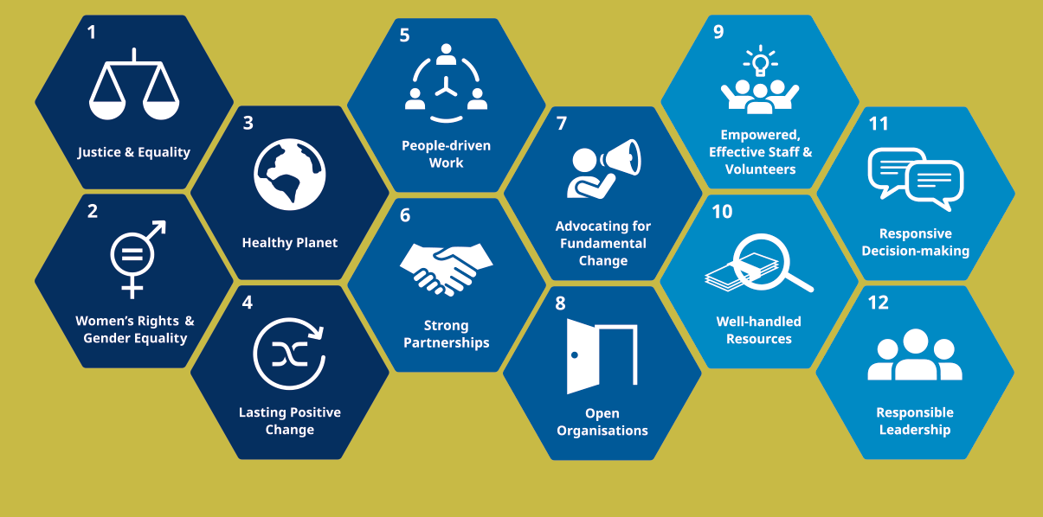
THREE CLUSTERS – 12 COMMITMENTS
CLUSTER A / WHAT WE WANT TO ACHIEVE
CLUSTER B/ OUR APPROACH TO CHANGE
CLUSTER C/ WHAT WE DO INTERNALLY

Slide 10

THE GLOBAL STANDARD FOR CSO ACCOUNTABILITY
  Builds on the Istanbul Principles and the rich experience across the CSO sector
  Deliberately aspirational and forms a powerful collective narrative for the role and contribution of CSOs worldwide
  Framed in simple language
  Provides a global reference of shared values and goals that can be contextualised

Slide 11
AIM
  Enhance existing and
  new accountability standards
  Reduce transaction
  costs
  Contribute to a more enabling CSO environment
  AIM
  To strengthen
  CSO effectiveness

Slide 12

Cluster A/What want to achieve
Key Actions
1.1 Listen to people, understand and address the root causes and effects of injustice, violence and inequality
1.2 Lead by example: Be inclusive, respect and promote human rights in our organization and make sure we do no harm ourselves
1.4 Collaborate with other actors to collectively address the Root causes and effects of injustice, violence and inequality and to ensure all people’s rights are respected and protected.
1.3 Support people to know their rights and to hold accountable those responsible for respecting, protecting and fulfilling them

Slide 13

Cluster A/What want to achieve
Key Actions
2.2 Lead by example: Address gender inequality and ensure women’s rights are respected in all we do
2.4 work closely with all parts of society, including men and boys, to drive lasting economic, political and social change towards women’s and girl’s rights and gender equality.
2.3 Empower women and girls to live more fulfilled lives
2.1 Listen to women, men, girls and boys to understand and address the root causes and effects of discrimination and gender inequality

Slide 14

Cluster A/What want to achieve
Key Actions
3.1 Listen to people and consult experts to understand the environmental issues faced by people and nature, and how to best address them
3.2 Lead by example: Map our organization’s environmental impact, minimize it to the extent possible and be open about our successes and failures
3.4 Collaborate with actors from different sectors to develop innovative and systemic solutions to environmental issues.
3.3 Motivate and support people to protect the environment and to promote systemic change for a healthy planet
Notes:
Definition COI, gift, asset, benefit, benefit, judge, commission (16)

Slide 15
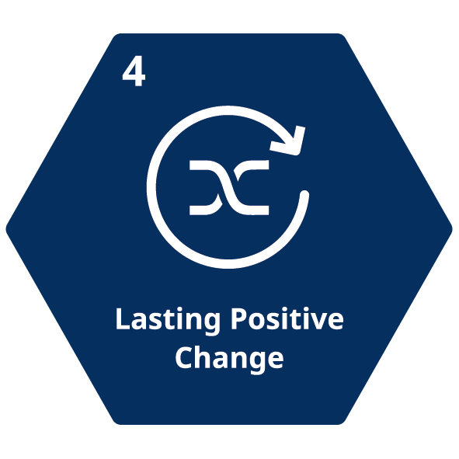
Cluster A/What want to achieve
Key Actions
4.1 Learn from people and partnerships where we can add most value to what already exists
4.2 Support people to have the information, resources and capacity to activity drive the changes we want to see collectively.
4.4 Collaborate with other actors in ways that build on once another’s strengthens and ensure accountability for our collective impact
4.3 Evaluate our long-term results in consultation with the people we work with, including unintended negative effects

Slide 16
Cluster A/What want to achieve
Key Actions
4.5 Continuously monitor, evaluate, learn, adapt and innovate with a focus on lasting results.

Slide 17
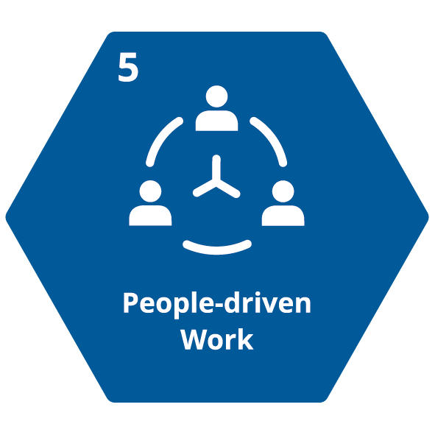
Cluster B/Our Approach to Change
Key Actions
5.1 Learn from people we work with and represent, so their issues are our goals
5.2 Support people in taking active roles to drive the change we collectively want to see
5.4 Invite and act on people’s feedback to improve our performance and collective impact.
5.3 Ensure that people’s views are well reflected in decision-making process at all levels of our organization.

Slide 18

Cluster B/Our Approach to Change
Key Actions
6.1 Identify organizations that work towards similar goals and build respectful partnerships that play to each other’s strengths
6.2 Ensure that the roles and responsibilities of our organization and our partners are clear and fair
6.4 Share information, resources and knowledge and make important decisions collectively.
6.3 Collaborate with different kinds of organizations to achieve shared goals
Notes:
6.1.2: code of conduct, work schedule, COI, sexual harrassment policy, recruitment, compensation, payroll, benefit, training, PA, disciplinary and terminate,
Arti: 12 (no discrimination), 65 (contract), 67 (timeframe of contract, type of contract), 68 (3month probation), 73(dissolve the contract), 96 (representative), 137 (8 hours per day), 161 (public holiday), 166 (annual holiday)

Slide 19

Cluster B/Our Approach to Change
Key Actions
7.1 Ensure our advocacy work is based on evidence and is informed by the views of affected people
7.2 Advocate for positive changes which address both root causes and their effects
7.4 Mitigate the risks for people involved in or affected by our advocacy.
7.3 Support people-including affected people to learn, connect, mobilize and make their voices heard

Slide 20
Cluster B/Our Approach to Change
Key Actions
7.5. Evaluate the effects of our advocacy in consultation with affected people.

Slide 21

Cluster B/Our Approach to Change
Key Actions
8.1 Share information on who we are, what we do, how decisions are made, the resources we have and the positive and negative impacts of our work
8.2 Share information in a timely and accurate manner and in ways which are accessible to all people
8.4 Provide opportunities for people to question our work and engage in constructive dialogue to reach a shared understanding where possible.
8.3 Establish and uphold clear procedures in our organization to respect privacy rights and protect personal data from misuse

Slide 22
Cluster B/Our Approach to Change
Key Actions
8.5. Ensure our communication and marketing is reflective of our values and protects people’s dignity and privacy.
Notes:
301 (conflict resolution), (way to solve the conflict by arbitration or agreed by both side)

Slide 23

Cluster C/What we do internally
Key Actions
9.1 Ensure that staff and volunteers share and act in line with our values and professional standards
9.2 Put in place recruitment and employment practices that are fair and transparent and value diversity
9.4 Involve staff and volunteers at all levels of our organization in our planning and decision-making and encourage leadership.
9.3 Encourage staff and volunteers to consistently improve their skills and provide them with the resource they need to do this

Slide 24

Cluster C/What we do internally
Key Actions
10.1 Acquire resources in ways that align with
our values, independence and goals.
10.2 Manage resources responsibly, using them for the causes they were provided for and in ways that maximize impact.
10.4 Report openly and transparently about who provides our resources and how we manage them.
10. 3 comply with professional accounting standards and ensure strict financial controls to reduce the risk of corruption, bribery misuse of funds, and conflict of interest.

Slide 25
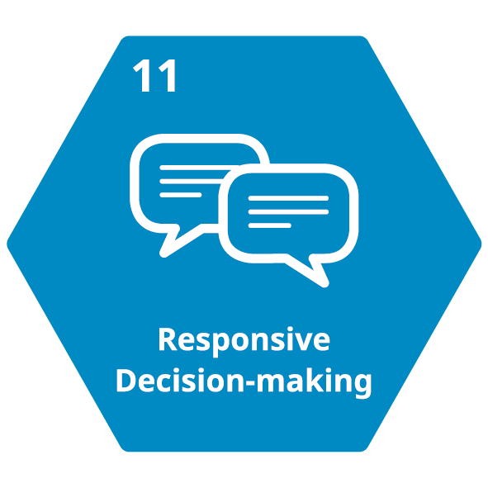
Cluster C/What we do internally
Key Actions
11.1 Invite and analyze feedback and complaints from key stakeholder groups to inform decision-making
11.2 Ensure decision-making processes at all levels are informed by and responsive to feedback from our stakeholders, especially from people affected by our work
11.4 Enable frontline staff and volunteers to respond to feedback and make decisions in real time.
11.3 Clarify and communicate how people can provide input and feedback into decision-making processes.

Slide 26
Cluster C/What we do internally
Key Actions
11.5 Communicate about the feedback received, how it was used and what changes have been made.

Slide 27
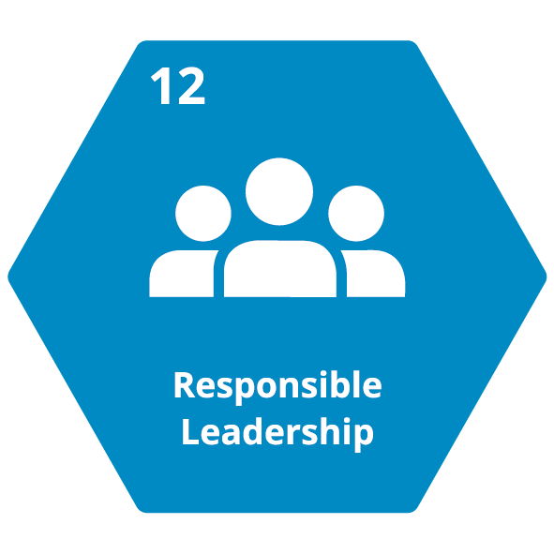
Cluster C/What we do internally
Key Actions
12.1 Ensure and independent governing body oversees our strategic direction, legal compliance, risk management and performance
12.2 Hold governing body and management equally accountable for delivering on our strategic goals and fulfilling the commitments in this standard
12.4 Support responsible, visionary and innovative leadership at all levels
12.3 Nurture a culture of accountability where all staff and volunteers feel a strong sense of accountability for their actions and impacts

Slide 28
Cluster C/What we do internally
Key Actions
12.5 Take interest and external complaints and disputes seriously, creating safe spaces and appropriate mechanisms to address them.

Slide 29
Question / Clarification ?
Thank You!

