Slide 1


Short Review on:
Sharing the Flesh Out practical exercise on
“Using Smartphone for Video Development”,
Presented at the previous ICT Learning Forum by:
Mr. Koy Borey, Executve Director, MEDIA ONE & Mr. Son Siveth, Advisor, MEDIA ONE
Review by: Chhouk Phalputhiridh,
Communications Specialist, CCC

Slide 2
Video Development
Development of storytelling and its impact
Development of Story Plan
Development of Storyboard
Interview & Vox-Pop
Video Shooting
Video Editing
1
2
3
4
5
6

Slide 3
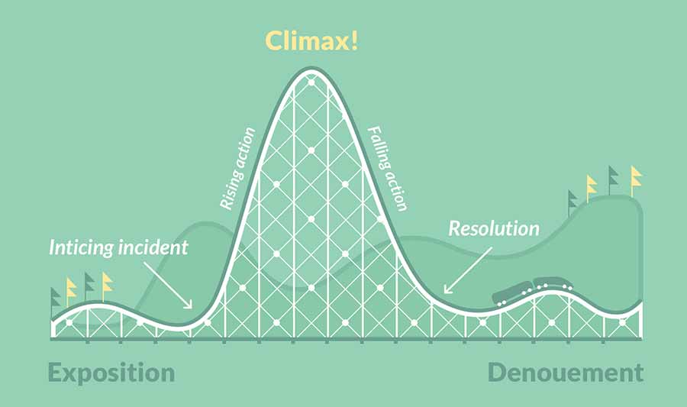
Development of story telling and its impact
តួអង្គសំខាន់នៃរឿងមិនមានជម្រើសតែនៅតែខិតខំបន្ត
ជម្នះបញ្ហា
តួអង្គសំខាន់នៃរឿងជួបប្រទះ​​បញ្ហា
ដំណោះស្រាយសមស្របនៅចុងបញ្ចប់​បន្ទាប់ពីចំណុចរបត់​ ឬការខិតខំប្រឹងប្រែង
ប្រឈមបញ្ហា
ដំណោះស្រាយ
ទីកន្លែង​​ និង ឬពេល
ចាប់កកើតនៃរឿង
ចំណុចចាប់ផ្តើម

Slide 4
Development of Story Plan
 | Short video ប្លង់រឿង | Picture ប្លង់រូប | Audio ប្លង់សម្លេង
Starting point
Problem
Challenge
Solution

Slide 5
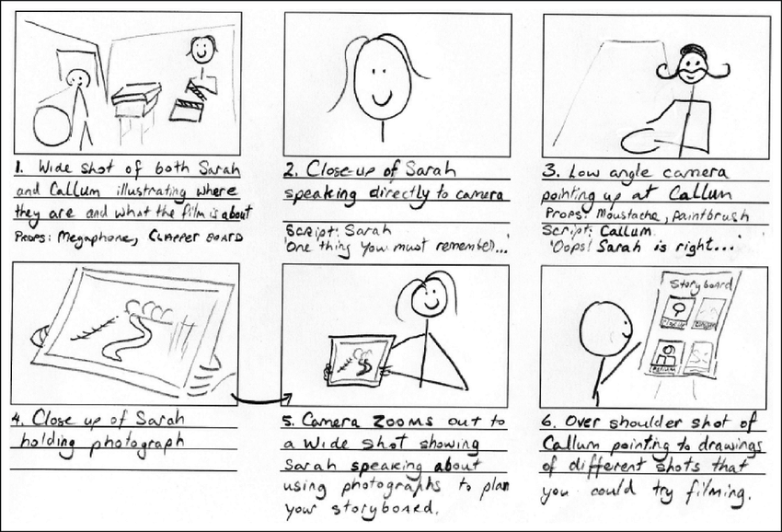
Development of Storyboard

Slide 6
Interview & Vox-pop
VoxPop:
  Using one question asking many people’s opinions in public on a particular topic.
  We use Vox-Pop to:
    get different opinions about something
    evaluate something, like services or products, etc.
  To do Video Vox-Pop:
    Keep your questions short, simple and easy to understand
    Ask the same number of men and women
    Do not stay in one place; ask different people in different areas to get different backgrounds
    Try to capture different emotions: funny, sad or angry

Slide 7
Interview & Vox-pop
Interview:
  Have a conversation between two people by using many questions to ask about particular topic.
  We use Vox-Pop to:
    get different opinions about something
    evaluate something, like services or products, etc.
  To do Video Vox-Pop:
    Keep your questions short, simple and easy to understand
    Ask the same number of men and women
    Do not stay in one place; ask different people in different areas to get different backgrounds
    Try to capture different emotions: funny, sad or angry

Slide 8
Interview Phases
Preparation Stage
Before the interview
During the interview
After the interview
Development Innovations

Slide 9
Preparation Stage
Draft your questions (open question, simple and easy)
Prepare the Consent Form
Know where the interview will take place (address, contact person)
    Prepare equipment
    Define role (interviewer and camera person)
Development Innovations

Slide 10
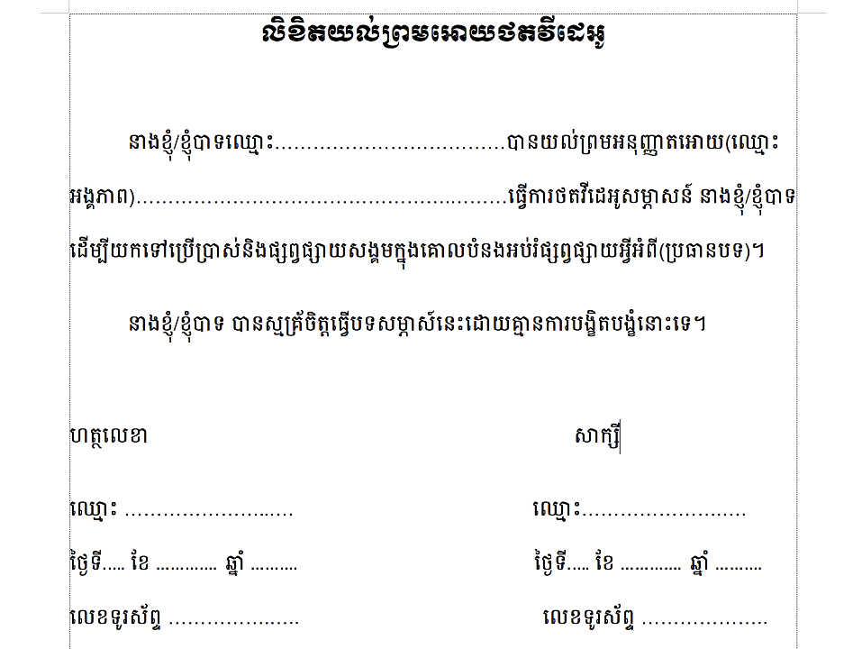

Slide 11
Before the Interview
  A. Interviewer
    Asking for permission (written consent is recommended or video record the consent)
    Check how you should address the interviewee (some people might have more than one position)
B. Camera person
    Set up equipment
    Test camera and sound by record a shot clip and play (level sound ok? Any background noise?)
    Say “Camera is ready” when ready to start
Development Innovations

Slide 12
During the interview
DO:
Be confident
Encourage them to answer with full sentence
If they don’t understand the question, simplify it rather than just repeating question
Maintain eye contact, nod and smile
Don’t:
Do not talk over the interviewee or finish their sentence
Do not reply “Yes...Oh...“
Don’t make noise
Development Innovations

Slide 13
After the interview
A-Interviewee:
  Check if you’ve covered all questions
  Make sure you have all the information (name in Kh&Eng, title, phone, collect name card if possible)
  Thank them
  Never guarantee it will be broadcast
  B-Camera person:
    Check if your video recorded. Is the sound ok?
Development Innovations

Slide 14
Video Shooting & Editing

Slide 15
Part II: Writing a good content for social media

Slide 16
Writing a good content for social media
Don’t be tell “me me me”
Don’t be afraid to be brief
Use extra punctuation
Ask a question and say “You”
Avoid Abstract Titles
Tell people what to expect
Check your spelling and grammar
Don’t forget your context
Don’t auto-post your context

Slide 17
Thank You!!

