Slide 1


GHP and Its Key Achievements 2018
Challenges
Working Groups Reflection Meeting
Tonle Bassac II, 14 November 2018
By: EL Sotheary, HOP
^{Vision:} Sustainable Development for Cambodia

Slide 2
Presentation Outlines
About the GHP Phase 3
Key Achievements
Voluntary Working Groups

Slide 3

1. About the GHP Phase 3

Slide 4


Slide 5

Increased capacity of CSOs
NGO governance and org. management
Knowledge sharing and management
Improved MSP for effective cooperation
Research and evidence informed finding
Platforms for MSI and development challenges
Strengthened membership and secretariat
CSO knowledge and information hub
CCC membership
Public communication of CSOs
Income diversification for CSOs
CSO use of critical program approach
Capacity of CBOs on governance and sustainability
CSO association and network
Performance of the CCC secretariat

Slide 6
2. Key Achievements

Slide 7
SO1: Increased Capacity of CSOs for Innovative Response to Development Challenges

Slide 8
SO1: Increased Capacity of CSOs for Innovative Response to Development Challenges
  88 certificates awarded and 229 applications stay in the system so far. Five other NGOs potentially become certified this year.
  Expanding mutual benefits from the Global Reference Standards project for CSO Accountability
  Balancing the GPP certification system: more adaptive, more responsive and more supportive.

Slide 9
GPP Revision
Impact study from the current system
Decision on the new modality
Process and Innovation of the new modality
Application of the new modality

Slide 10
SO1: Increased Capacity of CSOs for Innovative Response to Development Challenges
  Revisiting and polishing the Holistic Institutional Development package for NGOs:
    Good governance
    Effective program/project management, including DNH
    Resource mobilization
  Realizing the benefits from the learning forum, making them beyond learning….
  Expanding the learning forum opportunity on resource mobilization

Slide 11
SO1: Increased Capacity of CSOs for Innovative Response to Development Challenges
  Increasing demand on mentoring and coaching service: awareness and practicality on the governance documents
  Strengthening the governance for local NGOs
  Polishing the capacity development packages for CBOs:
    Capacity need assessment and curriculum
    Training of facilitator
    IEC materials
    Exchange of best practices…

Slide 12
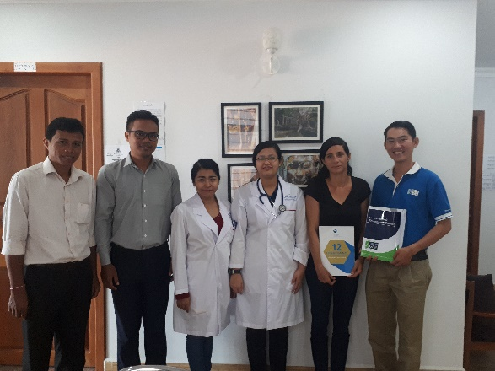
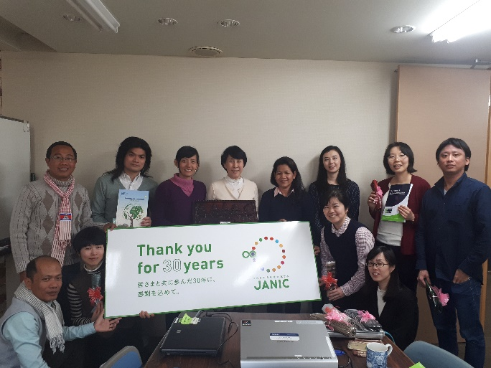
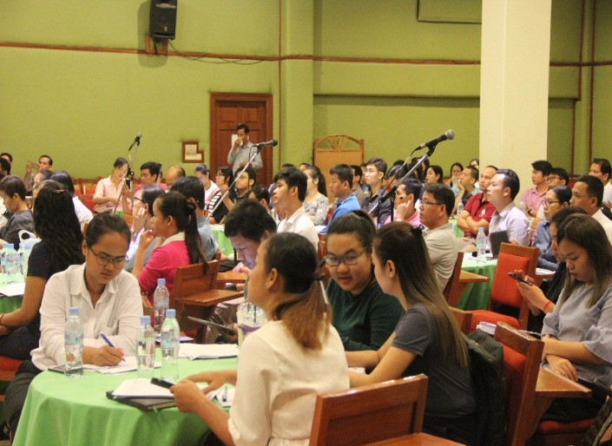
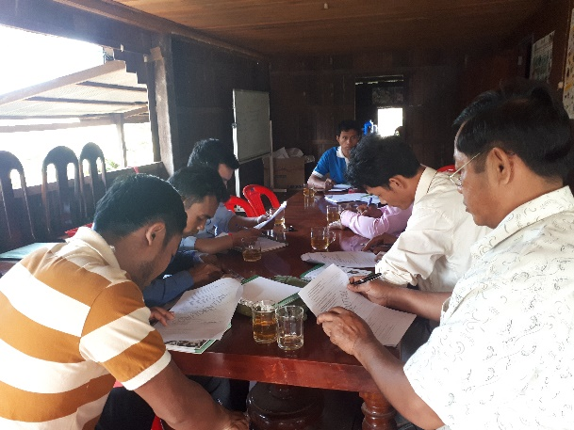

Slide 13
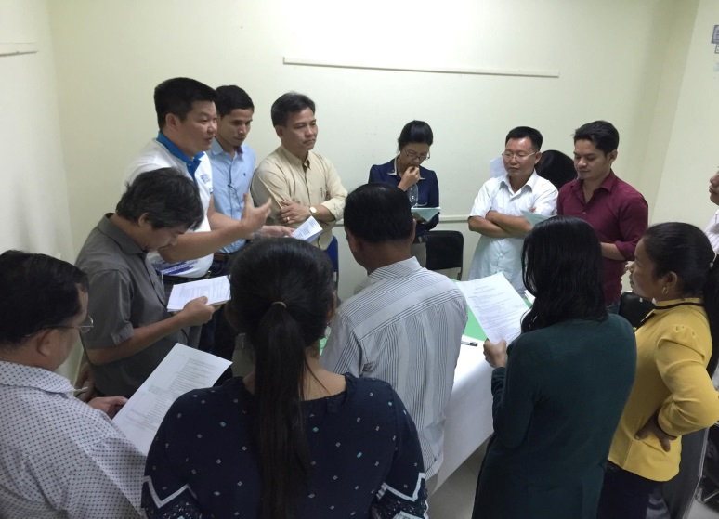
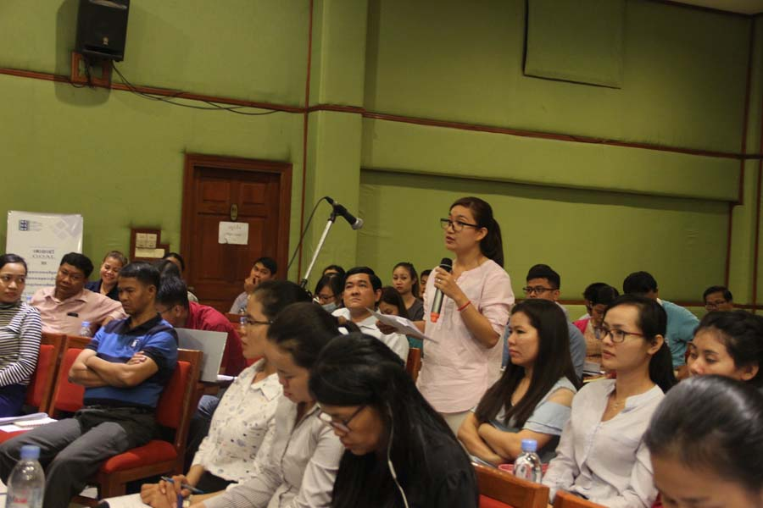
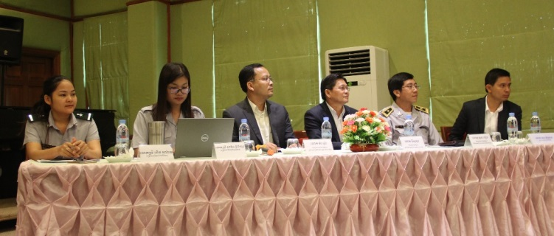

Slide 14
SO2: Improved Multi-Stakeholder Partnership for Policy Development
Done
In Progress
To Be Done
Impact and revision of the GPP
Civil society sustainability index
Capacity need assessment and HID for NGOs
Capacity need assessment for CBOs
Enabling environment and MSP for CSOs
CSO census and contribution
CCC Member satisfaction
Business Plan for CCC
Public image of CSOs
  Research

Slide 15
SO2: Improved Multi-Stakeholder Partnership for Policy Development
  Improved awareness and compliance capacity towards legal framework (LANGO, Taxation Law, Labour Law, NSSF, Accounting and Auditing Law)
    MoU with DFDL and LAC
    Learning forum on legal framework
    Dialogue mechanisms with relevant ministries
  Confirmed the necessity of multi-stakeholder partnership within the ISAF and SNDD process
  Important roles of CCC recognized within the GPEDC and CPDE process: monitoring report, pilot initiative…

Slide 16
SO2: Improved Multi-Stakeholder Partnership for Policy Development
  Fundamental capacity of the provincial NGO networks spilled over to 15 provinces
    Functionality of the provincial NGO networks
    Network instruments
    Capacity development materials
  CSO Fund brought into function
  Dialogue mechanisms established with influential DPs
  Representation of CCC strengthened at the global level
  Sensitized SDGs agenda among the stakeholders

Slide 17
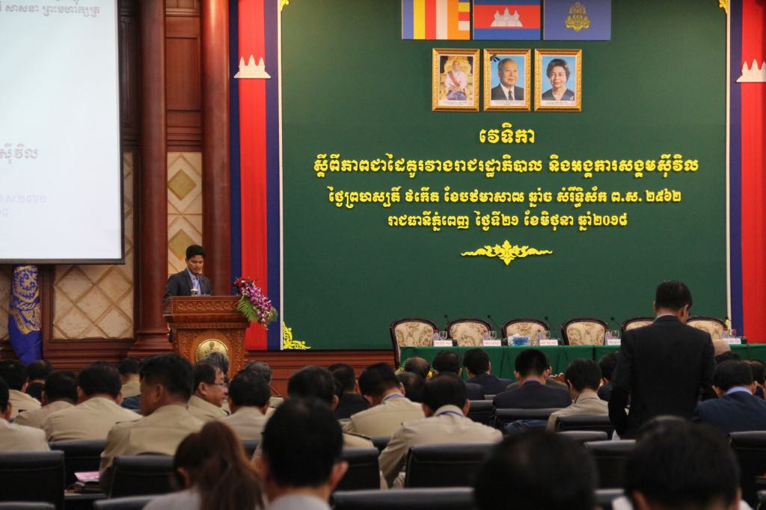
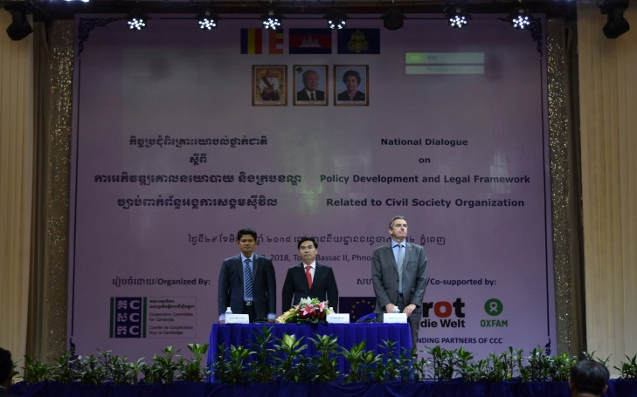
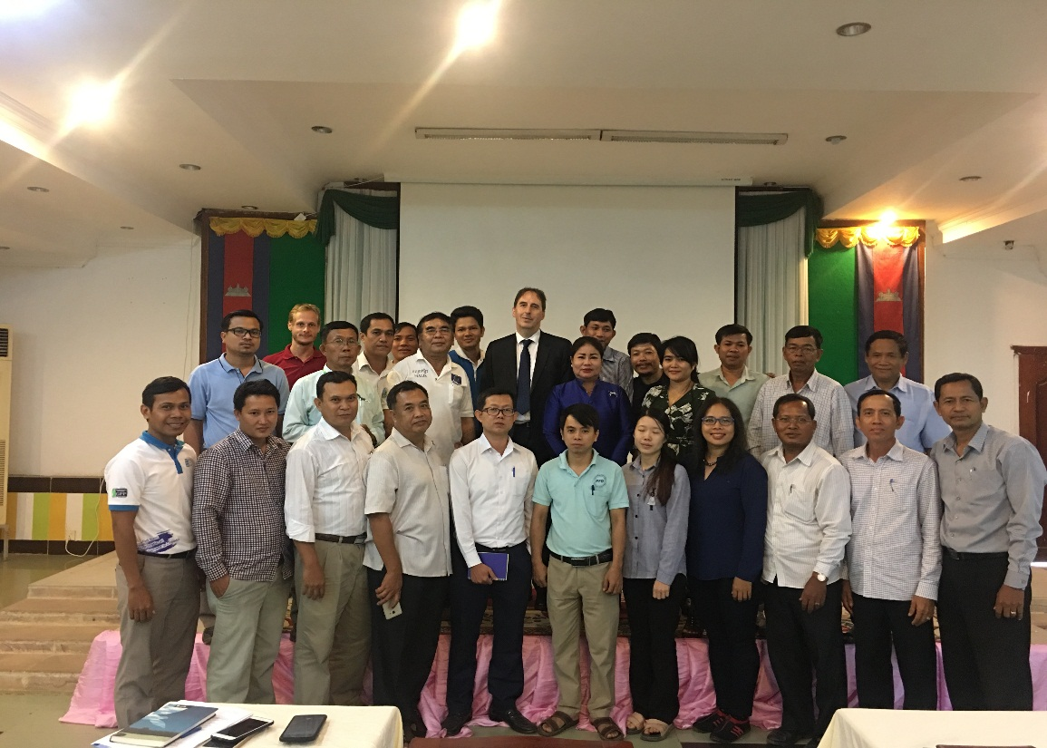
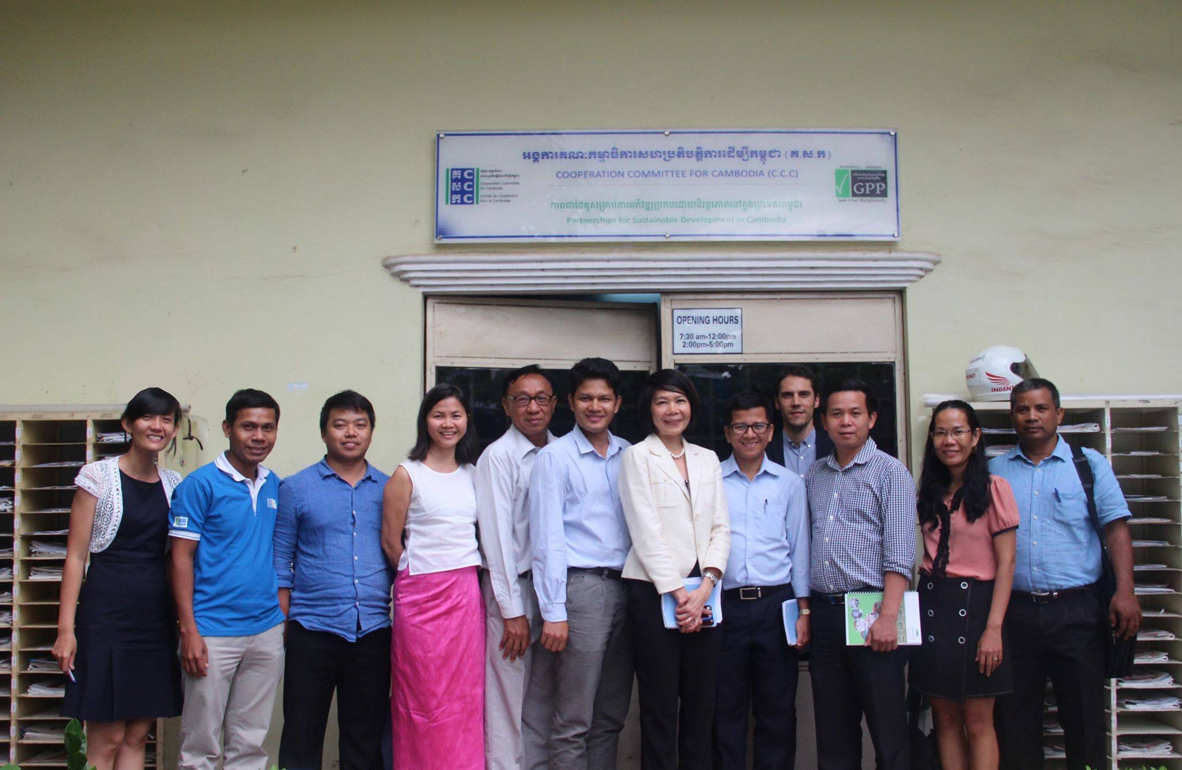

Slide 18
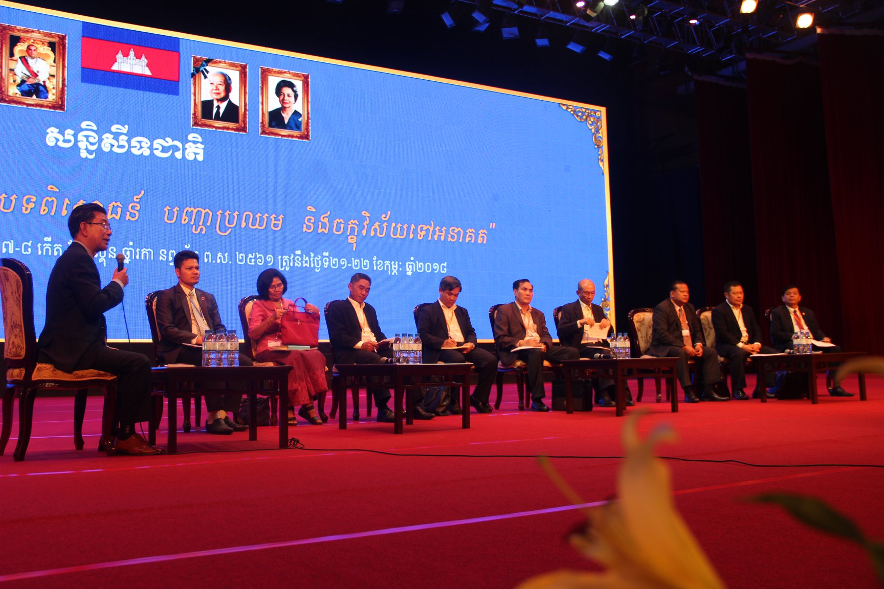
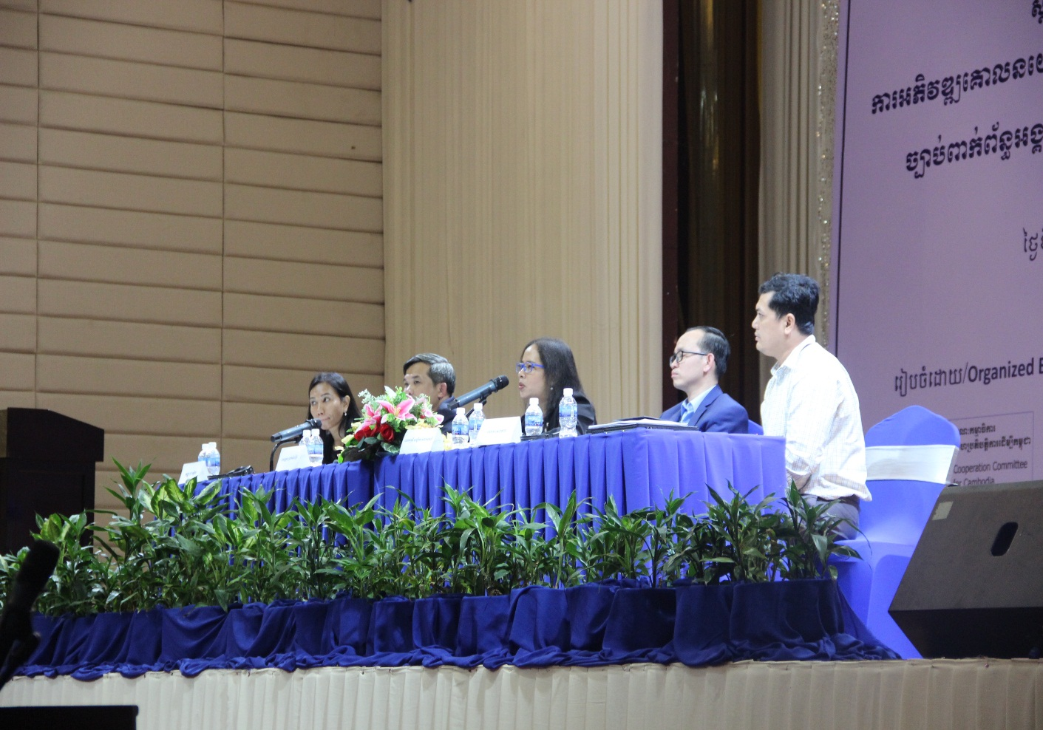
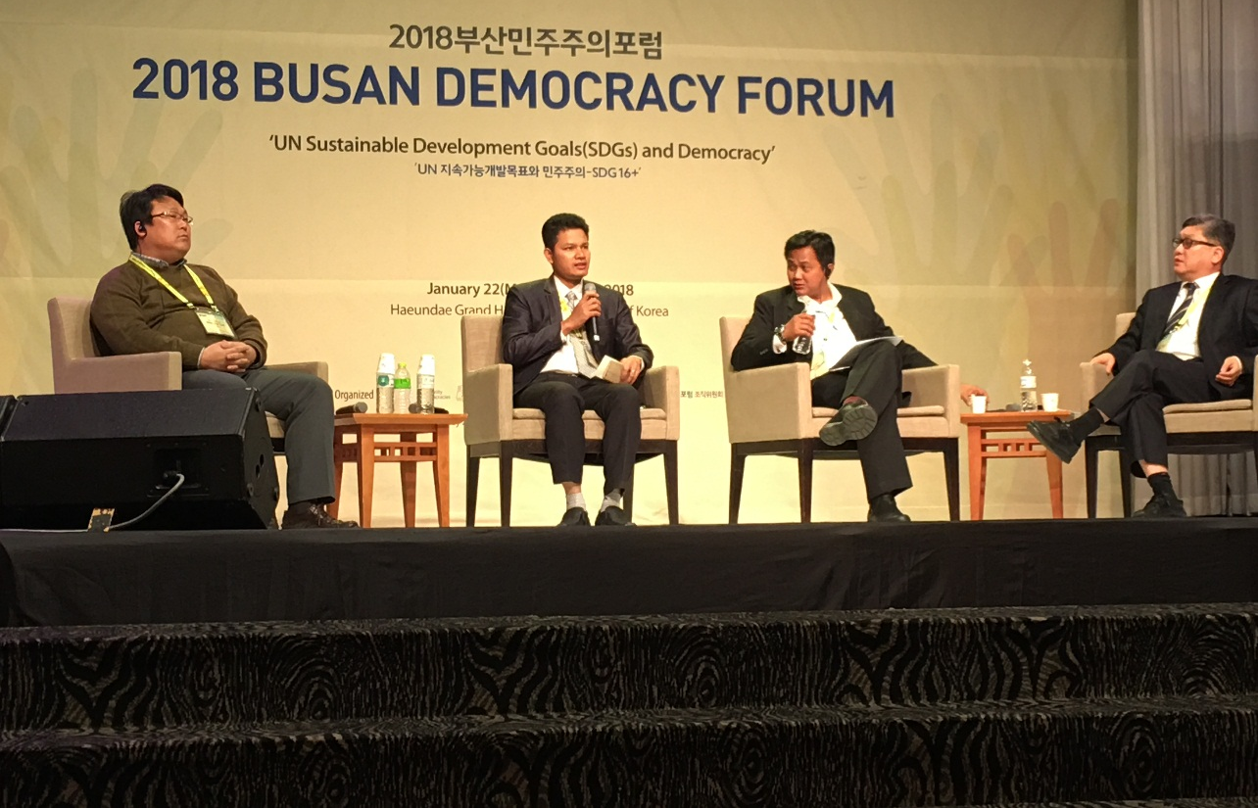
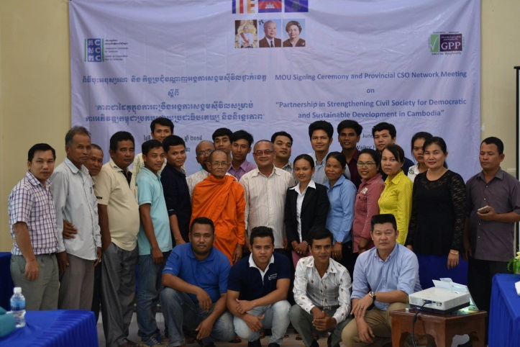

Slide 19
SO3: Strengthened Active Participation of CCC Members and Innovative Services of CCC
  Strong system in place: HR system, Financial management system, M&E system (SRI), Visibility and Communication….
  Outstanding support from the ExCom, funding partners, members, voluntary working groups…..
  10 new members admitted, making the current list of 175 members and a few more are observing
  Most of the required positions are on board
  Opportunity for staff capacity development according to their needs
  Realized the strength of team work: One team, One dream

Slide 20
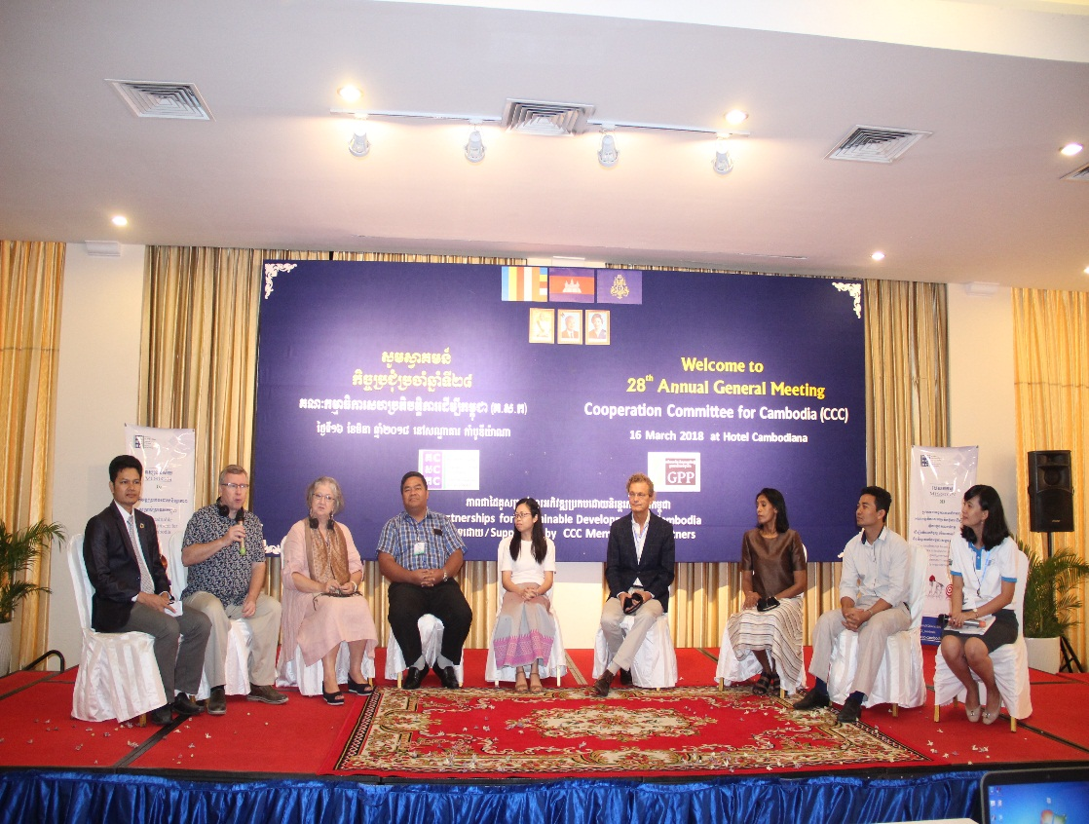
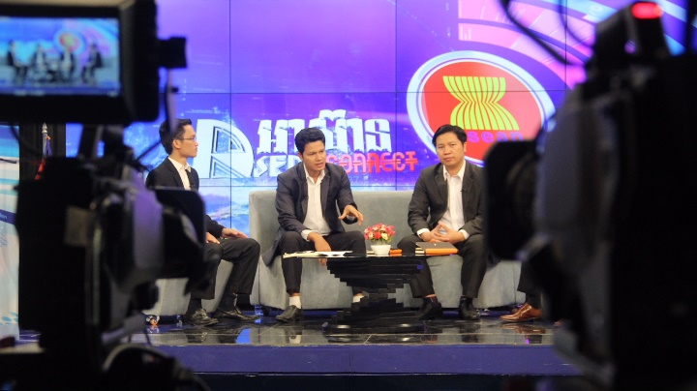
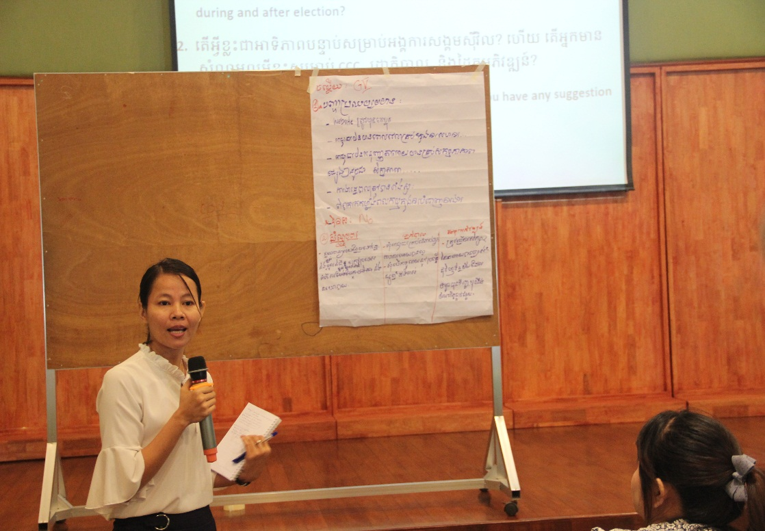
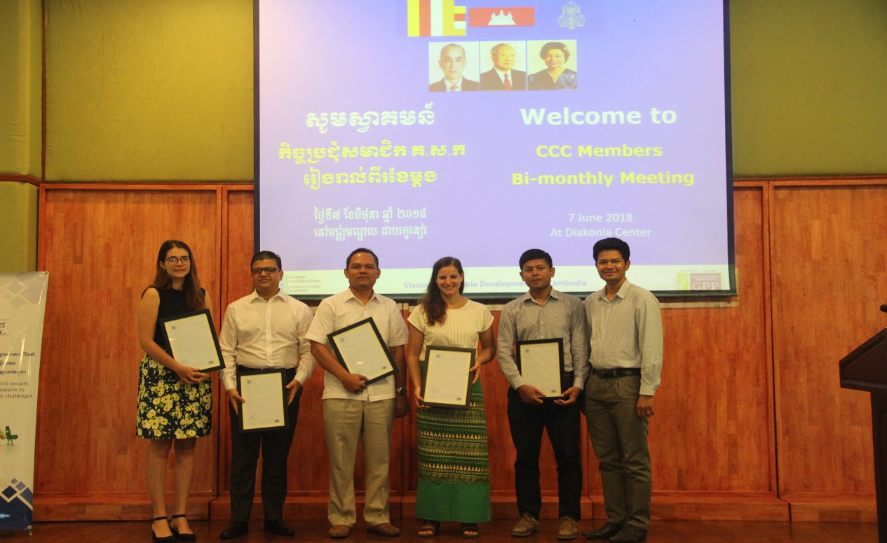

Slide 21
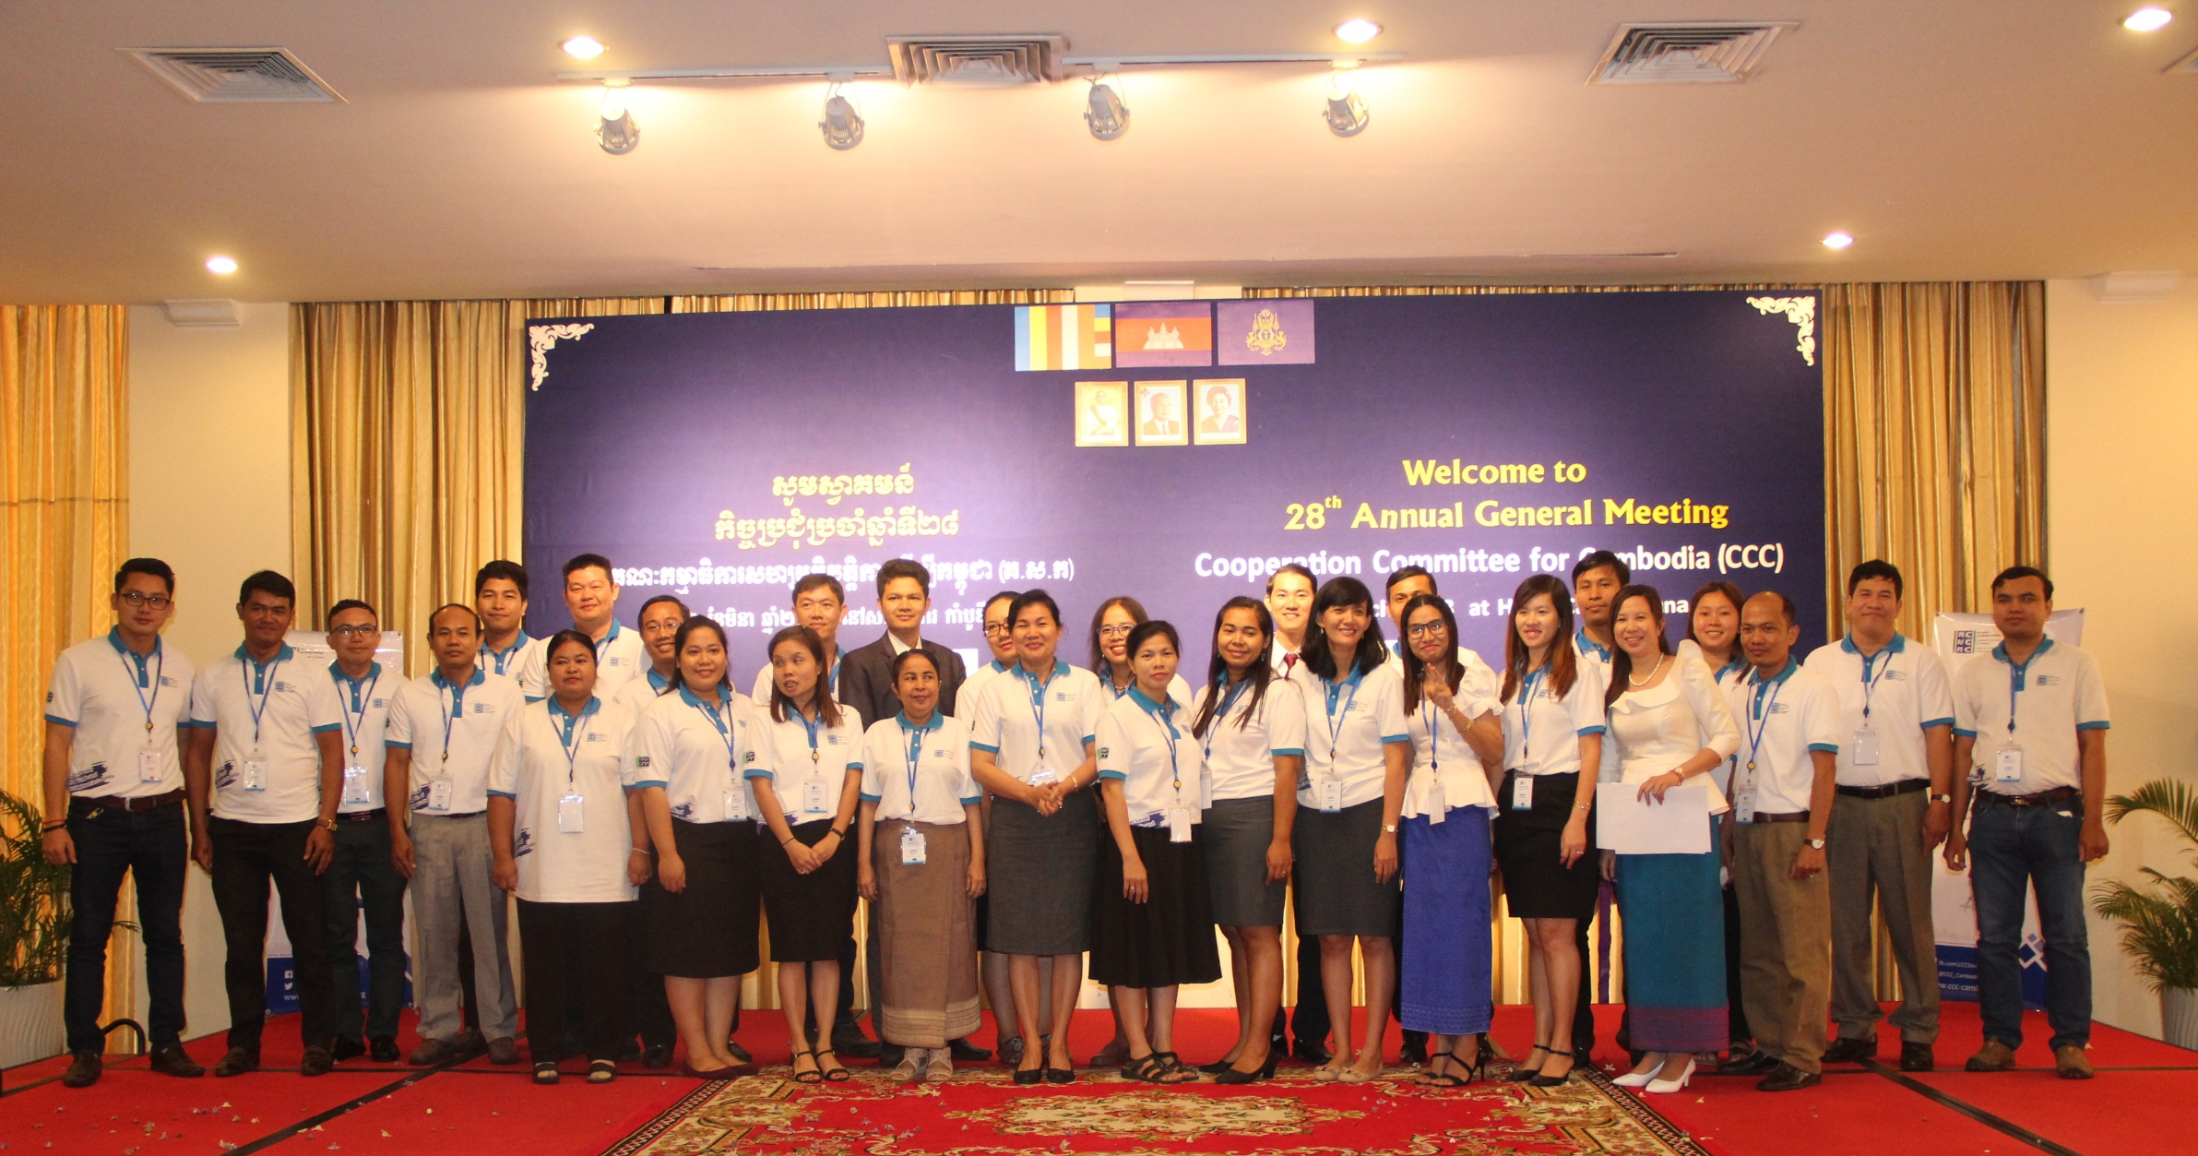

Slide 22
SO3: Strengthened Active Participation of CCC Members and Innovative Services of CCC
  Strong system in place: HR system, Financial management system, M&E system (SRI), knowledge management, online platforms….
  Important roles and visibility of the CCC membership platform
  Strong support structure and commitment from the outsider experts:
  A. Organizational Voluntary Support Structure, and
  B. Organizational Affiliation with other institutions.

Slide 23
3. Voluntary Working Groups

Slide 24

Organizational Voluntary
Support Structure
ExCom 7
Local governance 15
DNH 20
Taxation 17
CBO 18
GPP WG 10
CSO Fund 9
NCCC 7
FM WG 12
HRM WG 12
ICT WG 12
M&E WG 12
RAB 14

Slide 25
Affiliation with
Other Institutions
Affiliation with CSOs
MoUs with provincial NGO networks, ADA, ADN, Civicus, FoRUS, etc.
Engagement with the Government
Through the 4 TWGs (P&H, PPR, PAR, D&D)
Engagement with DPs
EU-CSO dialogue, UN-CSO dialogue, Meetings with DPs, Meeting with funding partners
Engagement with Private Sector
Through ISAF etc.
CSR platform
OECD Watch etc.

Slide 26

Financially Healthy
But
Are we there yet?
Let’s find out some challenges and see how we can get there together

Slide 27


4. Q&A and Discussion

