Slide 1


Welcome
Civil Society Academy (CSA)

Slide 2


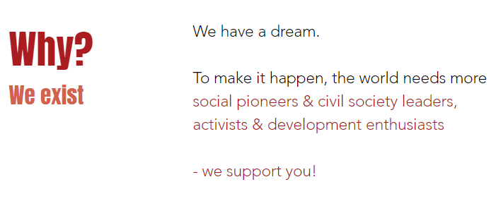
About CSA
Notes:
Why we exist: To generate power for social pioneers through excellent capacity and talent development.

Slide 3


Slide 4



Slide 5
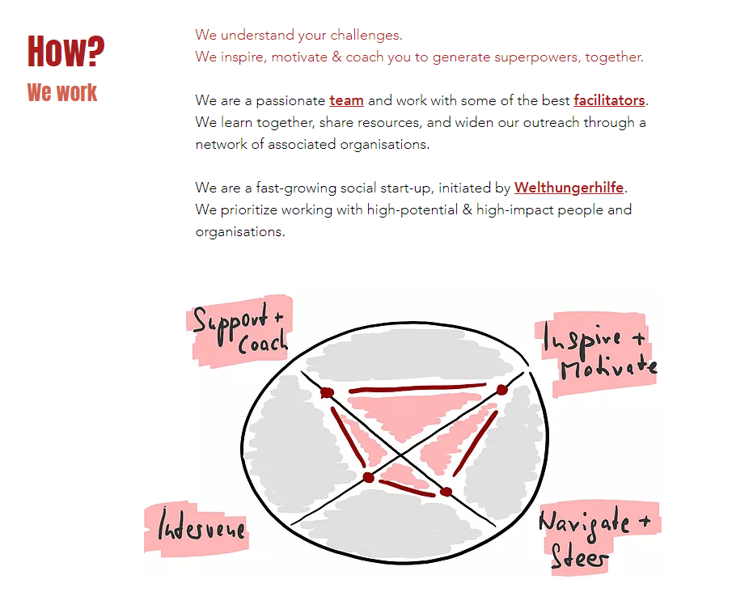

Slide 6
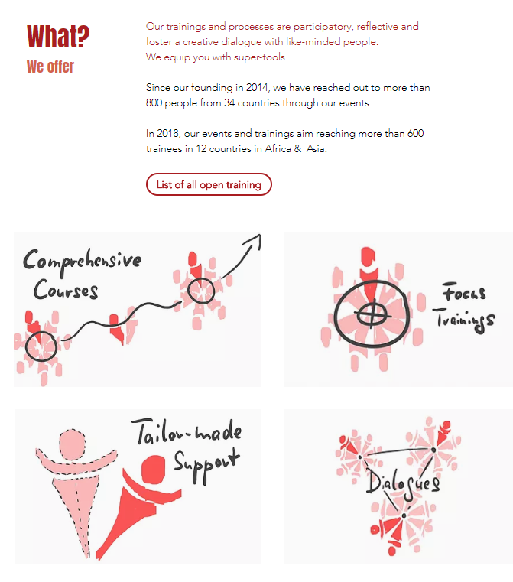
Focus Trainings
3-5 days | many locations in Asia & East Africa
Leadership & Management Series
The Social Start-up
Social Accountability
Achieving Nutrition Outcomes
Fundraising for Civil Society
Comprehensive Courses
10-13 training days | 2 workshops + coaching/mentoring
Leadership in Civil Society
Advocacy to end Hunger and Poverty
Programme Design
Civil Society Dialogues
Networking events | Connecting & sharing
​
Civil Society Dialogue
Making SDG 2 work
Tailor-made Support
Your challenges | Our expertise
Overview Tailor-made Support
Become more innovative

Slide 7
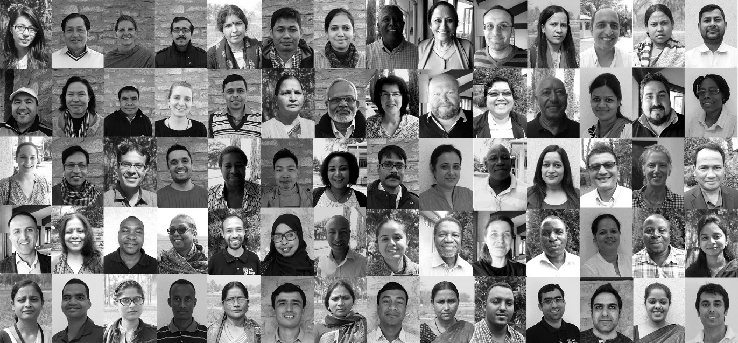
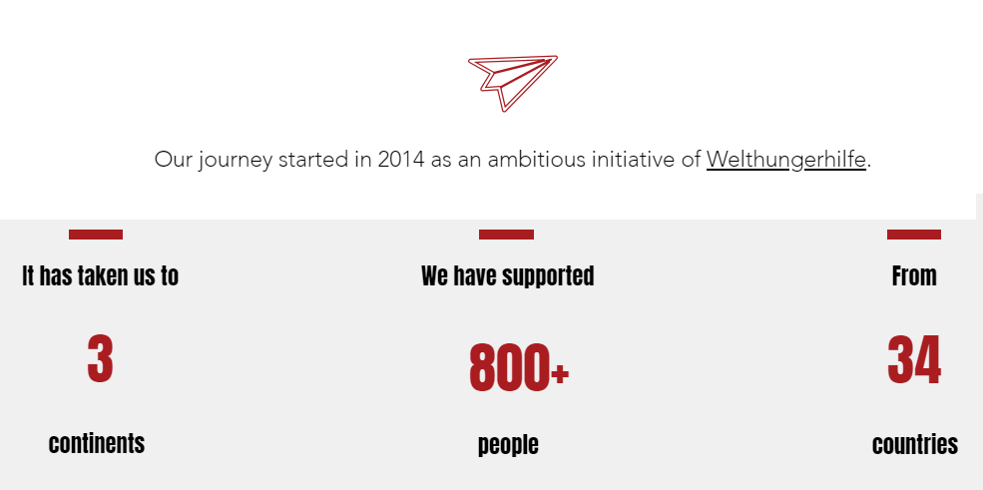
CSA Journey
Targets | No | %
Civil Society Dialogues | 256 | 30
Comprehensive Courses | 158 | 18
Focus Trainings | 216 | 25
Tailor-made Support | 193 | 23
Training of Facilitators | 36 | 4
859

Slide 8

Our Team
Core team: To be extended (in Africa) and increase 7 member incl. Monireth
Core team: 6 members incl. Dirk, Soeurth, Trang
Core team: 3 members incl. Aldo
Core team: 2 members incl. Sohini
Core team: Joachim
2018
2017
2016
2015
2014

Slide 9
Our Facilitators

Slide 10


Slide 11
PRICING
Comprehensive Course
No | Description | Price | Early Bird (10% off) | Group Register (10% off)
1 | Exceptional Leadership in Civil Society (Modul 1 in South East Asia and 2 in South Asia) | 2700 Euro | 2430 Euro | 2430 Euro
2 | Program Design in South Asia (New Delhi and Ethiopia) | 1900 Euro | 1710 Euro | 1710 Euro
3 | Advocacy to End Hunger and Poverty | 1500 Euro | 1350 Euro | 1350 Euro
Focus Training course
1 | Leadership and Team Management | 460 Euro | 414 Euro | 414 Euro
2 | Cooperative and Communication Skills
3 | Fundraising for Civil Society
4 | The Social Start-Up
5 | The Social Accountability
6 | Achieving Nutrition Outcomes (incl. Accomm.) | 520 Euro | 468 Euro | 468 Euro
Notes:
There are the slots of scholarship but we do not provide full scholarships and a final confirmation can only take place after the registration deadlines end. For the Leadership and Management Series. In case an organization register for the full series, we´ll provide 25% discount.

Slide 12

Civil Society Academy (CSA)
Ms. Monireth TOY
South East Asia Outreach and Customer Relations
Civil Society Academy (CSA)
Phone : +855 23 223 661
Mobile : +855 17 728 895/98 728 895
Email : monireth@civilsocietyacademy.org or
Monireth.toy@Welthungerhilfe.de
Website : www.civilsocietyacademy.org
Facebook: www.facebook.com/civilsocietyacademy
Twitter: @CSA_Globe

