Slide 1


Welcome to
The 21st Financial Management Learning Forum
On
“Cambodian Taxation and Law”
27 March 2018, 8:00-5:00pm,
Diakonia Center
^{Vision:} Sustainable development for Cambodia.

Slide 2
Objectives
1
Refresh the practitioners on how to make Internal Control be strong and Manage Financial Risk & Analysis
2
Practitioners well understanding how to compliance taxation and law of Cambodia
3
Create a learning and sharing environment, build stronger network of finance practitioners among CSOs community and tax authority effectively.

Slide 3
Key Agendas
Speakers
Open Remarks
Mr. Khorn Bunthong, Head Of Operation, CCC
Refreshing Sessions
Ms. Ken Sopheap, Finance & Admin Manager, Heinrich Böll Stiftung
Sharing on Cambodia Taxation & Law
ឯ.ឧ. វ៉ាន់ ពុទ្ធិពល
Way Forward, Selection Topic &Evaluation
Ms. Keo Mara, Learning Specialist, CCC
Closing Remarks
Overall Introduction and Objectives
Mr. Khorn Bunthong, Head Of Operation, CCC
Ms. Keo Mara, Learning Specialist, CCC
អគ្គនាយករងនៃអគ្គនាយកដ្ឋានពន្ធដារ

Slide 4
The CCC Learning Forum
06 November 2018
24 May Every Year
ICT Learning Froums
05 September Every year
25 April Every year
Human Resource Learning Froums
15 August
Every year
27 March
Every year
Finance Learning Froums
Mornitoring & Evaluation Learning Forums
25 October Every year
14 June Every year

Slide 5
Contribution Fee
CCC offers Learning Forums on ICT, M&E, HR and FM. It opens for CCC’s members and non-members. However, for the non-members are required to contribute 50.00 USD for each person/Forum.

Slide 6
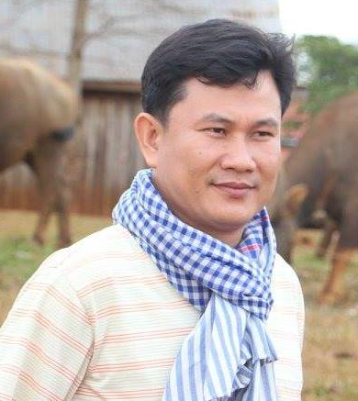
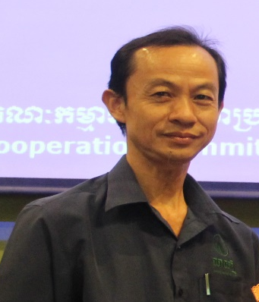
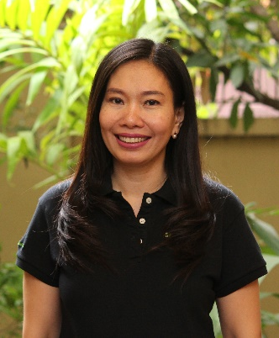
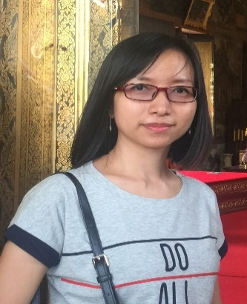
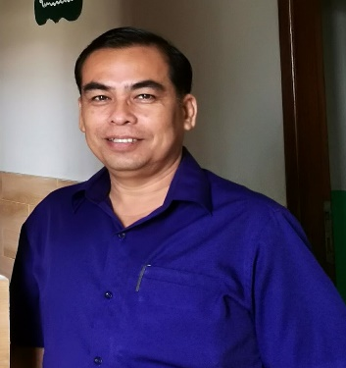
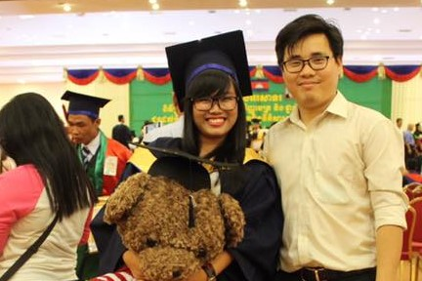
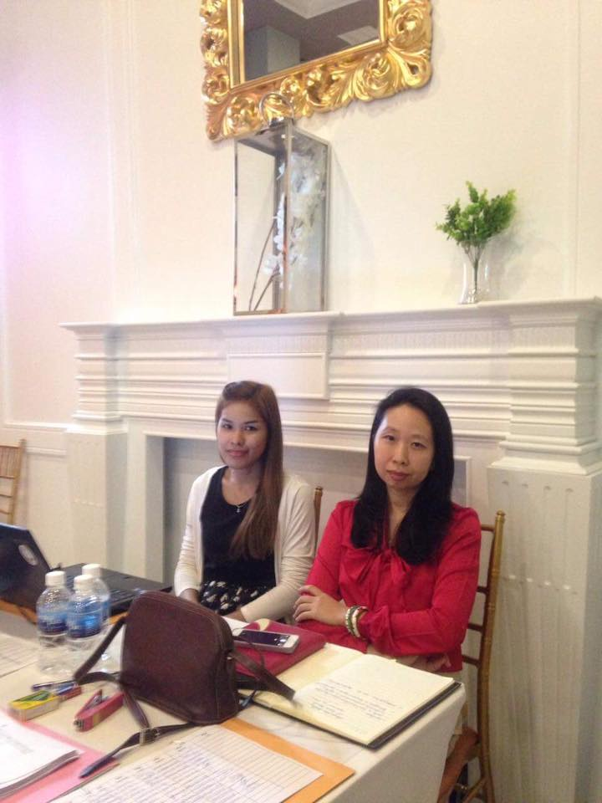
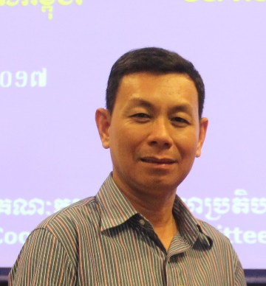
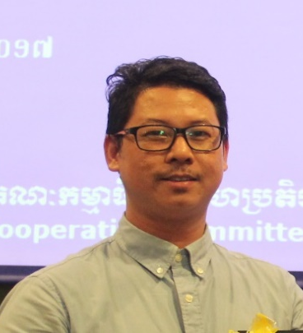
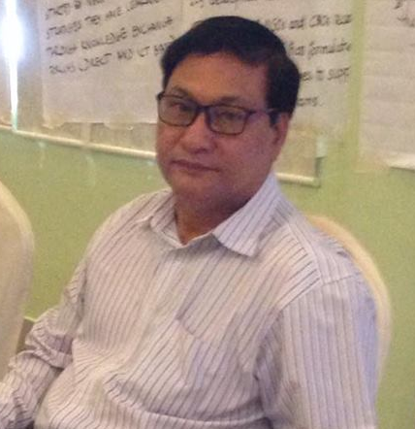
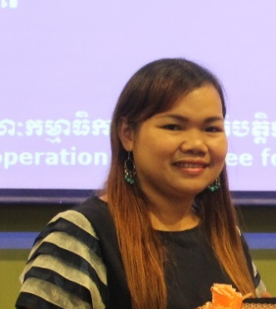
Financial Working Group Members
Mr. Meas Kheang , Operation Director, (CCIM)
Mr. Chhoeu Chhardaphea
Compliance Manager, iDE
Ms. Ken Sopheap, FAM, Heinrich Böll Stiftung
Ms. Uk Saysokonthea
FAM, Forum ZFD
Mr. Ok Libounna
Independent Consultant
Mr. Try Sokha
Head of Finance, MSIC
Ms. Bun Monyrod,
FAM, HACC
Mr. Cheng Rithy
Finance & Operations Director, PSI/C
Mr. Ky Sophan
Finance & Admin Manager, CPN⁺
Mr. Om Nareth,
FS, CCC
Ms. Leang Seila
CA, Plan International

Slide 7
HR WG Members
M&E WG Members
ICT WG Members

Slide 8
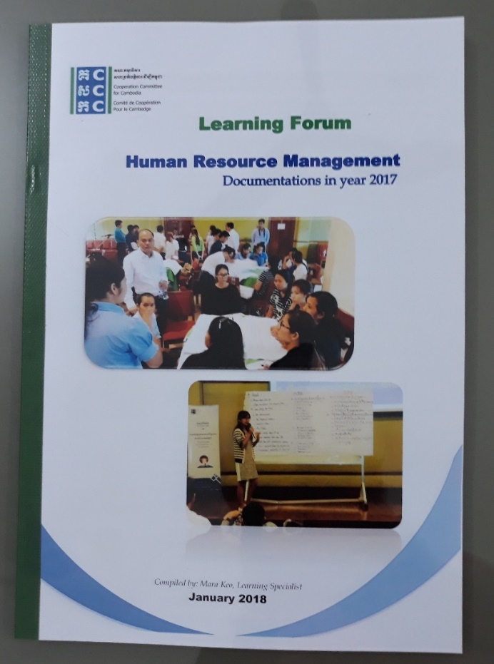
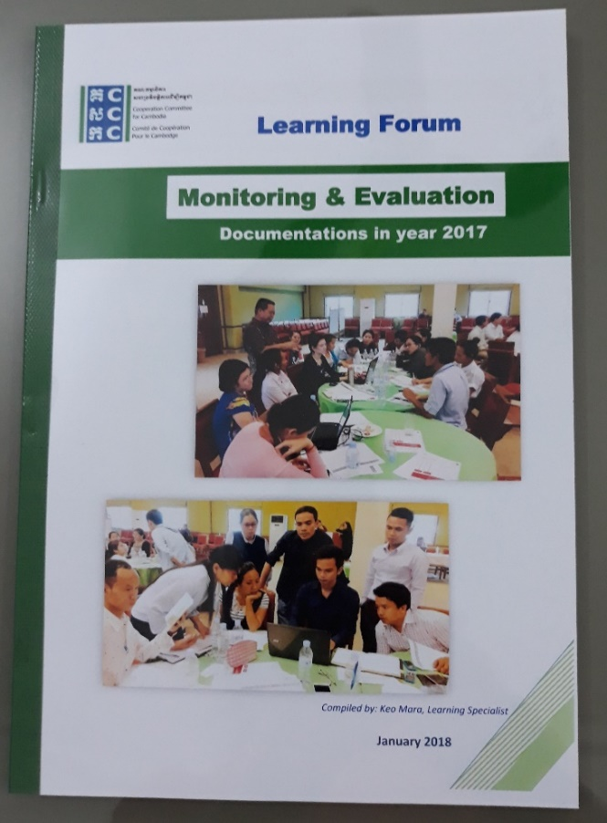
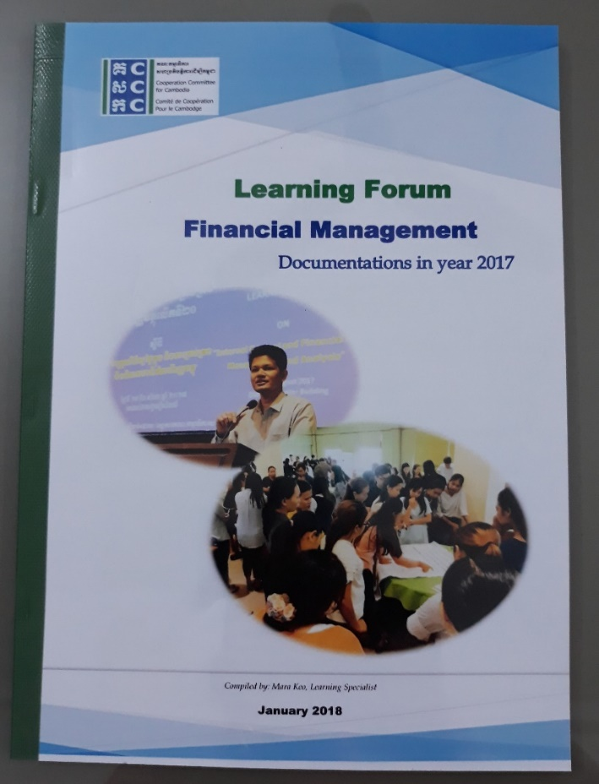
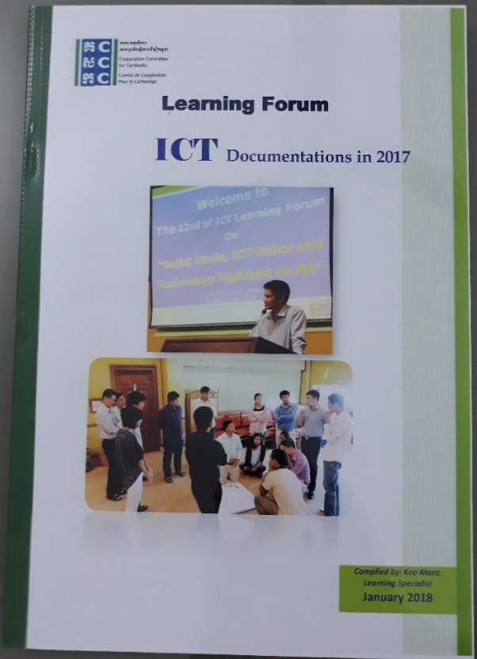
Learning Forum Documentations in 2017

Slide 9
HRM Learning Forum
25/4/2018, Diakonia Center, 8:00 -5:00pm
Learning Announcement
“ Law Compliance ”
National Social Security Fund (NSSF)
Work Permit / Workbook
Taxation compliance

Slide 10
Refreshing Session
Internal Control
And
Financial Risk Management and Analysis
Ms. Ken Sopheap
Finance and Admin Manager,
Heinrich Böll Stiftung

Slide 11
Internal Controls
Presented by:
Mr. Chhoeu Chhardaphea
Compliance Manager, IDE
1
What are Internal Controls?
2
3
What are Management Role & Responsibility?
4
What are Types of Internal Controls?
5
What are Special Policies?
Why Internal Controls are Important?

Slide 12
1. Internal Controls are the methods and procedures used:
1. To protect assets,
2.. To ensure accounting information is correct
3. To deter and detect fraud and error
4. To ensure operations run efficiently
5. To ensure policies set by management are being followed.

Slide 13
2. Why Internal Controls are needed?
Internal controls reduce the temptation to steal because of the likelihood of detection.
Strong internal controls help the staff to do the commitments.
Internal controls and systems help the staff and the organization to be more accountable for the funds given.

Slide 14
1- Establishing a good system of internal controls at projects and its offices.
2- Establishing a good system of internal controls at projects and its offices.
3- Be informed of problems, issues and any suggestions for improvement.
3. Management Role and Responsibility

Slide 15
1. Competent, trustworthy staff with clear lines of authority and responsibility
9. Preparation of financial reports
2. Organization Structure
3. Physical control over assets and records
4. Level of authority
5. Adequate documents and records
6. Independent checks on performance
7. Segregation of duties and responsibilities
8. Proper procedures for record keeping
4.Types of Internal Controls

Slide 16
8. Special Policies are:
1. Commissions, Gifts and Bribes
2. Fraud and Other Irregularities
3. Approval
of Personal Expenses
4. Lost or Stolen Assets
5. Private Use of Organization’s Properties
➔ Inappropriate segregation of duties increases the probability of fraud, carelessness, and unreliable record keeping.

Slide 17
4Ps are Important
Policies and Procedures
People
Participation
Promotion

Slide 18
Internal Controls Checklist Summary
Well documented policies
Supervision/ Performance Reviews
Segregation of duties
Security of Assets
Approvals, Authorizations, Verifications
General information systems controls
Reconciliations
Internal and external audits

Slide 19
Financial Risk Management and Analysis
  Overview Risks
  Risk and Uncertainty
  Types of Risks
  Who does Risk Management?
  Effective Risk Management
  How to manage the Financial Risk?
  What are Risks Management process?
  Strategic Financial Management
  How can Measurement of Risk
Presented by:
Mr. Ok Libounna
Independent Consultant

Slide 20
1. Overview Risks
It is important for all NGOs, large or small, to assess and then manage financial risks facing the organization. Significant financial risks that are not actively managed could threaten the NGO’s operations and financial security (Mango).
What is a Risk?
We deal with risks every day. Risks are a part of life, and in fact very much part of any organizations activities.
To define risk on a technical level, a risk is “the effect of uncertainty of an object”. Think of it as cause and effect… an event happens (the cause) and the risk is the effect (good or bad) and how likely it will happen.
A risk can be internal (within your control) or external (outside your control). Risk management then, is managing the possibility that something will happen.

Slide 21
2. Risk and Uncertainty
The two types of expectations individuals may have about the future:
B) Uncertainty
A) Certainty

Slide 22
3. Types of Risk
Risks
A_ Systematic Risk
B_ Unsystematic Risk
Interest Rate Risk
Market Risk &Economy
Purchasing Power Risk
Exchange Rate Risk
Business Risk
  Internal Business Risk
  External Business Risk
Financial Risk

Slide 23
4. Who does Risk Management?
The treasurer (Board members) is responsible for ensuring that a risk assessment takes place regularly.
It is often best done by a group of people including board members and management, say once a year. This will ensure ownership of the results and a greater awareness in the team of the potential threats.
External auditor may also be able to help or advise.

Slide 24
5. Effective Risk Management
can contribute to strategic and business planning and the general running (operational activities) of an organization.
it creates confidence organization can deliver the desired outcomes, manage threats to an acceptable degree, and make informed decisions about opportunities.
improves the quality of decision-making (appropriate, fast, accurate, and effective)
improves stakeholder relationships and stakeholders’ confidence in the organization through enhanced accountability and reporting processes.
contributes to the development of a positive organizational culture of improved governance, as well as helps establish clear purpose, roles and accountabilities for all staff
optimizes performance through efficiencies in service delivery, major change and quality assurance initiatives.

Slide 25
6. How does we manage the financial risk?
We can Manage Risk by:
1. Planning & Budgeting
2. Basic Accounting Systems
3. Financial Reporting
4. Internal Controls
5. Grant Management
6. Staffing

Slide 26
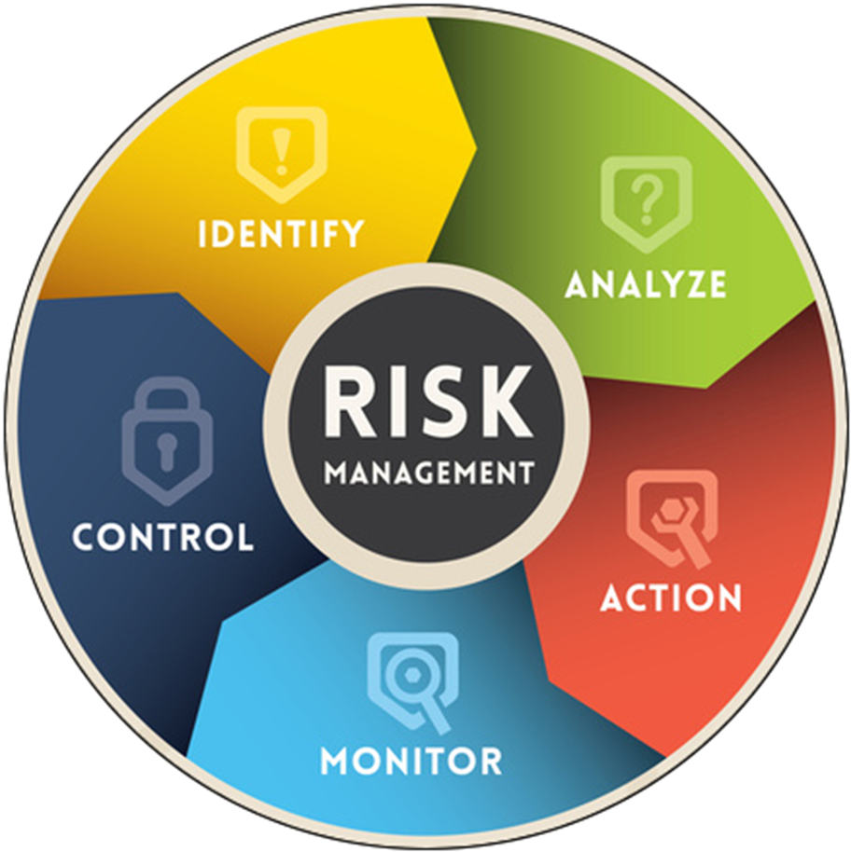
7. The risk management process

Slide 27
5. Strategic Financial management
An approach to management that applies financial techniques to strategic decision making.
Definition: “the application of financial techniques to strategic decisions in order to help achieve the decision-maker's objectives”.
Strategy: a carefully devised plan of action to achieve a goal, or the art of developing or carrying out such a plan.
Strategic Financial Management refers to both, financial implications or aspects of various business strategies, and strategic management of finances.

Slide 28
Standard deviation method
Coefficient of variation method
Sensitivity analysis
Simulation method
Probability and Expected value method
Decision Tree analysis
9. How can Measurement Risk?

Slide 29
9. How can Measurement Risk? Con’t
The absolute measures of risk include :
Sensitivity Analysis
Simulation
Standard Deviation

Slide 30
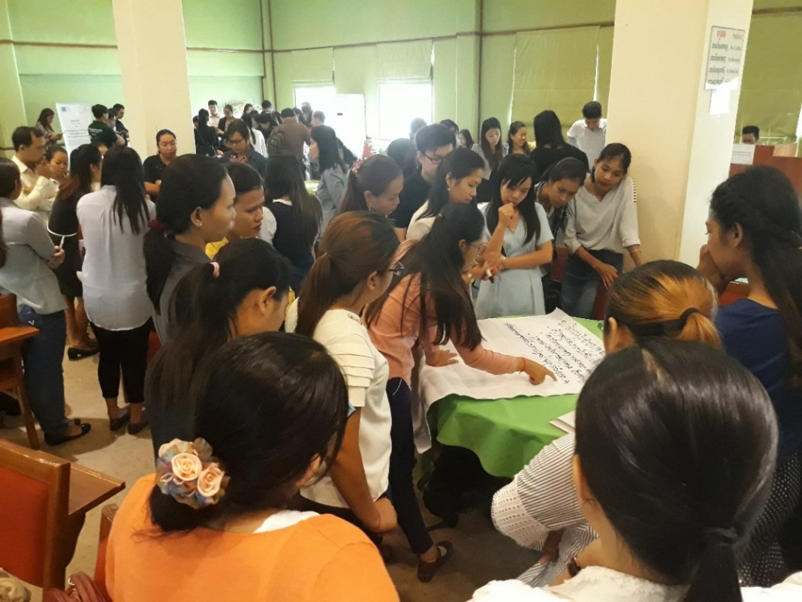
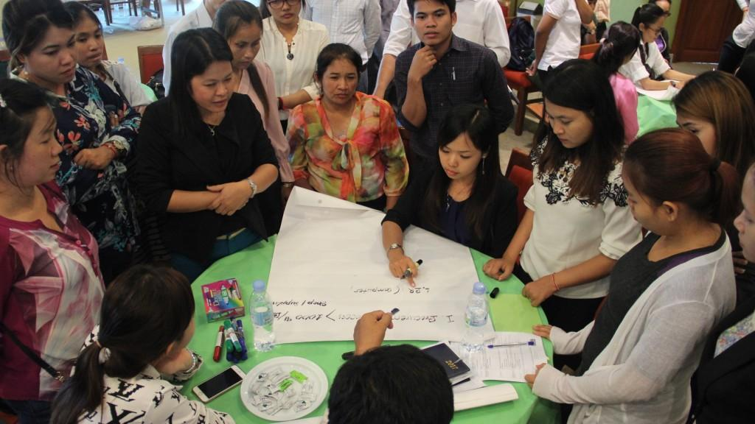
Thank you for attention !

