Slide 1


About GHP and Its Key Achievements 2017
Challenges
Working Groups Reflection Meeting
Diakonia Center, 17 November 2017
By: EL Sotheary, HOP
^{Vision:} Sustainable Development for Cambodia

Slide 2
Presentation Outlines
About the GHP Phase 3
Key Achievements
Voluntary Working Groups

Slide 3

1. About the GHP Phase 3

Slide 4


Slide 5
Program Objectives | Expected Results
SO1: Increased capacity of CSOs for innovative response to development challenges | ER1.1: Enhanced NGOs systems and practices in governance, organizational management and financial management.
 | ER1.2: Increased knowledge sharing and management on best practices & innovative actions in responding to development challenges.
 | ER1.3: Increased CSO use of key critical approaches to program implementation and management.
 | ER1.4: Enhanced capacity of CBOs in good governance and sustainability.

Slide 6
Program Objectives | Expected Results
SO2: Improved multi-stakeholder partnership in policy development and effective development cooperation at all levels | ER2.1: Increased use of research/evidence based to support advocacy for holistic, equitable and inclusive growth and development.
 | ER2.2: Increased platforms for MSI on policies and programs to better respond to development challenges in Cambodia.
 | ER2.3: Enhanced reach and effectiveness of CSOs in diversifying incomes at both national and sub-national levels.
 | ER2.4: Strengthened national and sub-national civil society associations and networks.

Slide 7
Program Objectives | Expected Results
SO3: Strengthened active participation of CCC members and innovative services of CCC secretariat | ER3.1: Hosted reliable CSO knowledge and information hub.
 | ER3.2: Strengthened and increased CCC members.
 | ER3.3: Enhanced CSO communication with the public.
 | ER3.4: Strengthened capacity and performance of the CCC secretariat.

Slide 8
2. Key Achievements

Slide 9
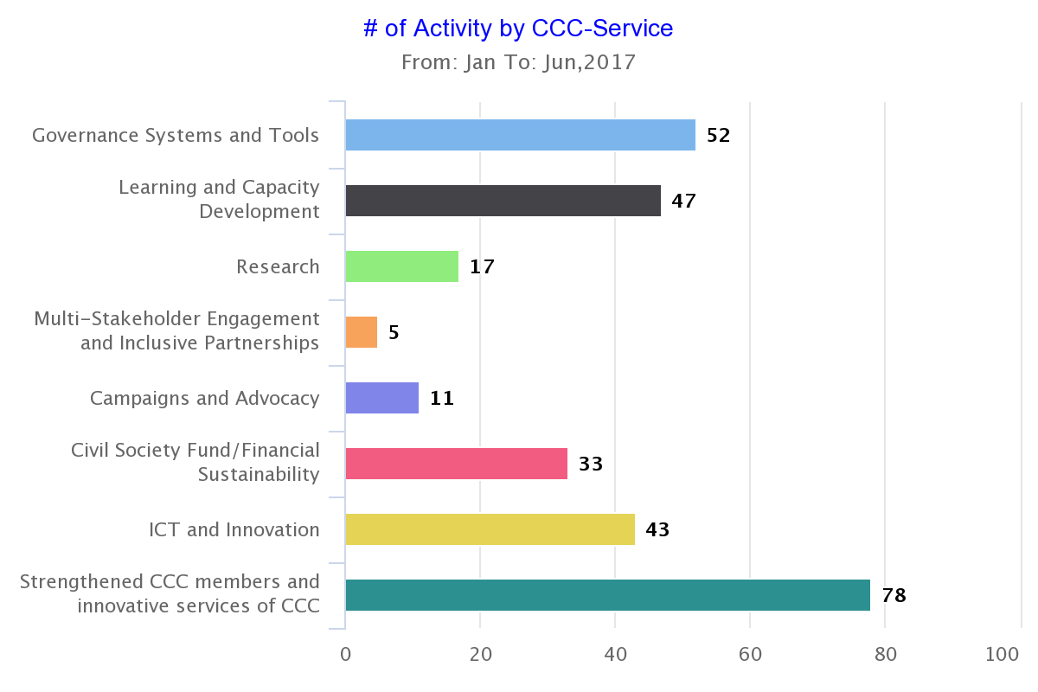
Number of Activity by CCC Services (Source: SRI)

Slide 10
CCC events provided to beneficiaries (Source: SRI)
Activity Category | # Events | # Participant | # Women | # Youth
Workshop | 9 | 333 | 107 | 10
Forum | 6 | 610 | 280 | 77
Training | 22 | 470 | 171 | 93
Meeting | 65 | 1,067 | 312 | 29
Field Work | 7 | 76 | 33 | 9
Assessment | 5 | 73 | 20 | 6
Mentoring & Coaching | 15 | 23 | 10 | 1
Total | 129 | 2,652 | 933 | 225

Slide 11
SO1: Increased Capacity of CSOs for Innovative Response to Development Challenges

Slide 12
Key Achievements of GHP
  85 certificates awarded so far, 90 certificates could be reached by end of 2017.
  CBO Guideline widely disseminated. Need assessment and curriculum are underway for the facilitators and CBOs.
  The GPP standards and process to be enhanced, making it more responsive, effective, efficient, and integrating other best practices.
  The learning forum have satisfied more than 80% of the participants.
  Needs assessment and curriculum being developed for Holistic Institutional Development.

Slide 13
SO2: Improved Multi-Stakeholder Partnership for Policy Development
1
Research on CSOs’ future development effectiveness
2
3
Baseline study for the GHP and the EU-BfdW project
Research on the feasibility of the CSO Foundation
Have reconfirmed the capacity of CCC in carrying out the GHP as well as inform the best possible strategies to reach GHP objectives
4
Research on CSOs Sustainability Index (CSOSI)
5
Member insights survey, Survey on taxation implication on CSOs….

Slide 14
Key Achievements of GHP
  Established three way governance support arrangement between CCC, funders and their local partners
  Fasten the negotiation with the Civil Society Academy (CSA) in terms of roles, services, marketing and replication of related courses.
  Promote and implement the official collaboration with LAC and DFDL to provide awareness and compliance capacity on LANGO, Taxation Law and Labour Law.
  Supported the provincial NGO networks in terms of legal compliance, development trends, CSO governance etc.

Slide 15
SO3: Strengthened Active Participation of CCC Members and Innovative Services of CCC
  Strong system in place: HR system, Financial management system, M&E system (SRI), knowledge management, online platforms….
  Strong support structure and commitment from the outsider experts:
  A. Official Governance Structure,
  B. Organizational Voluntary Support Structure, and
  C. Organizational Affiliation with other institutions.

Slide 16
A. Official Governance Structure
Members
165
Executive committee
7
Sub-Committee on CSO Governance and Effectiveness
TBC
Sub-Committee on CSO Enabling Environment
TBC
Sub-Committee on Financial Sustainability
TBC
Sub-Committee on Communications and Partnerships
TBC
CCC

Slide 17
B. Voluntary Support Structure
CAN Component
Do No Harm
Working Group
Commu. and Member Dev.
Research Advisory Board
CSO SDG Talk
GPP Component
NGO GPP Working Group
CBO Working Group
BCD Component
WG on FM
WG on HRM
NGO Code Compliance Committee
WG on M&E
WG on ICT
Project SC on Local NGO Governance
Operations and Org. Dev.
Taxation Working Group
BCD Component

Slide 18
C. Organization Affiliation with Other Institutions
Affiliation with CSOs
MoUs with provincial NGO networks, ADA, ADN, Civicus, IFP, etc.
Engagement with the Government
Through the 4 TWGs (P&H, PPR, PAR, D&D)
Engagement with DPs
EU-CSO dialogue, UN-CSO dialogue, Meetings with DPs, Meeting with funding partners
Engagement with Private Sector
Through ISAF etc.
CSR platform
OECD Watch etc.

Slide 19
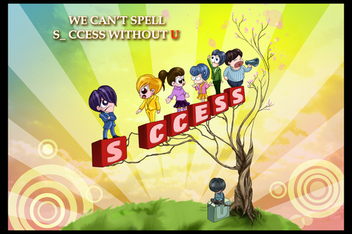
Financially Healthy
But
We are still not yet there!
Let’s find out some challenges and see how we can get there together

Slide 20


3. Q&A and Discussion

