Slide 1
CCC 32nd Annual General Meeting
Phnom Penh, Cambodia
Decentralisation & Administrative Reform Programme | 24.03.2022

Slide 2
‚Joint List of Recommendations‘ work package
Background of GIZ-DAR
Partnership on citizen participation:
  CPDD & 07 DMs in Battambang
Process
  separate study and assessment
  joint discussion and understanding
  dissemination (national level)
  follow-up
Recommendations
  information sharing from process (invitations) to socio-economic development and “life” in the DM
Conclusion
  duty bearer and rights-holder → civil servant
  clear understanding of roles and hierarchies in partnership
Notes:
2

Slide 3
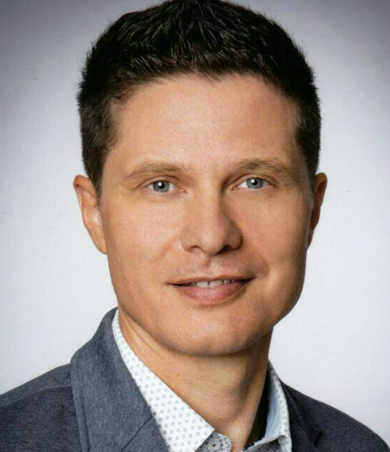
Contact
Christian Kapfensteiner
Programme Manager, Phnom Penh
christian.kapfensteiner@giz.de
T +855 23 216756
F +855 23 212783

