Slide 1
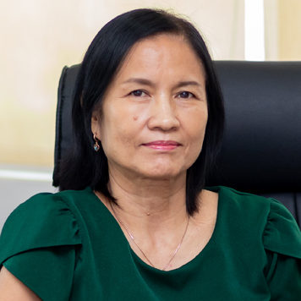
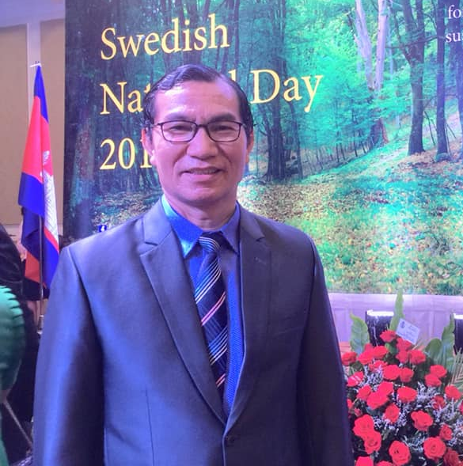
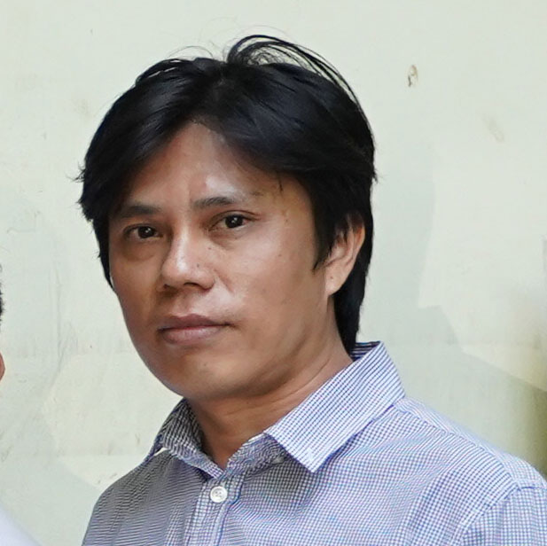
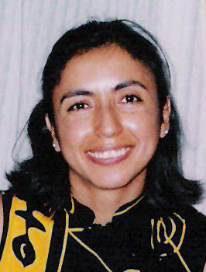
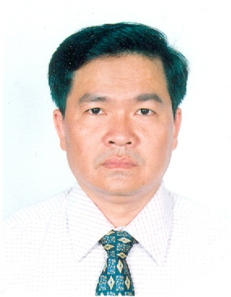
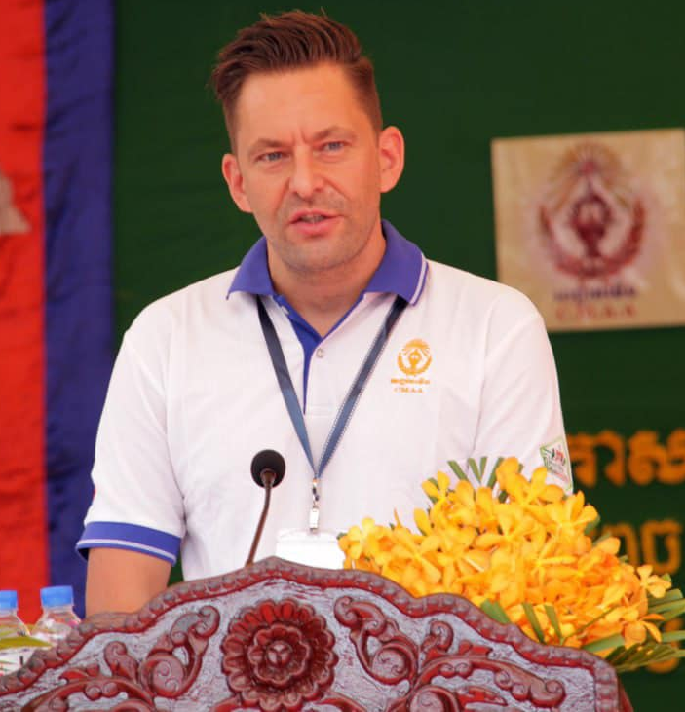
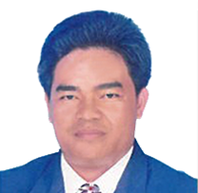
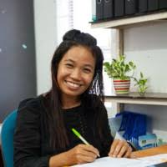
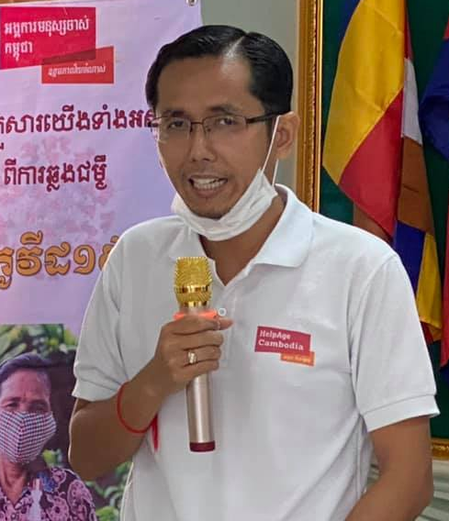
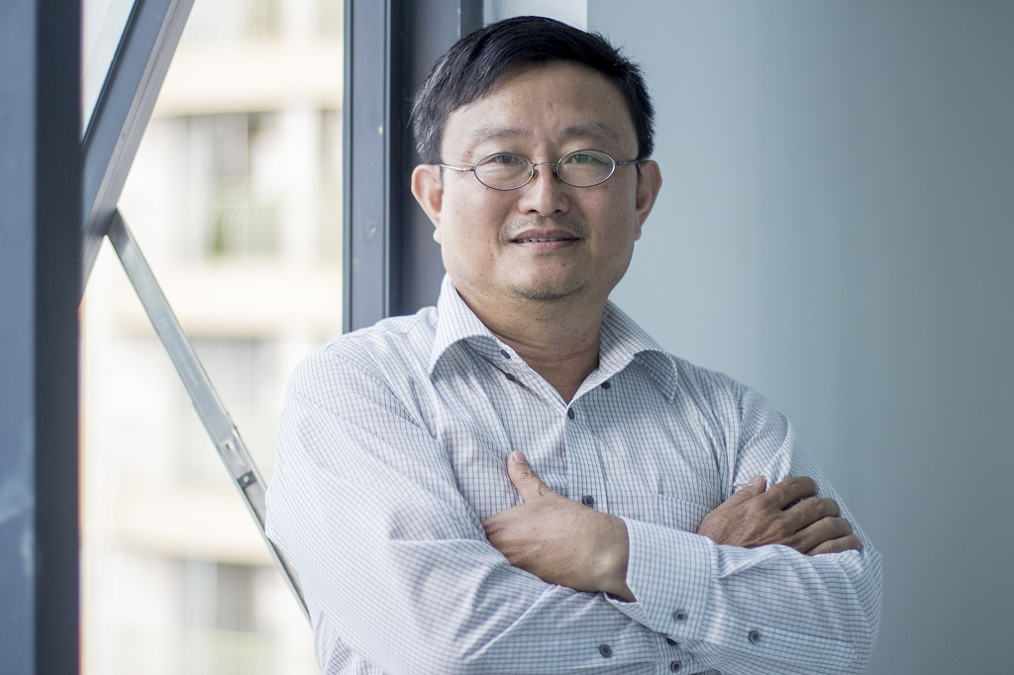
CCC’s EXCOM
Ms. Chi Socheat, Chair of EXCOM and Country Director of PSI Cambodia
Incoming EXCOM
Outgoing EXCOM
Mr. Keng Bunchhoeuth, EXCOM’s Member at Large and Regional Manager for Asia, ERIKS Development Partner
Mr. Hong Reaksmey, former Chair of EXCOM and Country Director of ActionAid Cambodia
Ms. Sandra Veloso, Vice-chair of EXCOM and Regional Director Asia of AFSC
Mr. Leng Vireak, EXCOM’s Treasurer and Operations Director of World Vision International Cambodia
Mr. Rune Kristian Dale-Andresen, EXCOM’s Member at Large and Country Director of NPA
Mr. Choub Sokchamreun, former EXCOM’s Treasurer and Executive Director of KHANA
Ms. Onn Sokny, EXCOM’s Member at Large and Country Director of EPICARTS
Mr. Tum Vira, EXCOM’s Member at Large and Executive Director of HelpAge Cambodia
Mr. Lim Phai, EXCOM’s Member at Large and Principle Consultant of VBNK

