Slide 1
The 22nd M&E Learning Forum
Review Session

Slide 2
Introduction
Project Monitoring

Slide 3
Definition
Monitoring is a continuous process of collecting, analyzing, and documenting information in order to report on progress towards achieving agreed project objectives. (ProPack II definition).

Slide 4
Definition
Evaluation is a periodic, systematic assessment of a project’s relevance, efficiency, effectiveness, impact and sustainability on a defined population.
(ProPack II definition)

Slide 5
Hierarchy of LogFrame
1
Input
2
Outputs
4
Impact
5
Outcome
3
Activities

Slide 6
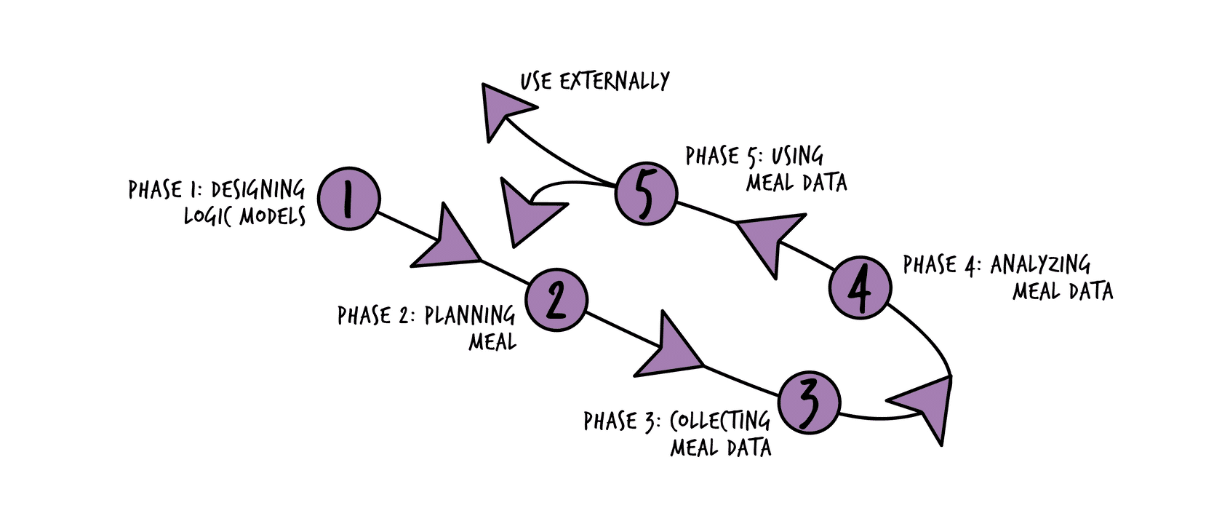
Five Phase of MEAL Cycle

Slide 7
Why monitoring?
Analyze current situation
Identify issues and find solution
Identify project needs
Discover trends and patterns
Keep project activities on schedules
Measure progress against outputs
Make decision about human, financial and material resources

Slide 8
Causal Pathway Framework
Evaluation
Monitoring
Desired
Impact
Inputs
Activities
Outputs
Outcomes
Did you have
the Inputs you
needed?
Were the planned
Outputs achieved?
Was Impact
achieved?
Did the
Outcomes/Effects
occur
Were your Activities carried out as planned?

Slide 9
How to monitor project?
Remotely
Meeting (i.e. face-to-face or online)
Field monitoring visits

Slide 10
Data Collection

Slide 11

Principle of designing data collection tools
Collect “Needs to Know” data only not “Nice to know”
“Do not COLLECT data unless somebody is going to USE IT”

Slide 12
Type of data collection tools
1- Quantitative data is collected using a questionnaire.
2-Qualitative data collection tools include semi-structured interviews (also known as KII) and focus group discussions.

Slide 13
Steps for successful data collections
Step 1:
Translate your data
Step 3:
Revise & finalize your tools
Step 4:
Plan for implementation
Step 2:
Train data collectors and test the tools

Slide 14
Data Analysis

Slide 15
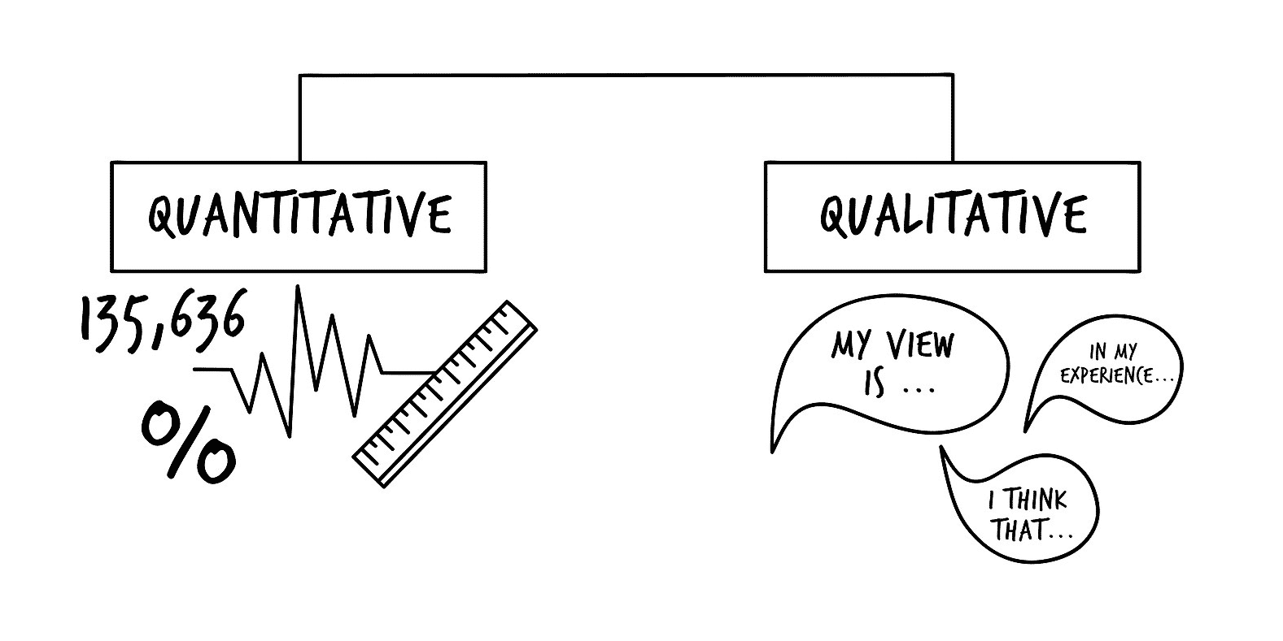
What is Data Analysis?
Data Analysis is the process of bringing order and structure to the collected data.

Slide 16
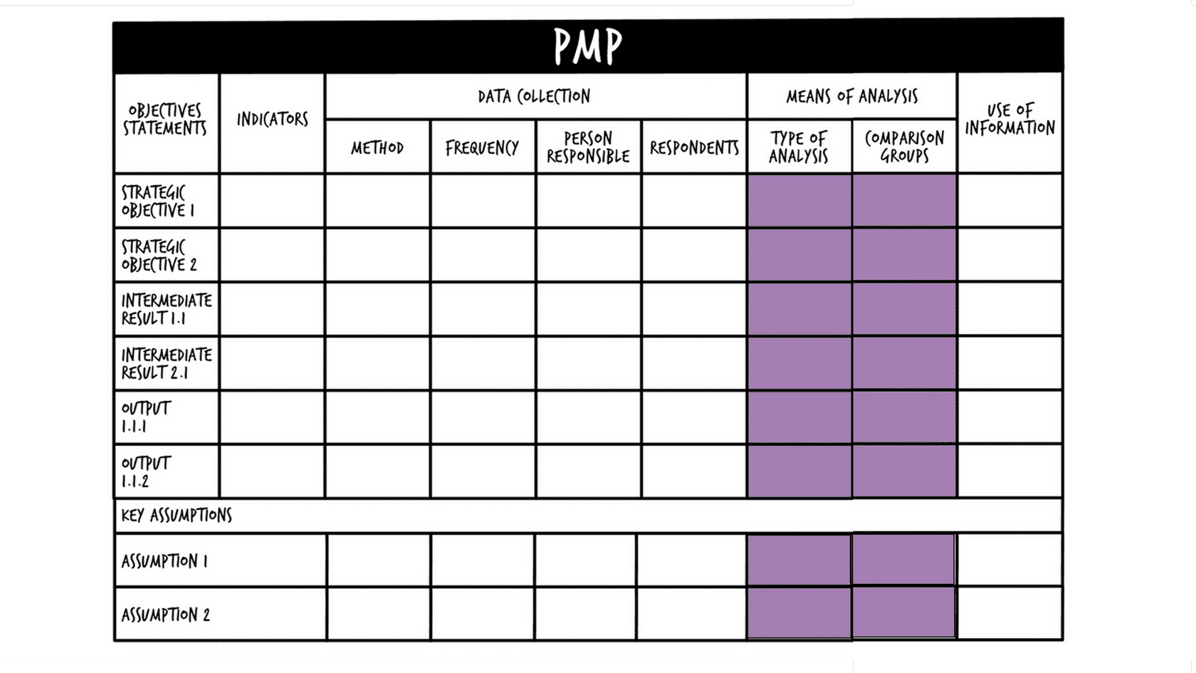
Performance Management Plan (PMP)

Slide 17
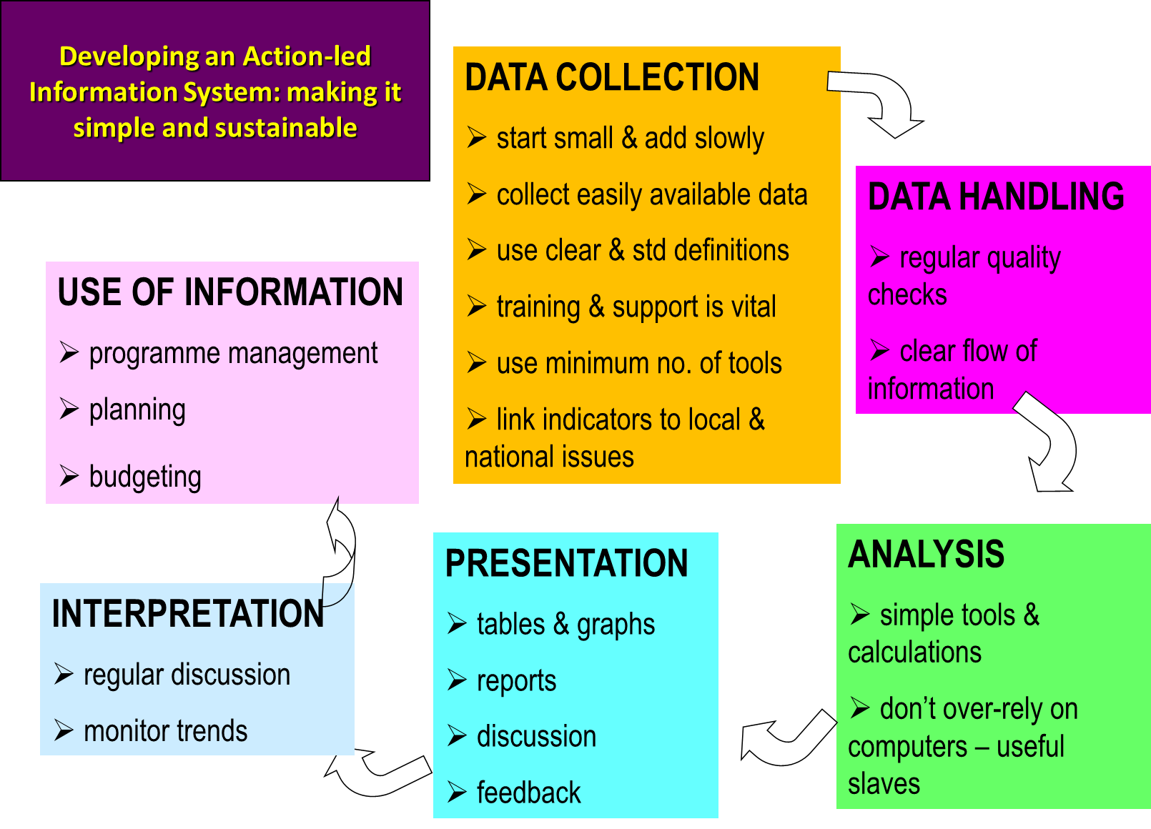

Slide 18
Key message
Know your information needed, Indicators and its disaggregation before working on data analysis
Structured your data analysis based on the info needed and indicators
Tailored presentation of the data analysis based on the audiences level of comfort and understanding and what key messages/attention you want to convey

Slide 19
Monitoring Report Writing

Slide 20
Project Monitoring Trip Process
Before
During
After

Slide 21
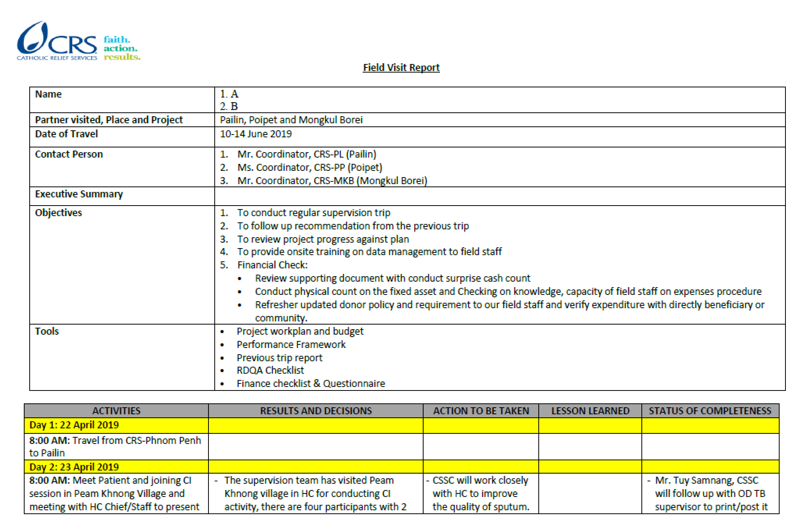
Trip Report
After

Slide 22

អរគុណ
Thanks
After

