Slide 1



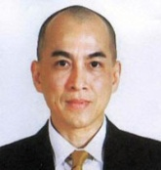




សូមស្វាគមន៍
វេទិកាសិក្សារៀនសូត្រ បច្ចេកវិទ្យាគមនាគមន៍ព័ត៌មានវិទ្យាលើកទី២៥
ស្តីពី
“”
ថ្ងៃទី ២៥ ខែ ឧសភា ឆ្នាំ ២០១៩ នៅរដាយកូនៀសិនធើ
Welcome to
The 25th Information Communications Technology (ICT) Learning Forum
On
“”
25.May.2019 at Diakonia Cent
Vision: Sustainable Development for Cambodia

Slide 2
Objectives of M&E Learning Forum

Slide 3
Key Agendas | Speakers
Introduction Objectives of learning forum | CCC
Open Remarks | , CCC
Reviewing Sessions on | ICT working group
“Creative way for story telling” | Speaker??
Expression Discussion on the Next Topics Evaluation forum | CCC
Closing Remarks | CCC

Slide 4
Welcome & Open Remarks

Slide 5
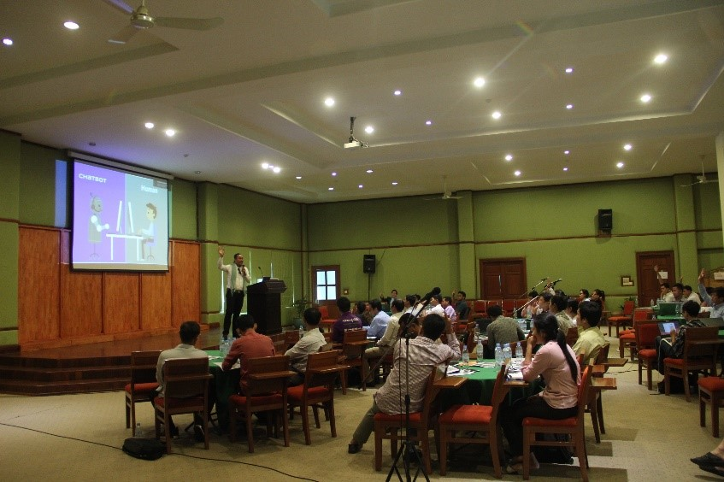
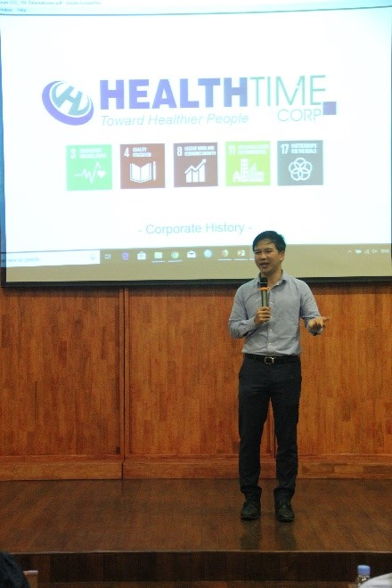
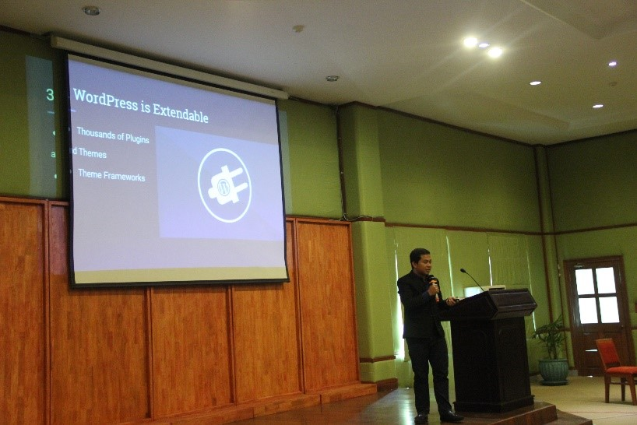
Reviewing the Last Sessions
“Bring your organization online and Auto Response via Chatbot

Slide 6
Key Contents
Auto Response via Chatbot
Healthogo
Process of getting Choosing the Right Publishing Platform to Sustain Your Voice Outreachhe case

Slide 7
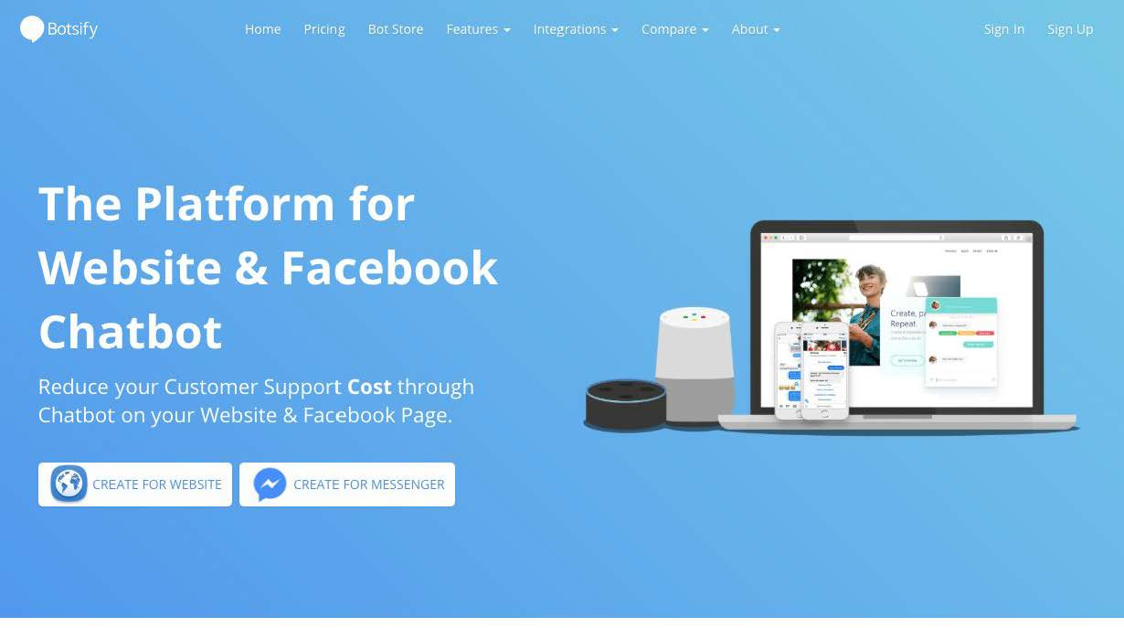
Auto Response via Chatbot
Content
What is Chatbot ?
Chatbot can help us ?
  Save time &money
Better Outcomes service
  Provide 7/24 support
Started with Chatbots
  Define your goal & your user
  Content strategy
Flow
Choose platforms

Slide 8
Process or staff of project Monitoring
Healthogo

Slide 9
Choosing the Right Publishing Platform to Sustain Your Voice Outreach
WordPress is Free!
  Free to Use
  Free to Make Change
  Free to sell
Ease of Learning and Using
WordPress is Extendable
  Thousands of Plugins and Themes
  Theme Frameworks
WordPress is Scalable
  Custom Post Type
  Custom Fields
  The power of WP_Query(), meta_query(), tax_query()
Huge Community
  Stack Exchange
  WordPress Codex
  WordPress Developer, ...

Slide 10
Choosing the Right Publishing Platform to Sustain Your Voice Outreach(cont)
WordPress is Search Engine Friendly
WordPress has Advanced Editor
  - Focus only on Content
  - Able to handle any type of content
  - Gutenberg
WordPress has Smart Database Structure
WordPress Has Command Line Interface
WordPress has REST API
  - Use WordPress as the backbone of any Web/Mobile Application
WordPress is Safe!
Website : www.wordpress.org

Slide 11
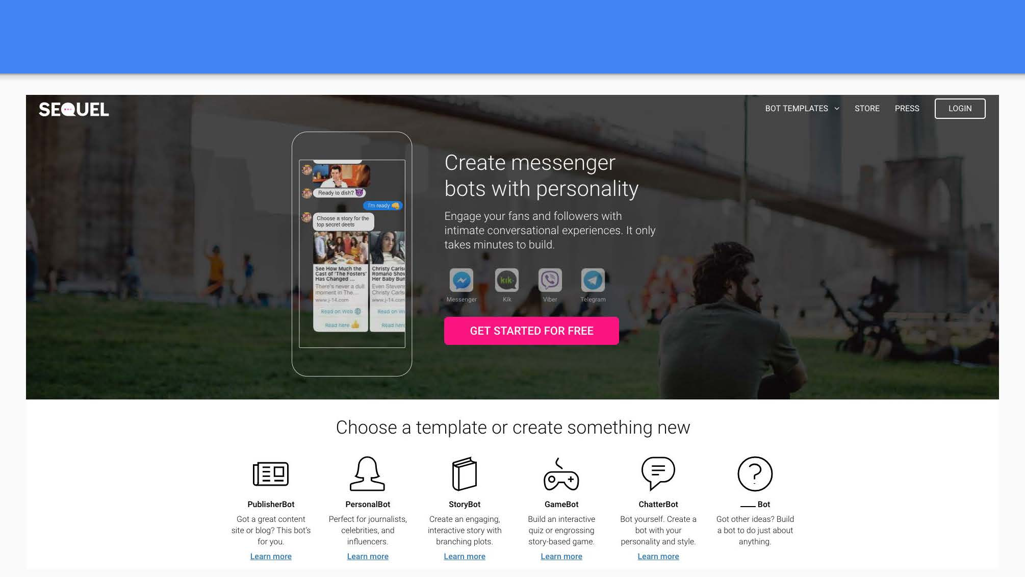
Thank you

