Slide 1


OIC Cambodia Overview

Slide 2
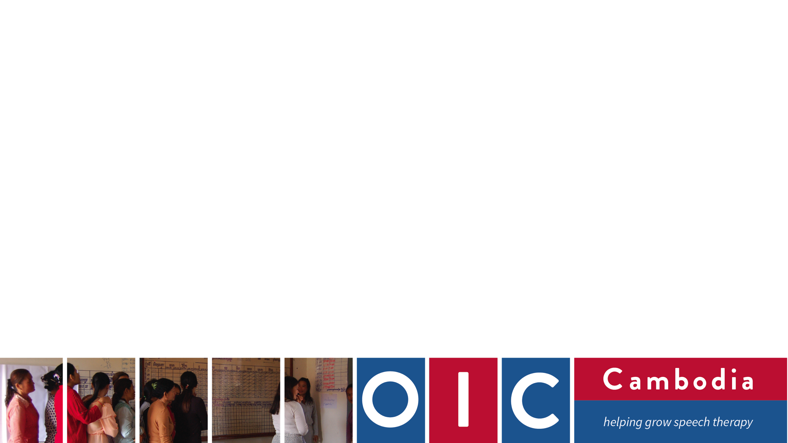
Content:
WHO WE ARE
Our Team and strategic activities
How we works
Our plan 2019

Slide 3
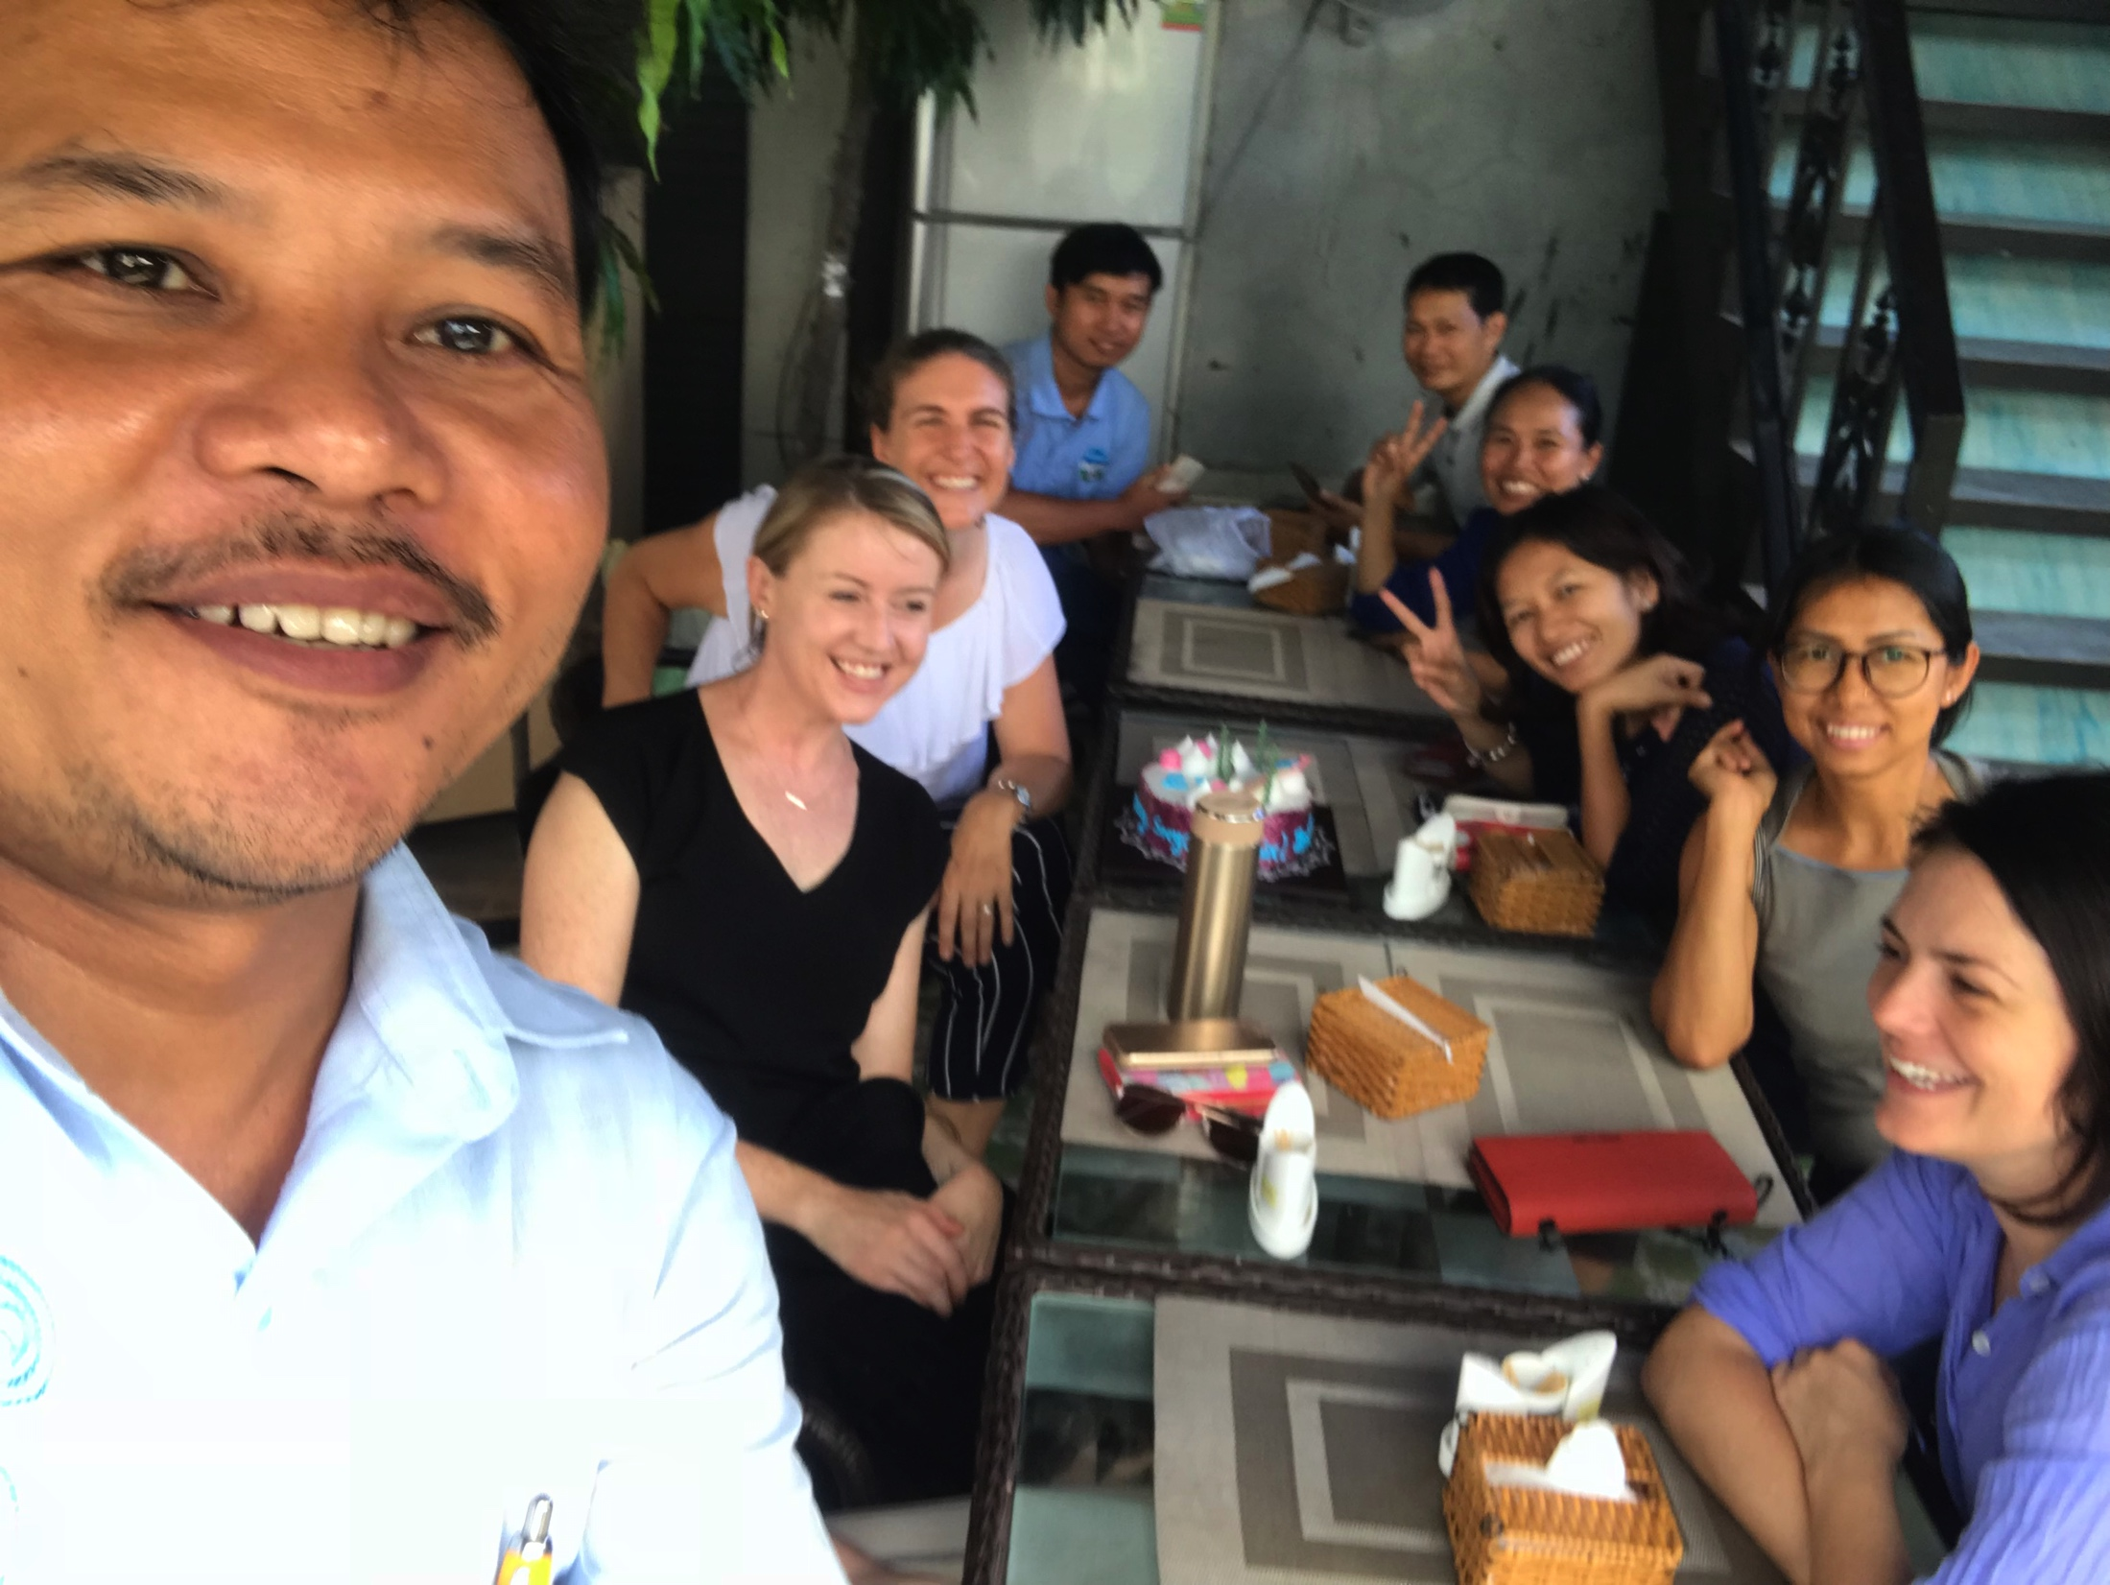
Who we are
OIC is called Organisation to Improve Communication and swallowing therapy services in Cambodia
Started in 2013 with a small team, that has grown quite rapidly, primarily from the generous individual donations of supporters, with some small grants along the way.
Our team is currently made up of a governing board, an advisory committee, management team, whose members work across the administration and program team.

Slide 4

100 Cambodian university qualified speech therapists are integrated into Cambodia’s public sector by 2030.
Notes:
It’s an image that gets used to symbolise all kinds of things, but what we are trying to do at OIC Cambodia does feel like we are growing a tree, with the ultimate goal having 100 Cambodian university qualified speech therapists are integrated into Cambodia’s public sector by 2030 after which OIC will exit Cambodia.
Vision: ST is lead by Cambodians and available to who need it in Cambodia
Mission: To establish speech therapy university courses and jobs for Cambodians, raise awareness, and influence government policy.
We would love to see speech therapists employed in the Health Sector, in the education sector as well in the disability and rehabilitation sector

Slide 5

The Roots
A solid knowledge of how to do “development” well
Understanding the past and the people
Strong partnerships
Embedded monitoring and evaluation
Sector/stakeholder mapping
A diverse, complementary team which is Cambodian led
A plan and an exit strategy
Notes:
The roots of the OIC tree are mostly completed.
We like to think that we have a good knowledge of doing development well. Four members of our management team have qualifications and/or extensive experience working in the development sector, three of them in Cambodia for many years.
A situational analysis about speech therapy was completed in 2013 through CABDICO, who was our umbrella organisation until July 2017.
Partnerships are key to moving forward and we are really excited by the Cambodian Speech Therapy Network and the opportunities that has given us to work with other individuals and organisations, such as Speech Therapy Cambodia.
We are an organisation that values learning and so as much as possible, we monitor and evaluate our work, to make sure we are making good decisions.
We have recently done an updated team mapping exercise, identifying all of the sectors and people who are involved or have the potential to be involved in the journey of establishing speech therapy in Cambodia.
(these include mixture of government and Non Government, grassroots and sector leaders, public and private Many of you are here today so we look forward to learning together with you about how best to develop speech therapy.

Slide 6

The Branches - building knowledge
Child development knowledge in Cambodia
Cultural perspectives and knowledge of disability
Speech therapy in other Asian countries
Service delivery models that work in Cambodia
Training approaches that work in Cambodia
Resources that work in Cambodia

Slide 7
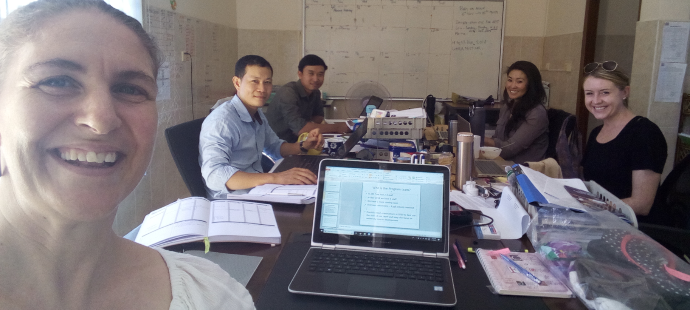
Who is the Program team?
Possibly need a restructure in 2019 to best use the skills of our team and keep the focus on university course development as core

Slide 8
Our key strategic activities
University and profession development:
University Partnership, Curriculum Outline
Capacity Building:
Target Early childhood and primary education
Research and Resource development:
Coaching service model, Baselines for teacher KAP, Speech Assessment
Awareness and advocacy:
Child speech and language development; Recognition of ST profession
Direct Speech Therapy:
Coaching teachers in whole service model, Happy Kids Pediatric focus

Slide 9
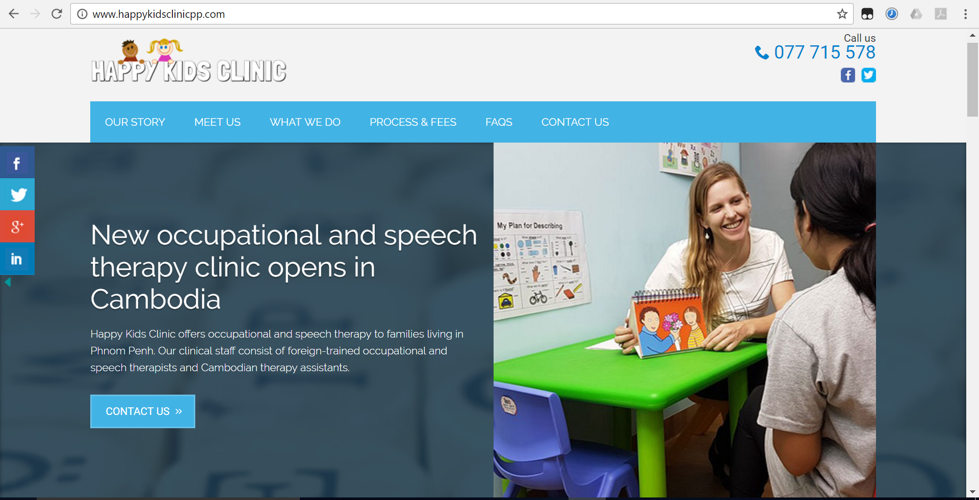
Happy Kids Clinic
Notes:
HKC was established as a social enterprise of OIC in June 2016.
provide user pays speech therapy and occupational therapy services.
We have 3 STs, oand two Khmer therapy assistants and provide services in clinic, home and school.
In kind support and profits go to OIC.

Slide 10
How we works
University course 2020
Governments;
MoEYs, MoH, MoSVYs
Stakeholders/
NGOs partners
Donor agencies
Teachers, parents, CWCDs,
Private sectors

Slide 11

Key outcomes:
Invited to work with S.E.D, early childhood dept and NISE in 2019
Planned curriculum development with UHS
Draft curriculum outline
Literature review childhood milestone research
6 month coaching
Meeting with UHS
International Advisory group established
Relationships with gov and NGO stakeholders in key sectors
Strong team
18 Mth - 2 yr strategy
Notes:
Foundations within OIC:
Grew strong program team and team culture of learning and partnership
Developed and started 18 month plan and strategy (July 18 – Dec 19)
Core relationships and resources
Meetings with UHS to pursue MOU for university course in 2020 – curriculum outline and summary presented
International advisory group established for university course development
Tangible projects and resources
Completed 6 month coaching project in Preschool and Primary school – presented to ECD, Primary Dept, Special Ed
Literature review of Cambodian research into childhood milestones for speech, language and cognitive development comparing to international norms
Draft curriculum outline
Needs assessment for Krousar thmey
Building collaboration partners
Developed relationship and common vision with key NGO in education – Krousar Thmey, RTI, UNICEF
Attended Speech Pathology Australia conference in May 2018 applied for grant from them in Oct
Future opportunities
Invitation to work with both Special Ed department and preschool department in 2019
Invitation to work with National institute of Special Education (NISE) on intellectual disability course in 2019/20
Plan for MOU with UHS and working group for full curriculum development

Slide 12
2019 Summary Plan:
University course / Early childhood / Special education / Health and rehabilitation sectors
University and ST profession development:
Core Subject development and overall curriculum (working group with UHS)
Engage NGO’s in funding and design of university course
MOUs with MoH and MoSVY (and MoEYS)
Capacity Building:
Early childhood: create training packages ; review government preschool curriculum
Write ST Uni module on early childhood devel in cambodia
Special education: pilot coaching project with KT; review government Special ed curriculum
Rehabilitation and Health sector initiatives: work with STC to formalise their training packages
Speech Therapy service delivery:
Special Education support models – out of class special ed support with SED
work with STC to pilot provincial rehab project
Research and Resource development:
Identify the teaching resources that are needed for university course theory and practical learning
Complied Pediatric text book
Produce child speech and language assessments, adult language screener
5 year research plan to support university curse and profession
Awareness and advocacy:
Early childhood public awareness fact sheets and campaigns (emphasis language and literacy link)
Increase awareness and understanding in Health and rehabilitation sector, prospective students – create interest in career
Day without speech campaign established in Cambodia

Slide 13
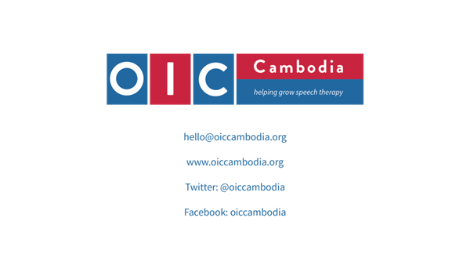

Slide 14
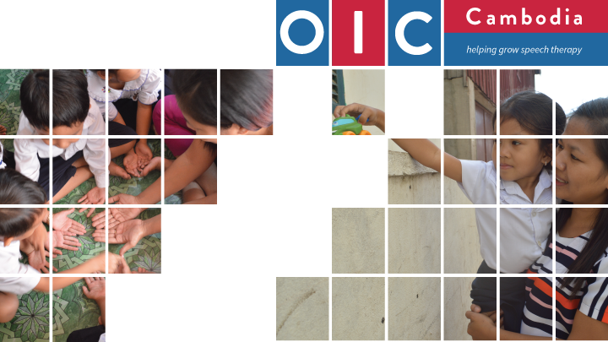

Thank You!

