Slide 1
CSO Sustainability Index (CSO SI)
Cambodia Country Study (2017)
CCC Member Bi-Monthly Meeting
6 December 2018

Slide 2
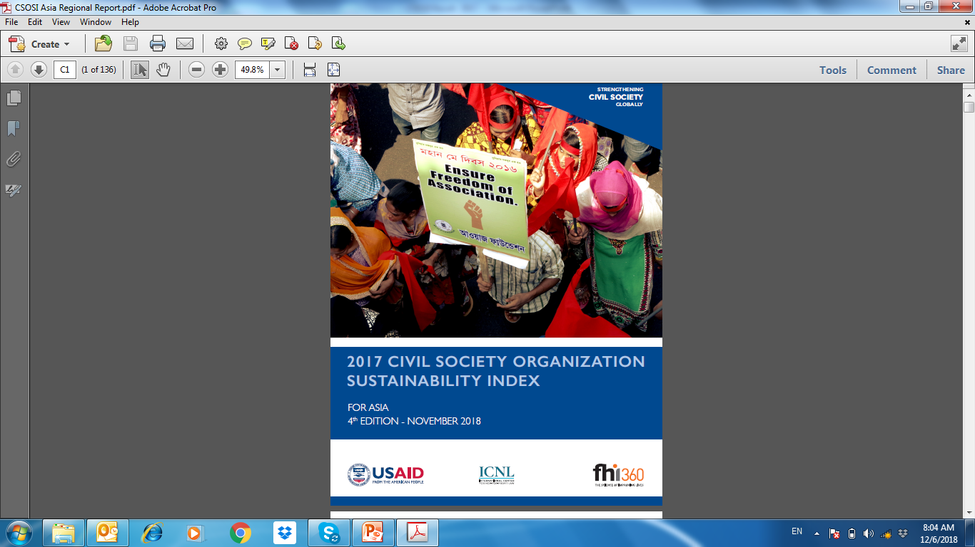
Outline of the presentation
Methodology
Key findings
Background
Notes:
- Failed State Index: 88 means Cambodia is close to the red line.

Slide 3
Background to CSO SI
CSOSI has been implemented since 1997 in Middle East and North Africa supported by USAID and ICNL, and now more than 60 countries
CSOSI reports on the strength and overall viability of CSO sectors. The Index highlights both advances and setbacks in the development of the civil society sector, and allows for comparisons across countries and sub-regions over time.
An important and unique tool for local CSOs, governments, donors, academics, and others to understand and measure the sustainability of the CSO sector.
Methodology is qualitative and relies on local expertise (CSO practitioners and experts) to apply seven standardized dimensions:
Notes:
- Failed State Index: 88 means Cambodia is close to the red line. Technical support from MFI but move to FHI 360

Slide 4
Methodology to CSO SI
Level of Sustainability
1-Legal | Registration
Environment | Operation
 | Administrative Impediment/State Harassment
 | Local Legal Capacity
 | Taxation
 | Earned Income
4-Advocacy | Cooperation with Local & Federal Government
 | Policy Advocacy Initiatives
 | Lobbying Efforts
 | Local Advocacy for Legal Reform
5-Service Provision | Range of Goods and Services
 | Community Responsiveness
 | Constituencies and Clientele
 | Cost Recovery
 | Government Recognition and Support
2-Organisation | Constitutuency Building
Capacity | Strategic Planning
 | Internal Management Structure
 | NGO Staffing
 | Technical Advancement
6-Infrastructure | Intermediary Support Organisations
 | Local Grant Making Organisations
 | NGO Coalitions
 | Training
 | Inter Sectoral Partnerships
7-Public Image | Media Coverage
 | Public Perception of NGOs
 | Government/Business Perception of NGOs
 | Public Relations
 | Self Regulation
3-Financial | Local Support
Viability | Diversification
 | Financial Management System
 | Fundraising
 | Earned Income
Notes:
- Failed State Index: 88 means Cambodia is close to the red line.

Slide 5
Cambodia CSO Sustainability Index 2017
Overall Index for Cambodian CSO Sustainability: 4.5 (Sustainability Evolving)
Sustainability Enhance Sustainability Evolving Sustainability Impeded

Slide 6
Overall of CSO Sustainability Index 4.5
About 6 000 registered CSOs
  Cambodia CSO SI continue decreased in 2017, negative development in all dimensions except organizational capacity.
  High political tension following dissolved of the only prominent opposition party, and government launched major campaign against CSOs alleged to be part of the color revolution. Several media, CSOs were closed, harassment, arrested, and intimidated.
  Outlet for advocacy are discouraged and reduced visibility of CSO, whilst CSO-Government mechanisms exist but give some space for selective organizations.
  CSOs fund from foreign sources reduce, and limit access to local philanthropy
  These limit the capacity for CSOs to provide services (staff turn over), and inter-sectoral partnerships weakening.

Slide 7
1-Legal Environment 4.6
  Cambodia Civil Code 2007, LANGO 2015, Taxation Law, Labor Law, and other legal provisions, with more strictly enforce.
  Restricting of registration and association: Need to update org. status & activities and financial reports, and informing of all activities (prakas)
  Certain CSOs and media shut down, intimidation and harassment, especially inline with US interference network support for color revolution
  As a legal entity, any organization can seek tax exemptions in accordance with the Law on Taxation, and no legal incentives for entities donation to CSOs.
  Legal advices for CSOs are primarily available in Phnom Penh (i.e. more support from DFDL and LAC)

Slide 8
2-Organizational Capacity: 3.9
  More tighten on civic space, and CSOs adjust models of operations in this response (limited their public size, reduce large scale meeting, and carefully giving voice)
  Many CSOs demonstrate transparent and accountable from donors influenced in monitoring and requirement, but mostly not in long term.
  Structural management commonly in place due to requirement by law and donors, but board has limit function and staff maintaining is also difficult due to staff benefits.
  ICT and materials could be available for use, i.e. email and popular social media, but take more control by Telecom law

Slide 9
3-Financial Viability: 5.2
  Financial viability continue decreased, and also reduce the major source of international agency.
  Generally CSO survive for short term but not long sustain. The limit of fund access make CSOs more competition, whilst local philanthropy is still nascent and rare support for advocacy based.
  Some income of CSOs could generate from members, services, and productions through social enterprise and membership platform.
  Large CSOs have sound financial management, but many other organizations need to improve their financial system to comply with the laws (financial report and auditing).

Slide 10
4-Advocacy: 4.7
  Advocacy noticeably decreased following tension in civic space and political issue-stigmatized. Results to largely avoid public advocacy during the year, and fear to place them at risk.
  However, some formal mechanism could be channels (DCPS, TWG, ISAF/D&D…) and adhoc meeting with relevant Ministries i.e. environment, but low follow up result generate from the meeting
  CSOs made some resilience to advocacy and lobbying efforts from this environment and adapting approaches to both domestic and international (criticism in carefully, measured manner, and more joint statement,…).
  However, some efforts made have been forced to improve on employment protection (benefits more social protection) and anti-corruption practices. Donor community give some more pressure to government to improve civic space.

Slide 11
5-Service Provision: 4.2
  CSOs services to wide ranks of sectors, but declined due to fund and restriction of legal environment, especially on advocacy and sensitive issues, i.e. land and housing rights.
  However, some CSOs work in services delivery, and other supports, i.e. ISAF have good partnership and appreciation.
  Most CSOs serve the benefits for vulnerable groups and free of charge with donor funds, and only small number of CSOs could try to generate diversify income from services or initiate of social enterprise

Slide 12
6-Infrustructure:4.3
  No CSO source center bring the entire sector together to address shrinking civic space, but umbrella, sectoral and provincial CSOs perform certain roles, i.e. information sharing, consultation , and dialogue.
  International CSOs is more available resources and opportunity, which typically give fund and support capacity to locally based CSOs, whilst local support to other CSOs is very rare those initiative started.
  Partnerships with government exist and some appreciation, but with private sector remain weak.

Slide 13
7-Public Image: 4.3
  More deteriorate in 2017, which certain media are shutting down, i.e. VOA, RFA, VOD, Cambodia Daily, broadcast CSO work.
  Public image of CSOs which commonly gaining trust from public but clampdown by the state &pro-state media, and increase negative perception on CSOs.
  However, CSOs could still promote their visibility through a popular social media with carefully discussion on sensitive issues.
  Small number of CSOs have communicate through printed or electronic copy for bulletin, brochure for distribution.
  GPP continue as the symbol of trust for NGOs, and having developed CBO Guideline for grassroots organization at community level.

Slide 14

THANK YOU!

