Slide 1


Slide 2

Outline of Presentation
Background of SACRED
Organizational Management
Program
Donors
Budget
AOB

Slide 3

1. Background of SACRED
SACRED is a Cambodian NGO localized from HEKS project in 2016 with head office in Prey Veng province. SACRED was registered with the Ministry of Interior via the official registration letter No. 193 សជណ issued on 14th February 2007.
Vision: Cambodia where poor and vulnerable people living with quality of life, equal rights, opportunities and full responsibilities to greater involve in leading their own community development.
Mission: Establish and empower community based organizations to build sustainable development in their communities.
Core Value: Neutrality, Accountability, Equality and Equity, Partnership and Networking.

Slide 4
2. Organizational Management
Board of Director (5 members, women: 1)
Executive Director
Management team (5 members, women: 1)

Slide 5
3. Program
Program Period: 2018-2012
Title of the Program: Community Empowerment and Livelihood Improvement.
Target Areas:
- Prey Veng: 3 districts, 6 communes, 45 villages
- Svay Rieng: 2 districts, 2 communes, 4 villages

Slide 6
Beneficiary
- Direct: 3,298 HHs, School student: 1,000
- Indirect: 13,192 persons
Working Approaches
- Market System Development (MSD)
- Human Right Base Approach (HRBA)

Slide 7

Partnership
Partners
Provincial Department of Labor and Vocational training
Provincial Department of Agriculture
Provincial Department of Water Resources And Meteorology
Provincial Department of Women Affair
Provincial Department of Rural Development
Local authorities (commune council, village chief)
Agriculture input suppliers
Private sectors

Slide 8


4. Donors

Slide 9
5. Budget
4 years (2018-2021)
853,540 USD

Slide 10
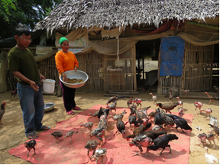
6. AOB
Success story:
Pheap made his efforts to take care of the chickens, using the techniques he had learned from the project such as building proper chicken pen, separating blocks for chicks and hen, building safety fence to protect chickens from diseases, and cleaning and other hygienic activities. To make the chicken value chain even more profitable, he also closely followed up local market situation, identified high-season for chicken supply, joined group selling, and connected the market for direct sales. All of his efforts resulted in remarkable success. Last month he sold 27kgs of chicken and got 486,000riels (around USD120.00). Pheap has planned to renovate the chicken farms by making bigger henhouses, prepare land nearby for growing vegetables and herb plants to supply for the chicken raising. He commits to share the knowledge and skills with farmers in his community as well. “My living condition has improved now! Thank SACRED for such intervention which is really responding to the needs of the farmers. Today I have around 300 chickens, and I expect to gain more income in coming months,” said Pheap smilingly.

Slide 11
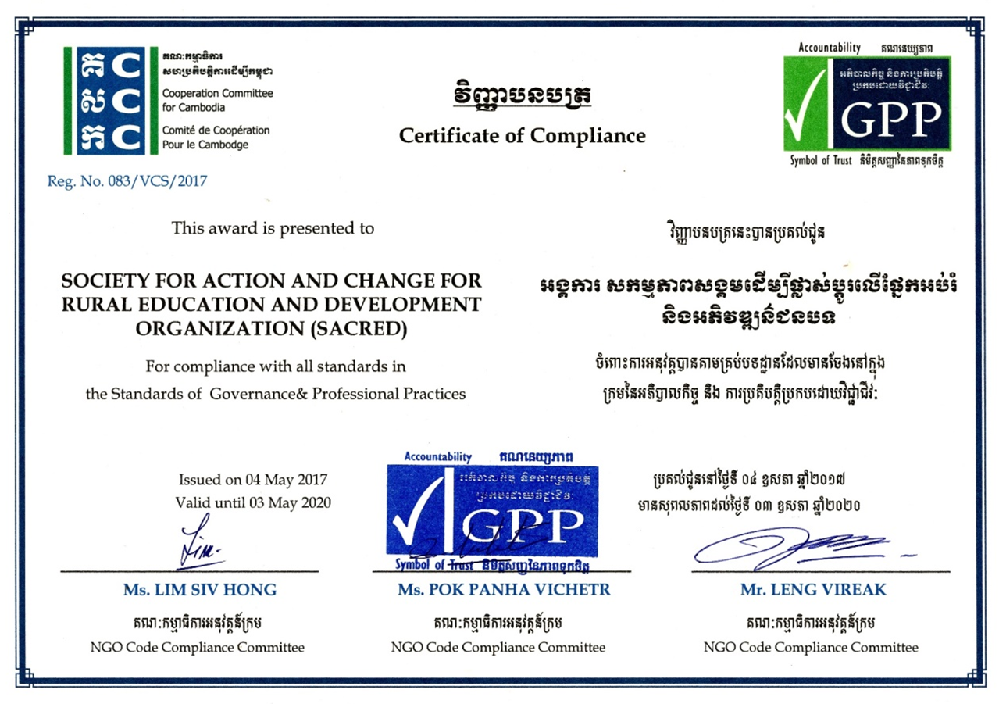

Slide 12
Thank You!!

