Slide 1


Introduction of CCC
Communication & ICT guideline
Challenges
Battambong Province
12 Nov 2018
By: Putheary SIN, HoC
^{Vision:} Sustainable Development for Cambodia

Slide 2
Presentation Outlines
Snapshot of CCC
What is Communication?
Why is it important for CSO?
What is the communication Process?
Quiz
Social Media Handbook version 2
CCC online platform promotion

Slide 3
Who We Are
The Cooperation Committee for Cambodia (CCC) is a leading membership organization with nearly 170 Local and International Non-Governmental Organizations (NGOs) in Cambodia.
CCC has been playing a unique role since 1990

Slide 4


Slide 5
Roles of CCC
Coordinator
Advocate
Governance Champion

Slide 6

What is Communication?
A process by which information is exchanged between individuals through a common system of symbols, signs, or behavior.

Slide 7

Why is it important for CSO?
Productivity increased
Operate Quickly & Effectively
Staff Commitment increased

Slide 8
Communication Process
Sender
Encoding
Receiver
Message
Channel
Encoding
Feedback

Slide 9
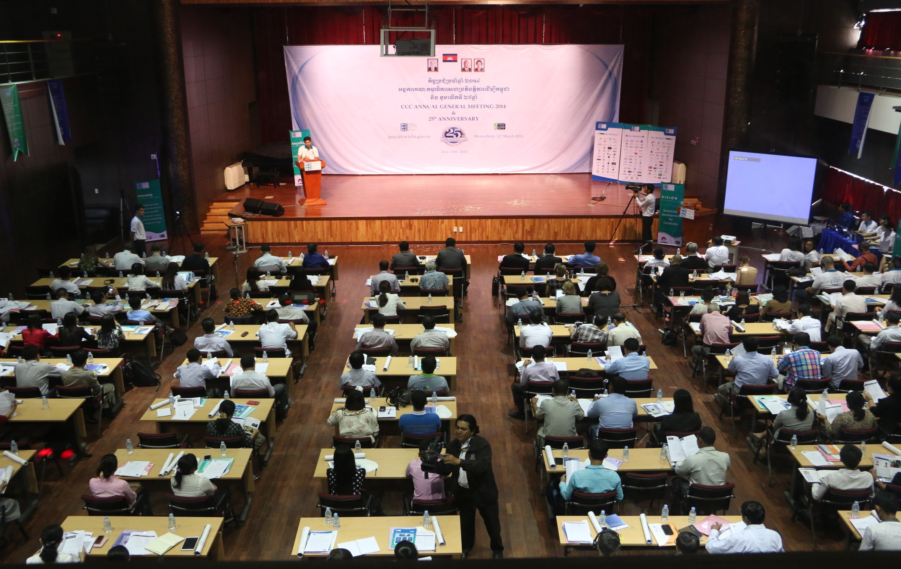
Quiz

Slide 10

Social Media Handbook
What is social media?
What is the value of social media?
Understanding Social Media (pro & con)
Tip to engage audiences
Popular social media tools
Privacy & security

Slide 11
CCC Online Platform
http://www.ccc-cambodia.org/kh

Slide 12
Thank You

