Slide 1


ការអនុវត្តស្តង់ដារបាយការណ៍ហិរញ្ញវត្ថុកម្ពុជាសម្រាប់អង្គភាព
មិនស្វែងរកប្រាក់ចំណេញ
CFRS for NFPEs
From historical data on a wide range of actual cases, Argenti developed a model that is intended to predict the likelihood of company failure.
Factors in Argenti’s model
Defects
  Autocratic Chief Executive (Sir Fred Goodwin at The Royal bank of Scotland could be an example here)
  Passive board
  Lack of budgetary control

Slide 2
មាតិកា
គោលបំណង
វិសាលភាព
ស្តង់ដា
កាលបរិច្ឆេទចូលជាធរមាន
លក្ខខណ្ឌចាំបាច់ជាក់លាក់
ការរៀបចំអន្តរកាល
ការផ្លាស់ប្តូរ
កាតព្វកិច្ចរបស់អង្គការមិនស្វែងរកប្រាក់ចំណេញ
From historical data on a wide range of actual cases, Argenti developed a model that is intended to predict the likelihood of company failure.
Factors in Argenti’s model
Defects
  Autocratic Chief Executive (Sir Fred Goodwin at The Royal bank of Scotland could be an example here)
  Passive board
  Lack of budgetary control

Slide 3
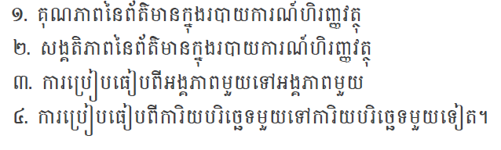
គោលបំណង
From historical data on a wide range of actual cases, Argenti developed a model that is intended to predict the likelihood of company failure.
Factors in Argenti’s model
Defects
  Autocratic Chief Executive (Sir Fred Goodwin at The Royal bank of Scotland could be an example here)
  Passive board
  Lack of budgetary control

Slide 4
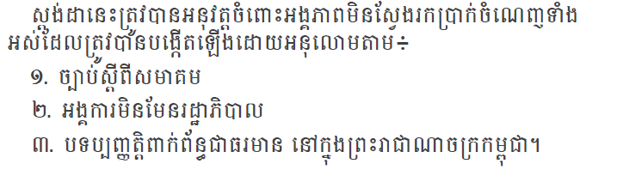
វិសាលភាព
From historical data on a wide range of actual cases, Argenti developed a model that is intended to predict the likelihood of company failure.
Factors in Argenti’s model
Defects
  Autocratic Chief Executive (Sir Fred Goodwin at The Royal bank of Scotland could be an example here)
  Passive board
  Lack of budgetary control

Slide 5
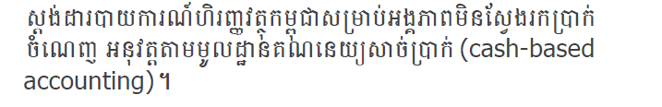
ស្តង់ដា
From historical data on a wide range of actual cases, Argenti developed a model that is intended to predict the likelihood of company failure.
Factors in Argenti’s model
Defects
  Autocratic Chief Executive (Sir Fred Goodwin at The Royal bank of Scotland could be an example here)
  Passive board
  Lack of budgetary control

Slide 6

កាលបរិច្ឆេទចូលជាធរមាន
From historical data on a wide range of actual cases, Argenti developed a model that is intended to predict the likelihood of company failure.
Factors in Argenti’s model
Defects
  Autocratic Chief Executive (Sir Fred Goodwin at The Royal bank of Scotland could be an example here)
  Passive board
  Lack of budgetary control

Slide 7
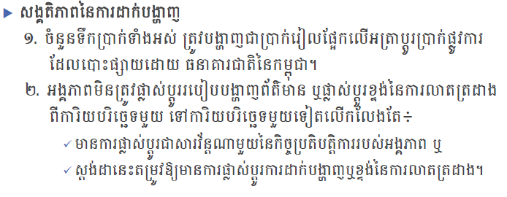
លក្ខខណ្ឌចាំបាច់ជាក់លាក់
From historical data on a wide range of actual cases, Argenti developed a model that is intended to predict the likelihood of company failure.
Factors in Argenti’s model
Defects
  Autocratic Chief Executive (Sir Fred Goodwin at The Royal bank of Scotland could be an example here)
  Passive board
  Lack of budgetary control

Slide 8
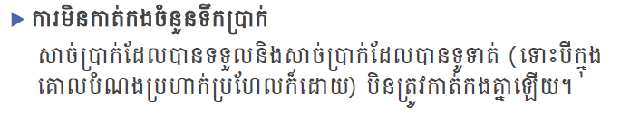
លក្ខខណ្ឌចាំបាច់ជាក់លាក់
From historical data on a wide range of actual cases, Argenti developed a model that is intended to predict the likelihood of company failure.
Factors in Argenti’s model
Defects
  Autocratic Chief Executive (Sir Fred Goodwin at The Royal bank of Scotland could be an example here)
  Passive board
  Lack of budgetary control

Slide 9
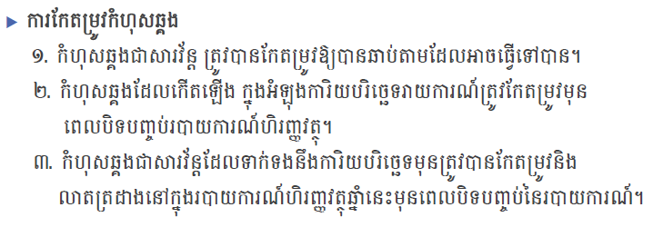
លក្ខខណ្ឌចាំបាច់ជាក់លាក់
From historical data on a wide range of actual cases, Argenti developed a model that is intended to predict the likelihood of company failure.
Factors in Argenti’s model
Defects
  Autocratic Chief Executive (Sir Fred Goodwin at The Royal bank of Scotland could be an example here)
  Passive board
  Lack of budgetary control

Slide 10
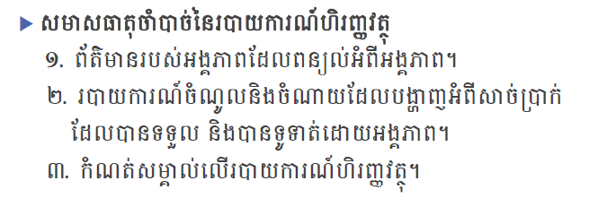
លក្ខខណ្ឌចាំបាច់ជាក់លាក់
From historical data on a wide range of actual cases, Argenti developed a model that is intended to predict the likelihood of company failure.
Factors in Argenti’s model
Defects
  Autocratic Chief Executive (Sir Fred Goodwin at The Royal bank of Scotland could be an example here)
  Passive board
  Lack of budgetary control

Slide 11
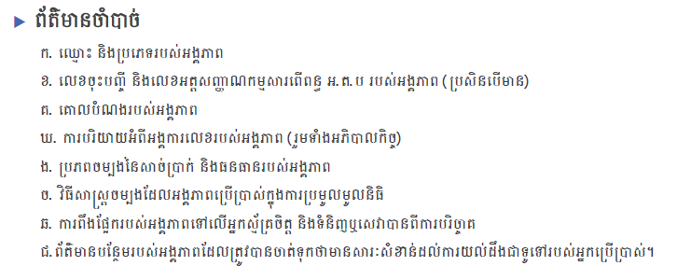
លក្ខខណ្ឌចាំបាច់ជាក់លាក់
From historical data on a wide range of actual cases, Argenti developed a model that is intended to predict the likelihood of company failure.
Factors in Argenti’s model
Defects
  Autocratic Chief Executive (Sir Fred Goodwin at The Royal bank of Scotland could be an example here)
  Passive board
  Lack of budgetary control

Slide 12
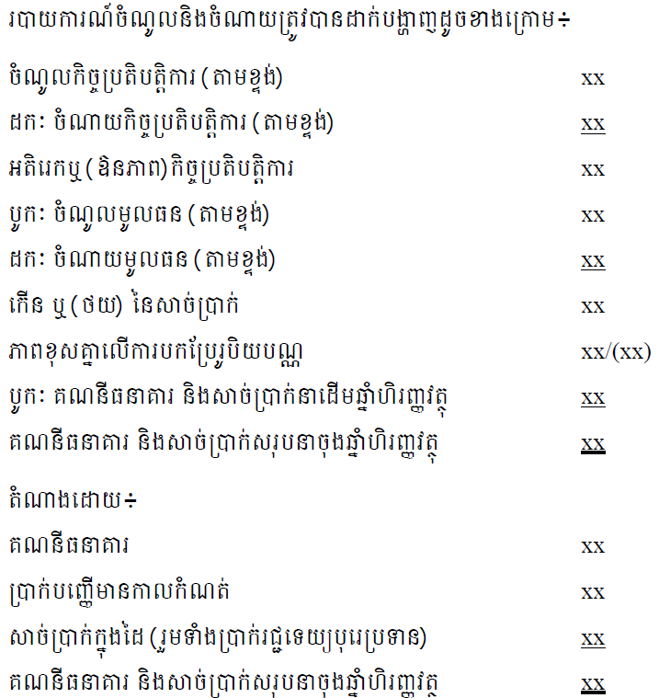
លក្ខខណ្ឌចាំបាច់ជាក់លាក់
From historical data on a wide range of actual cases, Argenti developed a model that is intended to predict the likelihood of company failure.
Factors in Argenti’s model
Defects
  Autocratic Chief Executive (Sir Fred Goodwin at The Royal bank of Scotland could be an example here)
  Passive board
  Lack of budgetary control

Slide 13
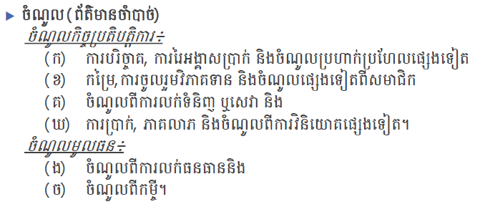
លក្ខខណ្ឌចាំបាច់ជាក់លាក់
របាយការណ៍ចំណូលនិងចំណាយ
From historical data on a wide range of actual cases, Argenti developed a model that is intended to predict the likelihood of company failure.
Factors in Argenti’s model
Defects
  Autocratic Chief Executive (Sir Fred Goodwin at The Royal bank of Scotland could be an example here)
  Passive board
  Lack of budgetary control

Slide 14
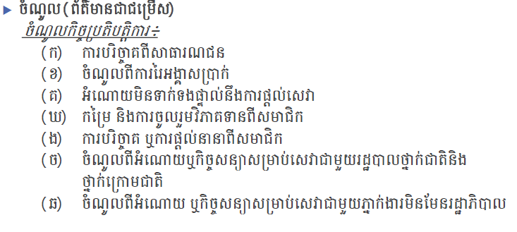
លក្ខខណ្ឌចាំបាច់ជាក់លាក់
របាយការណ៍ចំណូលនិងចំណាយ
From historical data on a wide range of actual cases, Argenti developed a model that is intended to predict the likelihood of company failure.
Factors in Argenti’s model
Defects
  Autocratic Chief Executive (Sir Fred Goodwin at The Royal bank of Scotland could be an example here)
  Passive board
  Lack of budgetary control

Slide 15
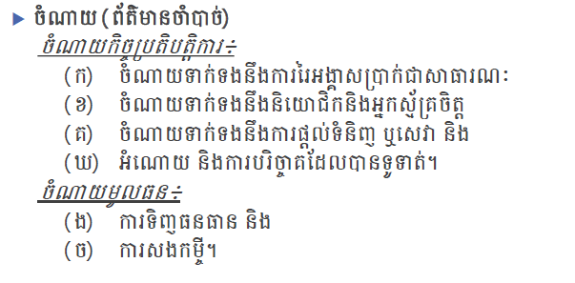
លក្ខខណ្ឌចាំបាច់ជាក់លាក់
របាយការណ៍ចំណូលនិងចំណាយ
From historical data on a wide range of actual cases, Argenti developed a model that is intended to predict the likelihood of company failure.
Factors in Argenti’s model
Defects
  Autocratic Chief Executive (Sir Fred Goodwin at The Royal bank of Scotland could be an example here)
  Passive board
  Lack of budgetary control

Slide 16
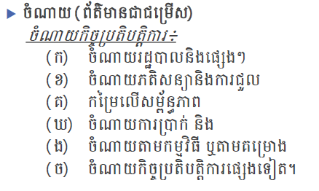
លក្ខខណ្ឌចាំបាច់ជាក់លាក់
របាយការណ៍ចំណូលនិងចំណាយ
From historical data on a wide range of actual cases, Argenti developed a model that is intended to predict the likelihood of company failure.
Factors in Argenti’s model
Defects
  Autocratic Chief Executive (Sir Fred Goodwin at The Royal bank of Scotland could be an example here)
  Passive board
  Lack of budgetary control

Slide 17
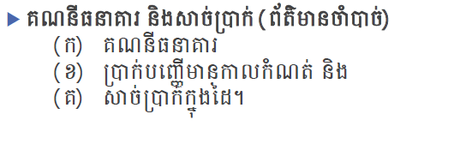
លក្ខខណ្ឌចាំបាច់ជាក់លាក់
របាយការណ៍ចំណូលនិងចំណាយ
From historical data on a wide range of actual cases, Argenti developed a model that is intended to predict the likelihood of company failure.
Factors in Argenti’s model
Defects
  Autocratic Chief Executive (Sir Fred Goodwin at The Royal bank of Scotland could be an example here)
  Passive board
  Lack of budgetary control

Slide 18
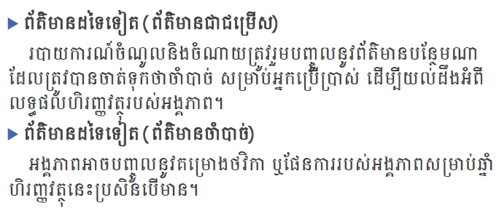
លក្ខខណ្ឌចាំបាច់ជាក់លាក់
របាយការណ៍ចំណូលនិងចំណាយ
From historical data on a wide range of actual cases, Argenti developed a model that is intended to predict the likelihood of company failure.
Factors in Argenti’s model
Defects
  Autocratic Chief Executive (Sir Fred Goodwin at The Royal bank of Scotland could be an example here)
  Passive board
  Lack of budgetary control

Slide 19
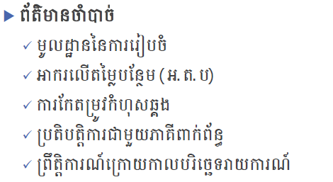
លក្ខខណ្ឌចាំបាច់ជាក់លាក់
កំណត់សំគាល់លើរបាយការណ៍ហិរញ្ញវត្ថុ
From historical data on a wide range of actual cases, Argenti developed a model that is intended to predict the likelihood of company failure.
Factors in Argenti’s model
Defects
  Autocratic Chief Executive (Sir Fred Goodwin at The Royal bank of Scotland could be an example here)
  Passive board
  Lack of budgetary control

Slide 20
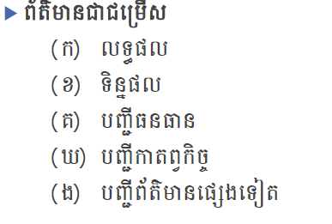
លក្ខខណ្ឌចាំបាច់ជាក់លាក់
កំណត់សំគាល់លើរបាយការណ៍ហិរញ្ញវត្ថុ
From historical data on a wide range of actual cases, Argenti developed a model that is intended to predict the likelihood of company failure.
Factors in Argenti’s model
Defects
  Autocratic Chief Executive (Sir Fred Goodwin at The Royal bank of Scotland could be an example here)
  Passive board
  Lack of budgetary control

Slide 21
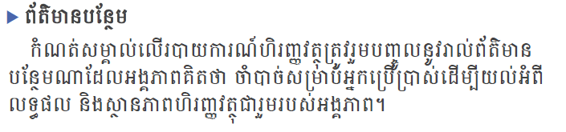
លក្ខខណ្ឌចាំបាច់ជាក់លាក់
កំណត់សំគាល់លើរបាយការណ៍ហិរញ្ញវត្ថុ
From historical data on a wide range of actual cases, Argenti developed a model that is intended to predict the likelihood of company failure.
Factors in Argenti’s model
Defects
  Autocratic Chief Executive (Sir Fred Goodwin at The Royal bank of Scotland could be an example here)
  Passive board
  Lack of budgetary control

Slide 22
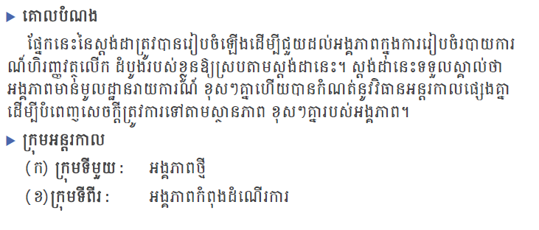
ការរៀបចំអន្តរកាល
From historical data on a wide range of actual cases, Argenti developed a model that is intended to predict the likelihood of company failure.
Factors in Argenti’s model
Defects
  Autocratic Chief Executive (Sir Fred Goodwin at The Royal bank of Scotland could be an example here)
  Passive board
  Lack of budgetary control

Slide 23
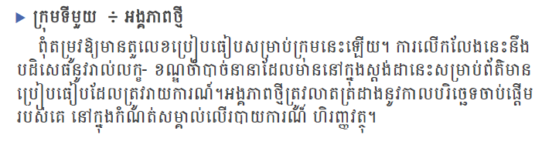
ការរៀបចំអន្តរកាល
From historical data on a wide range of actual cases, Argenti developed a model that is intended to predict the likelihood of company failure.
Factors in Argenti’s model
Defects
  Autocratic Chief Executive (Sir Fred Goodwin at The Royal bank of Scotland could be an example here)
  Passive board
  Lack of budgetary control

Slide 24
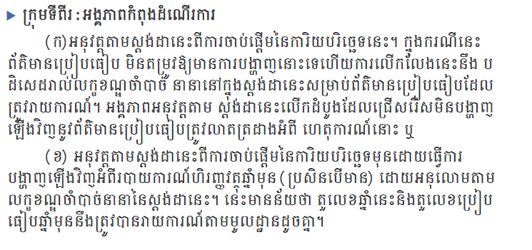
ការរៀបចំអន្តរកាល
From historical data on a wide range of actual cases, Argenti developed a model that is intended to predict the likelihood of company failure.
Factors in Argenti’s model
Defects
  Autocratic Chief Executive (Sir Fred Goodwin at The Royal bank of Scotland could be an example here)
  Passive board
  Lack of budgetary control

Slide 25
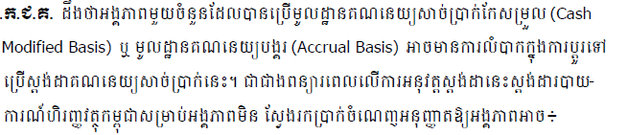
ការផ្លាស់ប្តូរ
From historical data on a wide range of actual cases, Argenti developed a model that is intended to predict the likelihood of company failure.
Factors in Argenti’s model
Defects
  Autocratic Chief Executive (Sir Fred Goodwin at The Royal bank of Scotland could be an example here)
  Passive board
  Lack of budgetary control

Slide 26
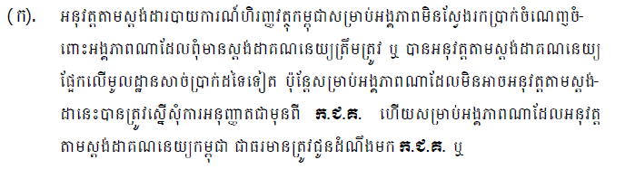
ការផ្លាស់ប្តូរ
From historical data on a wide range of actual cases, Argenti developed a model that is intended to predict the likelihood of company failure.
Factors in Argenti’s model
Defects
  Autocratic Chief Executive (Sir Fred Goodwin at The Royal bank of Scotland could be an example here)
  Passive board
  Lack of budgetary control

Slide 27
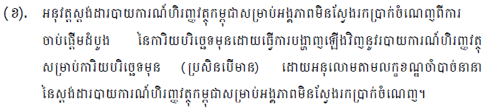
ការផ្លាស់ប្តូរ
From historical data on a wide range of actual cases, Argenti developed a model that is intended to predict the likelihood of company failure.
Factors in Argenti’s model
Defects
  Autocratic Chief Executive (Sir Fred Goodwin at The Royal bank of Scotland could be an example here)
  Passive board
  Lack of budgetary control

Slide 28
កាតព្វកិច្ចរបស់អង្គភាពមិនស្វែងរកប្រាក់ចំណេញ
កាន់កាប់បញ្ជីគណនេយ្យ និង រក្សាទុកយ៉ាងតិច១០ឆ្នាំ
រៀបចំរបាយការណ៍ហិរញ្ញវត្ថុអោយបានត្រឹមត្រូវក្នុងច្បាប់ស្តីពីគណនេយ្យនិងបទបញ្ញត្តិពាក់ព័ន្ធ
បញ្ជូនរបាយការណ៍ហិរញ្ញវត្ថុប្រចាំឆ្នាំមកក្រុមប្រឹក្សាជាតិគណនេយ្យ​ និងនាយកដ្ឋានពន្ធដារយ៉ាង
យូរថ្ងៃទី៣១ ខែមីនា នៃឆ្នាំបន្ទាប់។
ដាក់របាយការណ៍ហិរញ្ញវត្ថុអោយរងសវនកម្មឯករាជ្យតាមលក្ខខណ្ឌ និង នីតិវិធីដែលកំណត់
ដោយប្រកាសរបស់ក្រសួងសេដ្ឋកិច្ចនិងហិរញ្ញវត្ថុ។
​
From historical data on a wide range of actual cases, Argenti developed a model that is intended to predict the likelihood of company failure.
Factors in Argenti’s model
Defects
  Autocratic Chief Executive (Sir Fred Goodwin at The Royal bank of Scotland could be an example here)
  Passive board
  Lack of budgetary control

Slide 29

Contact Us
Mr. Sok Monirith
Chief Executive Officer
Contact : 017 733 555, 016 309 333
Office Phone : 012 659 200
Email : monirith@standardbizconsulting.biz
Office Address : #Building 20B, Doung Ngeap II, Dom Nak Thom II, Khan Mean Chey, Phnom Penh
Website : www.standardbizconsulting.biz
Facebook : StandardBizConsulting

Slide 30

Thanks!
You Never Walk Alone !!!

