Slide 1


The Upcoming Sixth National Assembly Elections,
July 29, 2018 and Role & Responsibility of CSOs in the Elections Process and Risk Mitigation Measures
24 April 2018
By: Mr. YOEURNG SOTHEARA
Legal Support Specialist (LLS)
Email: sotheara.yoeurng@ccc-Cambodia.org; tell: (+855) 70 400 131
^{Vision:} Sustainable Development for Cambodia

Slide 2
Contents
Principle of Free and Fair Elections
Fact of the Issues: Legal Framework ; Political Climate and Commitment of International Communities & Donors
Principle of Free and Fair Elections
Elections Observation/Monitoring
Implications under Electoral Laws & LANGO

Slide 3
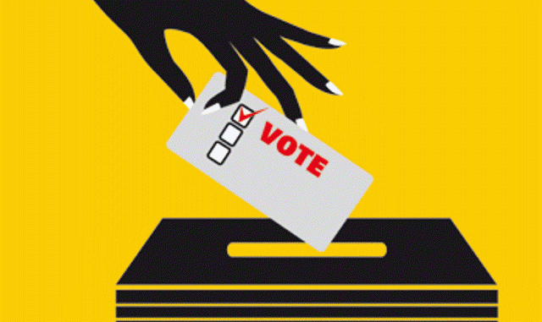
Sixth National Assembly Elections, 2018
And what things We (CSOs) should do and should not do?

Slide 4
I. Principles of Free and Fair Elections
Principles of Free and Fair Elections
Legal Framework
The Elections Management Body (EMB)
Voter Registration and Voter List
The Registration of Candidacy and Candidates of Registered Contesting Political Parties
Elections Campaign
Polling and Counting
Consolidating Result
Voter Education

Slide 5
Principles of Free and Fair Elections (Con’t)
9) Recognition and Participations of Elections Observers and Agents
10) Elections Dispute Resolutions (EDR)
11) Inclusion or Participants
12) Elections Climate/Security and Violence
13) Transferring Powers?

Slide 6
II. Facts of the Issues
Legal Framework:
Law on the Elections of Members of National Assembly “LEMNA” and its amendments.
The Amendments of the Law on Political Parties, 1997 (Twice in 2017), First, in Feb 2017 and Second in July 2017.
Amendments of the Four Elections Laws (LEMNA, Senate Elections Law, Commune/Sangkat Elections Law and Capita/Provincial/Municipal/Khan/District Elections Law) on determinations of seats and votes.
Amendments of the Constitutions, Penal Code and Law on Organization and Functioning of the Constitutional Council
New Composition of the National Elections Committee (NEC)
The Dissolution of the former political vocal Opposition Party, CNRP
The Restriction of Freedom of Expression, Esp. on Social Media Platform while the Polling Day comes closer.

Slide 7
Facts of the Issues (Con’t)
Political Climate and Commitment of International Communities & Donors
The Dissolution of CNRP and Crackdowns
Crackdown on Civil Society Groups (Joint-Elections Watchdogs and Media outlets)
Civil Society Space Restriction
The International Communities Reactions to the U-turn Democracy in Cambodia (Including EU, USAID, Japan, IPU, and UN).
The reiterating of Chinese Govt. position in supporting Cambodian Govt.
The attempts of the Govt. to lobby some foreign Govt. to send the elections observers to the upcoming elections.
Other attempts aim bringing legitimacy of the upcoming elections
Threats by warning the implication of legal harassment against voters

Slide 8
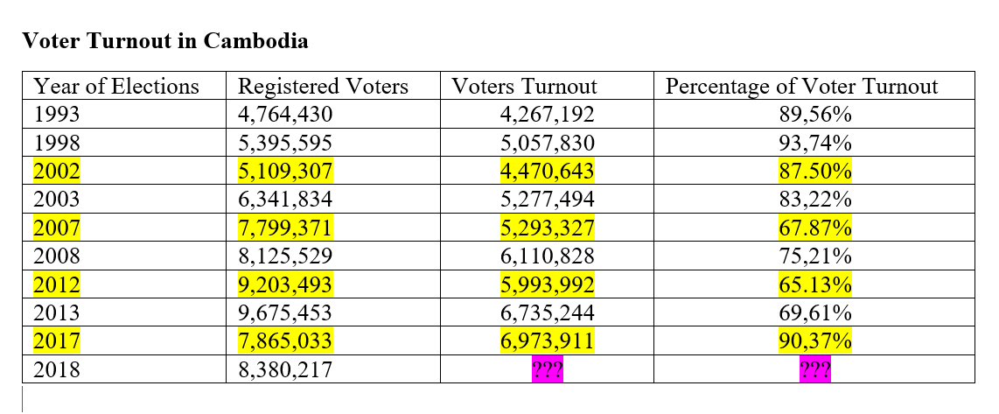
Cambodian Elections Voter Turnout Records
1993-2013
National Assembly Elections:

Slide 9
II. Elections Observation
Art. 10 of the LEMNA provides rights to NGOs/Associations to join or not to join the election observation. The NGOs/Associations shall submit application to NEC for the mission of observation.
Art. 11: NEC shall recognize and issue ID for the applicant NGOs/Associations’ observers. The qualifications/conditions for applicant NGOs/Associations who wish to conduct election observation are provided in Section 3.3 of the Regulations and Procedure issued by the NEC.
Art. 24 of LANGO, NGOs/Associations shall remain political neutrality.
Art. 84 of LEMNA required NGOs/Associations shall remain political neutrality.
By Law of each NGOs/Associations.

Slide 10
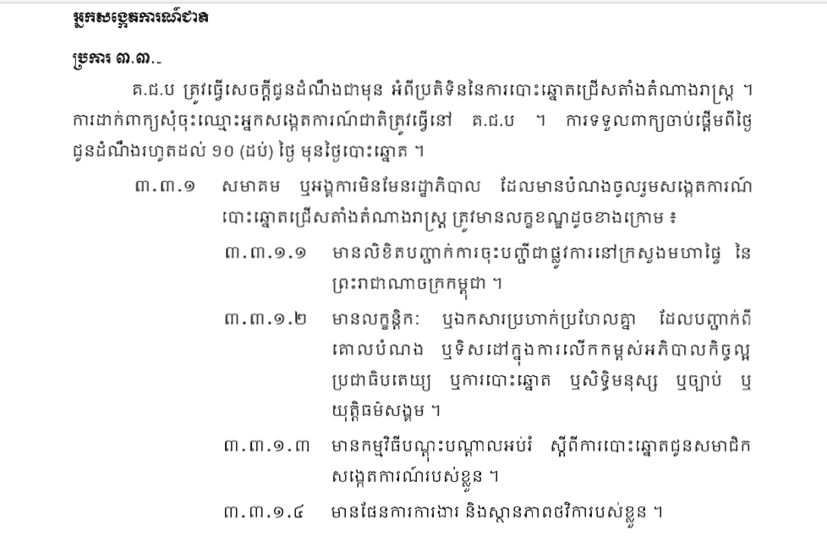

Slide 11
III. Implications under Electoral Laws & LANGO
Law on Elections of Members of National Assembly (LEMNA)
Article 84: Required NGOs/Associations remain political neutrality.
Article 148: Sanction may be made against NGOs/associations who violated provisions article 84 of the law
Law on Political Party (First Amendment)
A political party shall not receive any form of contribution from state, NGOs/Associations, Public Establishments, Public Enterprises, Public Institutions,
Article 24 of the LANGO: Domestic organizations, foreign non-governmental organizations, or foreign associations shall maintain their neutrality towards political parties in the Kingdom of Cambodia.

Slide 12
IV. Conclusion
Look at to your by-law and think about your mandate.
Take serious look to all relevant laws, and apply risk mitigation policy for institution and staff.
In the Campaign Days
In the Polling Day.
The situation after the 2018-elections?
What things NGOs/Associations should act in conform to the recent Situation?

