Slide 1


Cambodian Sustainable Development Goals (CSDGs): Progress of the Localization
CCC Bi-Monthly Member Meeting
Diakonia Center, 05 October 2017
CHEN Sochoeun
Research &Member Development Manager, CCC
^{Vision:} Sustainable Development for Cambodia

Slide 2
Presentation Outlines
Global SDGs and Progress of localization for CSDGs
Key discussion points and ways forward

Slide 3

  17 Goals, 169 Targets, 230 Indicators

Slide 4
Proposed Timeline for localization*
Times | Activities | Expected outputs
15 June 2016 | WS after receive final list from Inter-Agency Expert Group (IAEG) of SDGs. (the pre-localize process) | List of all indicators (result from WS on 19-20 Nov. 2015) reviewed and considered including into national-sectorial priorities. Source of data and responsible agency for each indicator has been identified.
11-12 August 2016 | WS to define definition, and define base line and target of indicators. (the pre-localize process) | Standard of definition and calculation of each indicator has been identified and set up. Targets of each indicator by year have been identified.
August - September 2016 | Sub-national level WSs to get input for SDG localization (4 regional WSs) | Input from the sub-national level WSs for contributing to SDGs localization
October 2016 | WS to define final list of indicators, based on endorsement.(the pre-localize process) | List of indicators (definition, sources of data, responsible agency, and calculation indicator) has been adopted.
* Timeline Extracted from UNDP, 21 July 2016

Slide 5
Proposed Timeline for localization
Times | Activities | Expected outputs
November 2016 | WS to validate list of Goals, targets, and indicators of CSDGs. | List of indicators (including definition, sources of data support, responsible agency, and how to calculation the value of based line indicator) endorsed
Late November to December 2016 | SNEC (high level) Meeting to provide political guideline on the list of Goals, targets, and indicators | CSDGs Framework provided political guideline for mainstream into National Priority next step.
December 2016 | Localize all indicators into national priority and mainstream into national and sectoral plans | All indicators has been mainstreamed into national and sectoral plans (CSDGs Frame Work)
January 2017 |  | CSDGs Frame Work sends to Government for endorsement.
January-March 2017 | CSDGs frame work endorse by the RGC | CSDGs Frame Work endorse by Cabinet Meeting and published
May-June 2017 | Launching and disseminating | Published CSDGs launch at national level and sub-national level

Slide 6
CSDGs at a Glance
18 Demining
  18 Goals, 171 Targets, 416 Indicators (up on document shared for discuss on 29 Sep 2017)

Slide 7


# Local Target/Global |  | # Indicators | Resp. Institutions | Others
​​១៖ បញ្ចប់ភាពក្រីក្រ គ្រប់ទម្រង់ នៅគ្រប់ទី កន្លែង
7/7 | 34 |  | MEF, MoP/NIS, MAFF, NCDM, MoI, Red Cross, MoE, CNMC, MoH, MoEYS, MLMUPC, MoLVT, NSSF, CARD, MoSVY
​​២៖ បញ្ចប់ភាពអត់ឃ្លាន សម្រេចឲ្យបានសន្តិសុខស្បៀង ធ្វើឲ្យប្រសើរឡើងនូវអាហាររូបត្ថម្ភ និងលើកកម្ពស់ កសិកម្មប្រកបដោយចីរភាព​
8/8 | 31 |  | MoP/NIS, MAFF, MoH, CARD, MoE/GDLC, CRDB/CDC, MoC, | FAO, WFP, SIDA, SUN-CSA, CAM, USAID, UNICEF,

Slide 8


# Local Target/Global |  | # Indicators | Resp. Institutions | Others
៣​​៖ ធានាឲ្យជីវភាពរស់នៅរបស់ប្រជាជន ប្រកបដោយសុខភាពល្អ និងលើកកម្ពស់សុខុមាលភាព របស់មនុស្សគ្រប់រូបនិងគ្រប់វ័យ
14/13 | 56 |  | MoH, NAA, CRDB/CDC, MoI/NRSC
​​៤៖ ធានាការអប់រំប្រកបដោយគុណភាព បរិយាប័ន្ន និងសមធម៌ និងលើកកម្ពស់កាលានុវត្តភាព សិក្សាពេញមួយជីវិតសម្រាប់មនុស្សគ្រប់រូប
10/10 | 37 |  | MoEYS, MRD, MoE, MoCulture?

Slide 9


# Local Target/Global | # Indicators | Resp. Institutions | Others
​​៥៖ សម្រេចឲ្យបានសមភាពយេនឌ័រ និងពង្រឹង ភាពអង់អាច របស់ស្រ្តី និងកុមារីគ្រប់រូប
9/9 | 31 | MoWA, MEF, MoP, MAFF, MLMUPC, MCS, MoLVT | NCDD
​​៦៖ ធានាឲ្យមានទឹកនិងអនាម័យ​ និងការគ្រប់ គ្រងទឹក និង​អនាម័យប្រកបដោយចីរភាពសម្រាប់ ប្រជាជនគ្រប់រូប
8/8 | 22 | MRD, MoI/NCDD, CRDB/CDC, MORWAM, MoE

Slide 10


# Local Target/Global | # Indicators | Resp. Institutions |  | Others
​​៧៖ ធានាឲ្យទទួលបានថាមពលដែលមាន បច្ចេកទេសទំនើប ប្រកបដោយចីរភាព អាចជឿជាក់បាន និងមានតម្លៃសមរ្យសម្រាប់ប្រជាជនគ្រប់រូប
5/5 | 9 | MME, MoE,
​៨៖ ធានាកំណើនសេដ្ឋកិច្ចប្រកបដោយចីរភាព និងបរិយាប័ន្ន មានមុខរបរពេញលេញនិងផលិតភាព និង មានការការងារសមរម្យសម្រាប់ប្រជាជនគ្រប់រូប
12/12 | 33 | MEF, MoC, CRDB/CDC, NBC, MLVT, MoE,

Slide 11
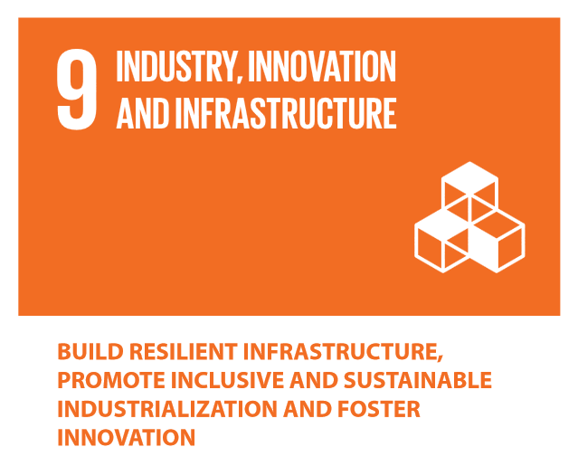
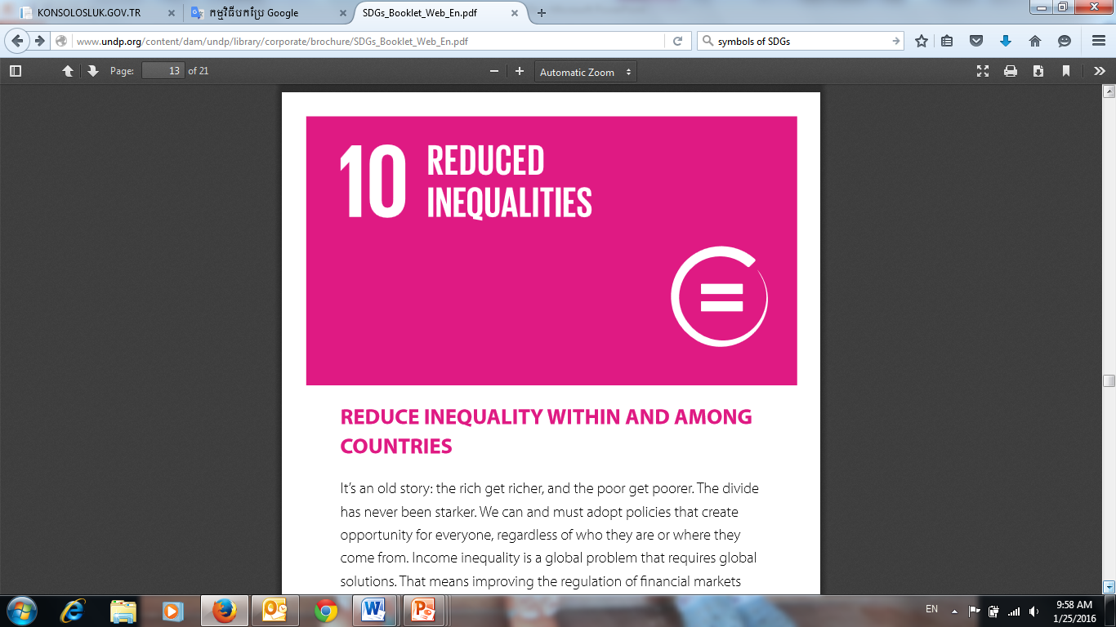
# Local Target/Global | # Indicators | Resp. Institutions |  | Others
​​៩៖ កសាងហេដ្ឋារចនាសម្ព័ន្ធដែលធន់នឹង បម្រែបម្រួលអាកាសធាតុ លើកកម្ពស់ឧស្សហូបនីយកម្ម ប្រកបដោយចីរភាព និង​បរិយាប័ន្ននិងលើកកម្ពស់នវានុវត្តន៍
8/8 | 11 | MPTC, CRDB/CDC, MIH, MEF, SSCA, MPWT
​១០៖ កាត់បន្ថយវិសមភាពនៅក្នុងប្រទេស និងក្នុងចំណោម បណ្តាប្រទេសនានា
10/10 | 15 | NBC, CRDB/CDC, MoSVY,

Slide 12


# Local Target/Global | # Indicators | Resp. Institutions |  | Others
១១៖ ធ្វើឲ្យទីក្រុងនិងទីកន្លែងតាំងទីលំនៅ ថ្មីសម្រាប់ប្រជាជន មានលក្ខណៈបរិយាប័ន្ន​ សុវត្ថិភាព ធន់នឹងបម្រែបម្រួលអាកាសធាតុ និងចីរភាព
10/10 | 21 | NCDM, MLMUPC, MOWA, MoE,
​១២៖ ធានាឲ្យមានចីរភាពក្នុងទម្រង់នៃ ការប្រើប្រាស់​ និង ផលិតកម្ម
11/11 | 17 | MME, NCSD, MoE, MAFF,

Slide 13
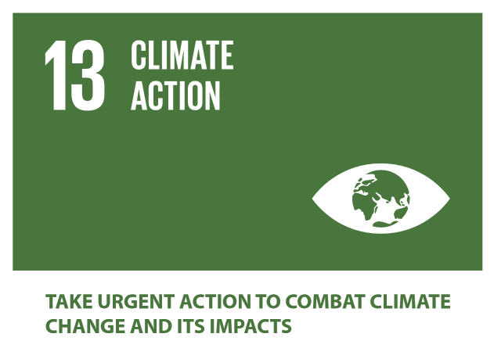
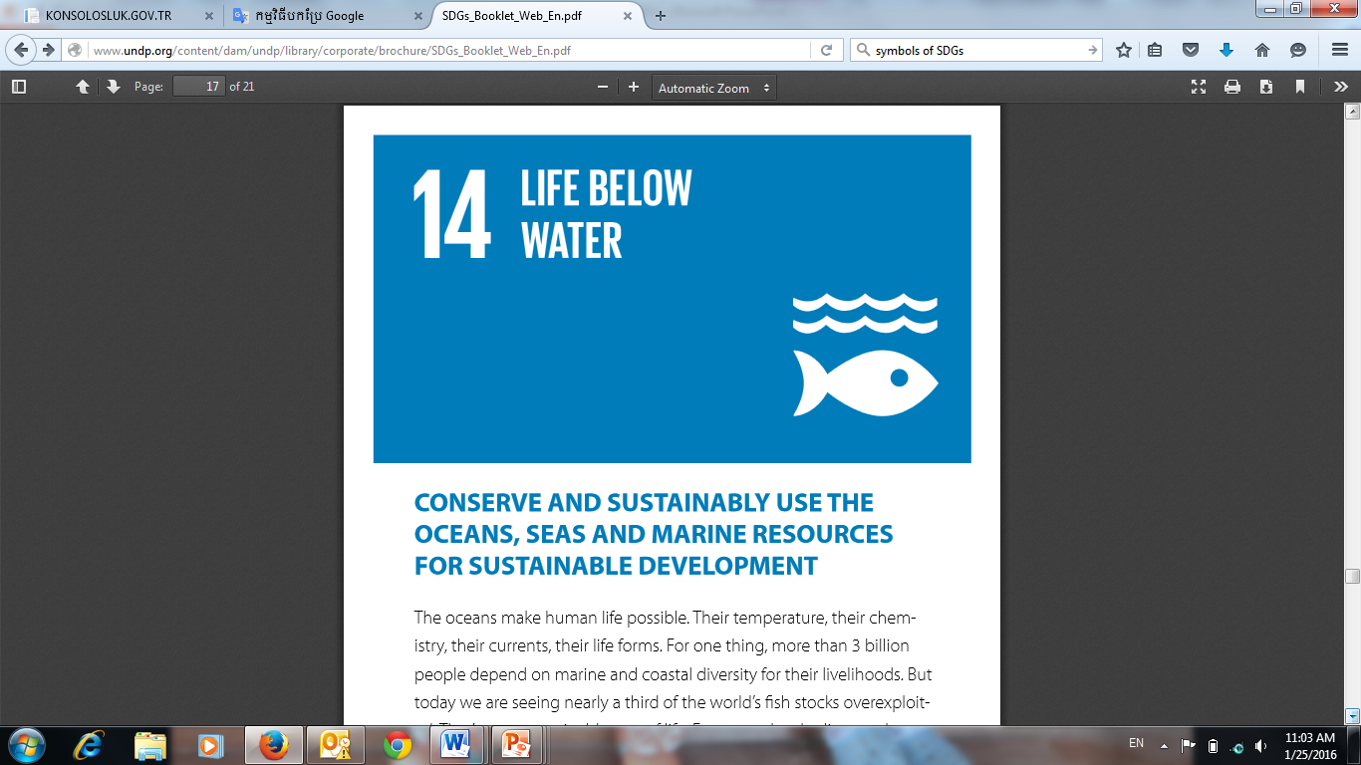
# Local Target/Global | # Indicators | Resp. Institutions |  | Others
១៣៖ ចាត់វិធានការជាបន្ទាន់ ដើម្បីប្រយុទ្ធ ប្រឆាំងនឹងបម្រែ បម្រួលអាកាសធាតុ និងផលប៉ះពាល់ របស់វា
4/5 | 13 | MORWAM, MAFF, MOEYS, NCSD, NCDM, MoH,
​១៤៖ អភិរក្ស និងប្រើប្រាស់ប្រកបដោយចីរភាព នូវមហាសមុទ្រ សមុទ្រនិងធនធានសមុទ្រសម្រាប់ការ អភិវឌ្ឍប្រកបដោយចីរភាព
10/10 | 15 | MAFF, MEF, MoE,

Slide 14
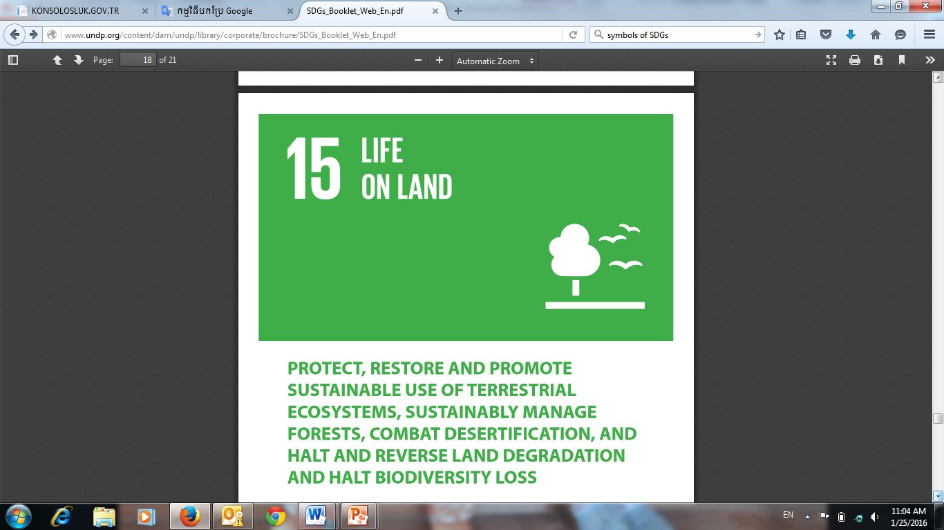

# Local Target/Global | # Indicators | Resp. Institutions |  | Others
១៥៖ ការពារ ស្តារនិងជម្រុញការប្រើប្រាស់ ប្រកបដោយចីរភាពនូវប្រព័ន្ធអេកូឡូស៊ីនៅលើដែនគោក គ្រប់គ្រងព្រៃឈើ.......
12/12 | 27 | MAFF, CRDB/CDC, MoE,
១៦៖ លើកកម្ពស់សង្គមដែលមានសន្តិភាព ប្រកបដោយបរិយាប័ន្នដើម្បីការអភិវឌ្ឍប្រកបដោយ ចីរភាព ផ្តល់នូវការទទួលបានយុត្តិធម៌សម្រាប់ប្រជាជន គ្រប់កម្រិតនិងកសាងស្ថាប័នដែលមាន.......
11/12 | 14 | MoI, MEF, MoJ, ACU, MCS, MoFAIC, MoWA,

Slide 15

# Local Target/Global | # Indicators | Resp. Institutions |  | Others
​​១៧៖ ពង្រឹងមធ្យោបាយអនុវត្តនានា និងបង្កើត ភាពរវើកនៃ ភាពជាដៃគូសកល សម្រាប់ការ អភិវឌ្ឍប្រកបដោយចីរភាព
19/19 | 26 | MoP, NIS, MoI, CRDB/CDC, MoC, MPTC, NBC,
​១៨៖ បោសសម្អាតមីន/សំណល់ជាតិផ្ទុះពីសង្រ្គាមនិង ការ​សង្រ្គោះជនរងគ្រោះ
3 | 4 | MCAA,
18 Demining

Slide 16
Goal | Target |  | Indicator |  | Responsible | Other
 | Global | Local | Global | Local
1 | 7 | 7 |  | 34 | MEF, MoP/NIS, MAFF,NCDM, MoI, Red Cross, MoE, CNMC, MoH, MoEYS, MLMUPC, MoLVT, NSSF, CARD, MoSVY
2 | 8 | 8 |  | 31 | MoP/NIS, MAFF, MoH, CARD, MoE/GDLC, CRDB/CDC, MoC, | FAO, WFP, SIDA, SUN-CSA, CAM, USAID, UNICEF,
3 | 13 | 14* |  | 56 | MoH, NAA, CRDB/CDC, MoI/NRSC
4 | 10 | 10* |  | 37 | MoEYS, MRD, MoE, MoCulture?
5 | 9 | 9 |  | 31 | MoWA, MEF, MoP, MAFF, MLMUPC, MCS, MoLVT
6 | 8 | 8 |  | 22 | MRD, MoI/NCDD, CRDB/CDC, MORWAM, MoE
7 | 5 | 5 |  | 9 | MME, MoE,
8 | 12 | 12 |  | 33 | MEF, MoC, CRDB/CDC, NBC, MLVT, MoE,
9 | 8 | 8 |  | 11 | MPTC, CRDB/CDC, MIH, MEF, SSCA, MPWT
10 | 10 | 10 |  | 15 | NBC, CRDB/CDC, MoSVY,
11 | 10 | 10 |  | 21 | NCDM, MLMUPC, MOWA, MoE,
12 | 11 | 11 |  | 17 | MME, NCSD, MoE, MAFF,
13 | 5 | 4* |  | 13 | MORWAM, MAFF, MOEYS, NCSD, NCDM, MoH,
14 | 10 | 10 |  | 15 | MAFF, MEF, MoE
15 | 12 | 12 |  | 27 | MAFF, CRDB/CDC, MoE,
16 | 12 | 11* |  | 14 | MoI, MEF, MoJ, ACU, MCS, MoFAIC, MoWA,
17 | 19 | 19 |  | 26 | MoP, NIS, MoI, CRDB/CDC, MoC, MPTC, NBC,
18 |  | 3 |  | 4 | MCAA,
Total | 169 | 171 | 230 | 416

Slide 17
Challenges along the Localization
Some indicators are not relevant or are not reflected within the target.
Some ministries are responsible for too many indicators while some other ministries are not.
Some proposed responsibility (policy and technical) is suggested to take out, and may suggest to other relevant ministry.
Too many indicators, even more than the neighboring countries.
  Newly proposed indicators, no clear measurement, no baseline information
  Data is not available, particularly in the national statistics
  No clear definition, no common understanding
Notes:
Cover all aspects unlike CMDGs.

Slide 18
From Now Till the Adoption of CSDGs
All indicators need to come along with:
  Definition and method
  Rational and interpretation
  Source and data collection
  Comment and limitation
One week deadline from the meeting of 29 September 2017 for relevant ministries to send the revised version to MoP.
MoP will review and get back for validity and measurability of the indicators

Slide 19
Actions for CSOs
Consolidate comments and channel them to:
  Focal contact of relevant ministries
  Consolidate overall comments and specific comments for MoP
Familiarize with the final version of the CSDGs and align the programs according to the priorities

Slide 20

THANK YOU!
Please visit CCC website:
http://www.ccc-cambodia.org

